Slide 1
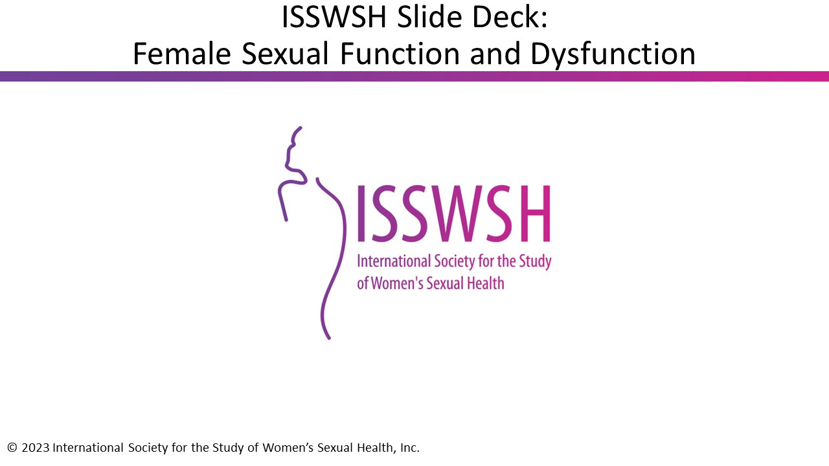

Slide 2
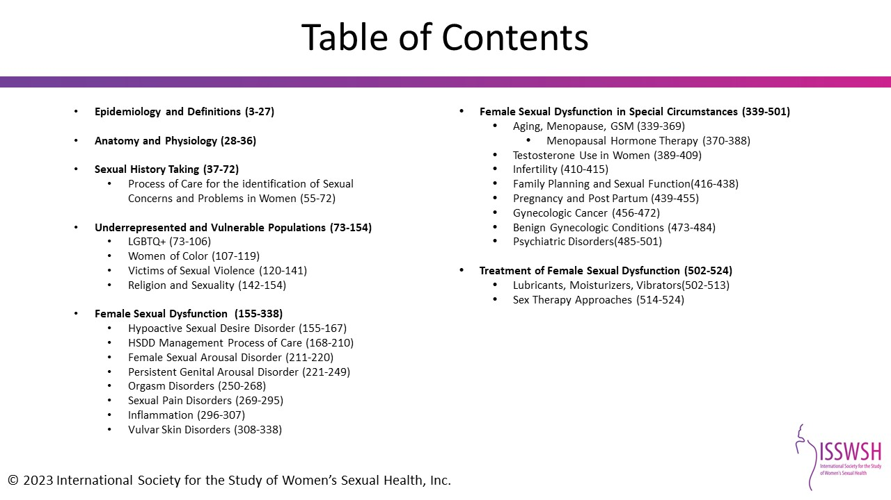

Slide 3
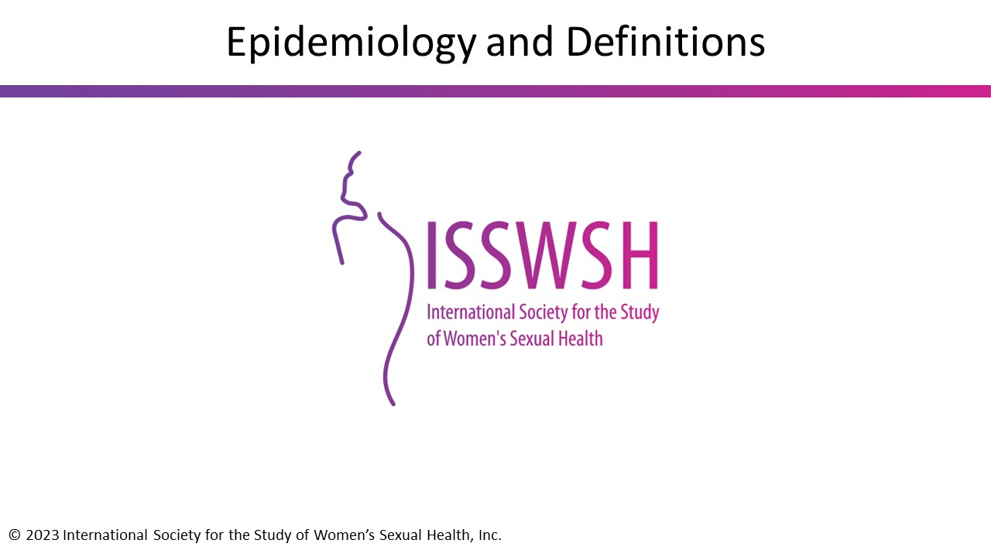

Slide 4
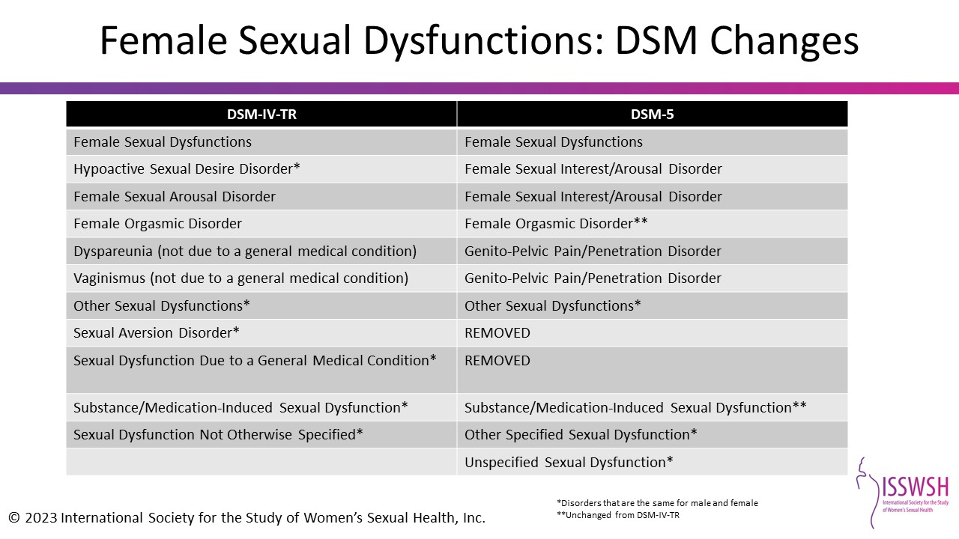
Notes:
Reference:
IsHak WW, Tobia G. DSM-5 changes in diagnostic criteria of sexual dysfunctions. Reprod Sys Sexual Disorders 2013, 2:2.

Slide 5
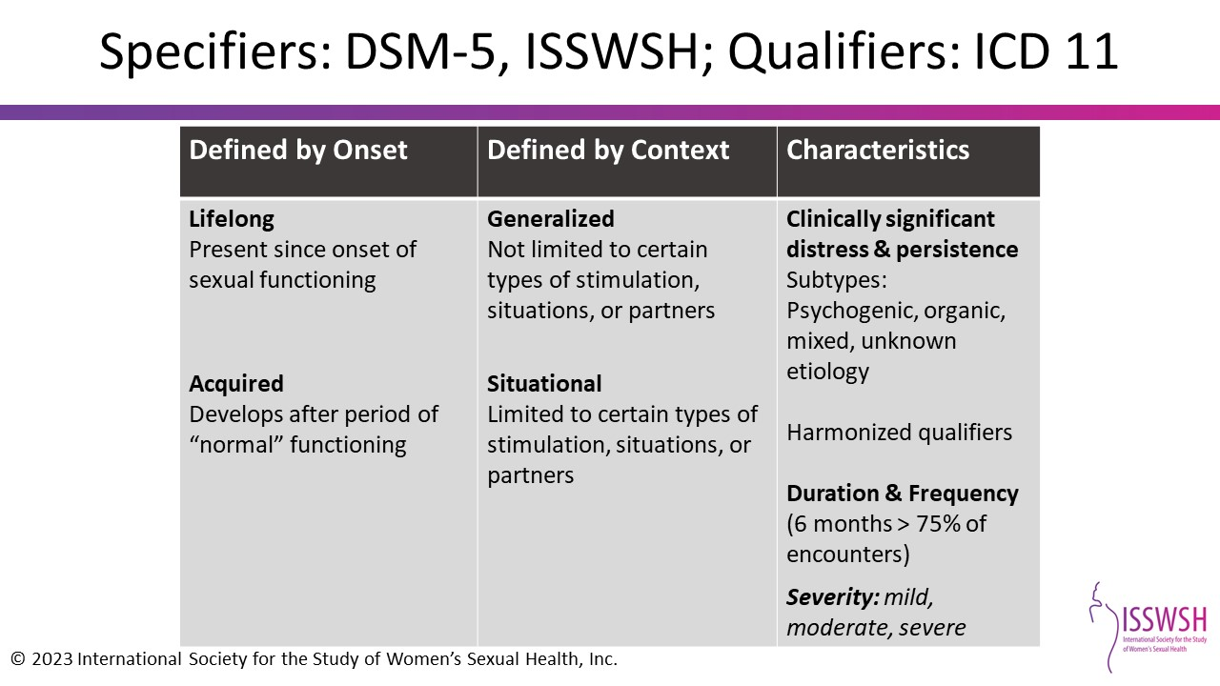
Notes:
The DSM-IV-TR–defined sexual desire disorders include:
Hypoactive sexual desire disorder, which is a deficiency or absence of sexual fantasies and desire for sexual activity
And sexual aversion disorder, which is an aversion to and actual avoidance of genital sexual contact with a sexual partner
Arousal disorders, defined as the persistent or recurrent inability to attain, or to maintain until completion of the sexual activity, an adequate lubrication-swelling response of sexual excitement
Female orgasmic disorder, defined as the delay or absence of orgasm following the excitement phase
And finally, the sexual pain disorders, which include dyspareunia and vaginismus
It’s important to indicate that all FSDs are classified as causing “marked distress” or “interpersonal difficulty.” Also, the sexual dysfunction not better accounted for by another Axis I disorder and is not exclusively due to the physiological effects of a substance (e.g., substance abuse or medication) or general medical condition
Reference:
American Psychiatric Association. Diagnostic and Statistical Manual of Mental Disorders 2013;5:433-436.
American Psychiatric Association. Diagnostic and Statistical Manual of Mental Disorders 2000;4

Slide 6
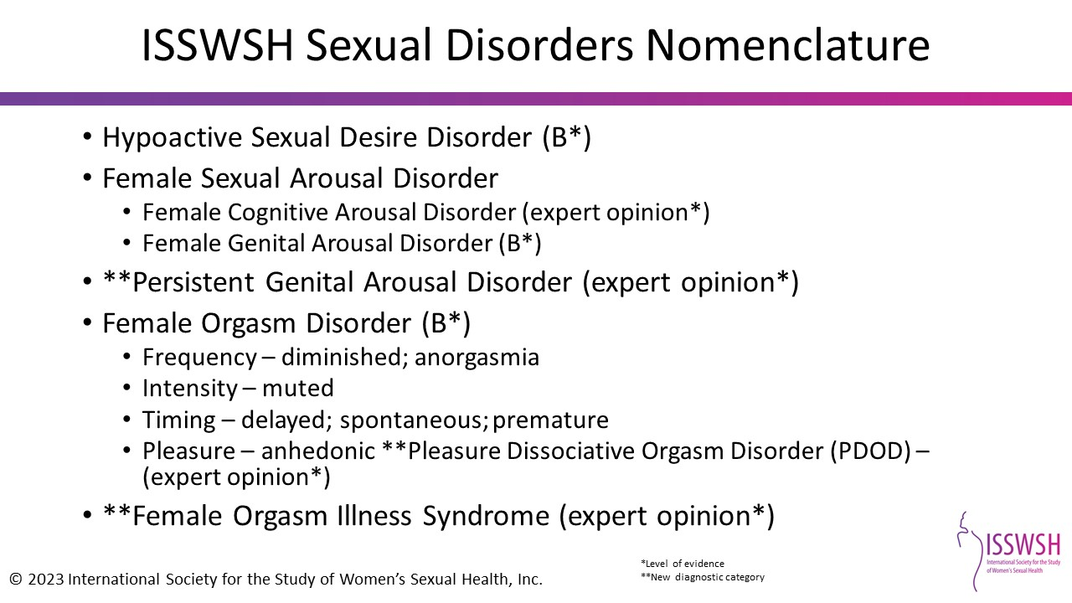
Notes:
The ISSWSH Sexual Disorders are:
Hypoactive Sexual Desire Disorder (grade B, level of evidence 2-3)
Female Genital Arousal Disorder (grade B, level of evidence 2-3)
Persistent Genital Arousal Disorder (expert opinion)
Female Orgasm Disorders (grade B, level of evidence 2-3) are orgasm difficulties of
Diminished Frequency or anorgasmia
Muted Intensity
Timing which can be delayed; spontaneous; premature
Pleasure such as anhedonia; pleasure dissociative orgasm disorder (PDOD) – (expert opinion)
And Female Orgasm Illness Syndrome (expert opinion)
The levels of evidence are listed on the slide.
References:
Parish et al. J Sex Med 2016;13(12):1888-1906.
Parish et al. J Sex Med 2019;16:452-462

Slide 7
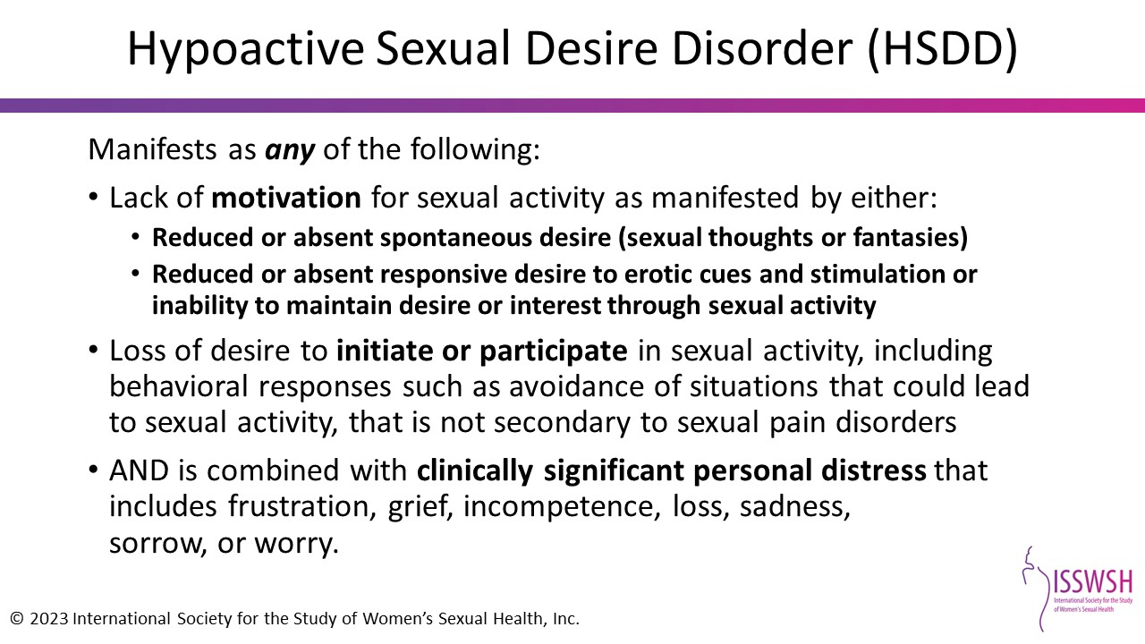
Notes:
References:
Parish, SJ, Goldstein AT, Goldstein SW et al. Toward a more evidence-based nosology and nomenclature for female sexual dysfunctions—part 2. J Sex Med. 2016 Dec;13(12):1888-1906.

Slide 8
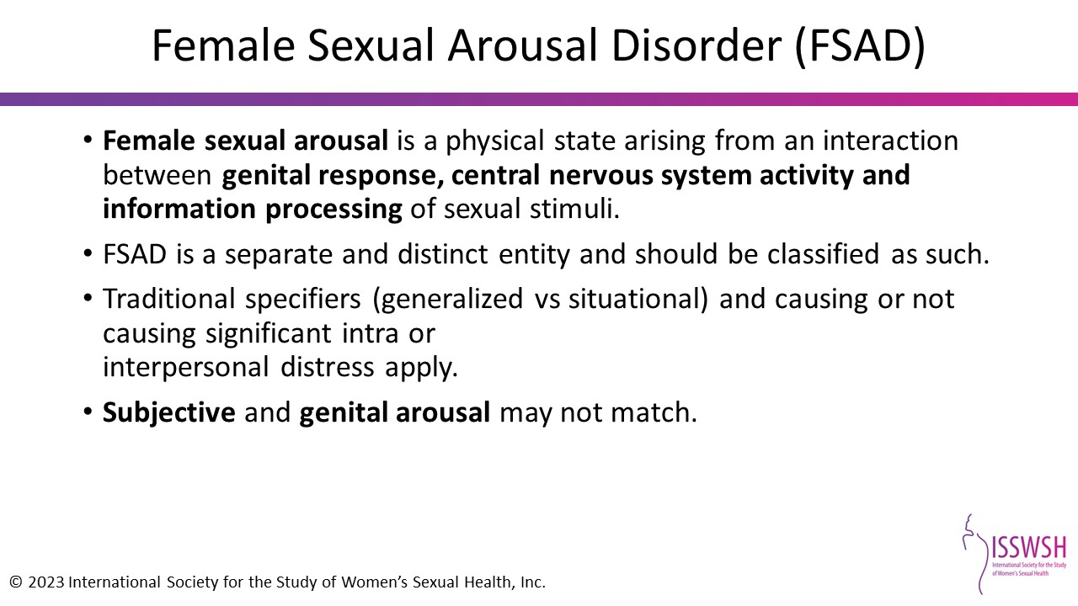
Notes:
References:
Parish, SJ, Goldstein AT, Goldstein SW et al. Toward a more evidence-based nosology and nomenclature for female sexual dysfunctions—part 2. J Sex Med. 2016 Dec;13(12):1888-1906.

Slide 9
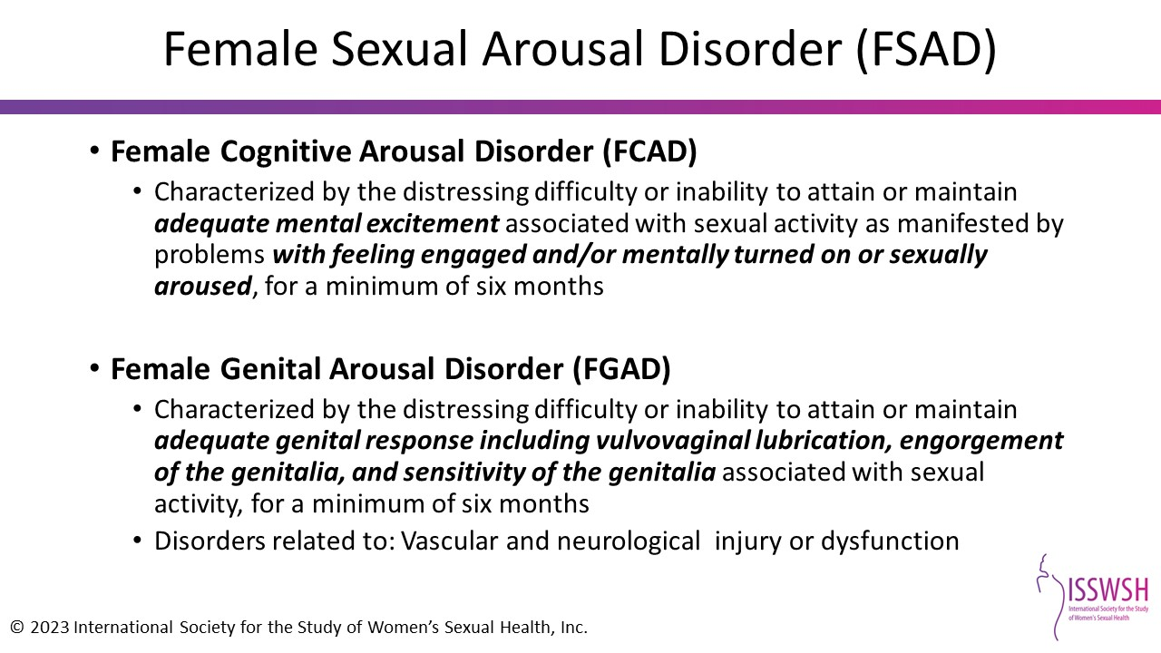
Notes:
References:
Parish et al. J Sex Med 2016;13:1888-1906.
Parish et al. J Sex Med 2019;16:452-462.

Slide 10
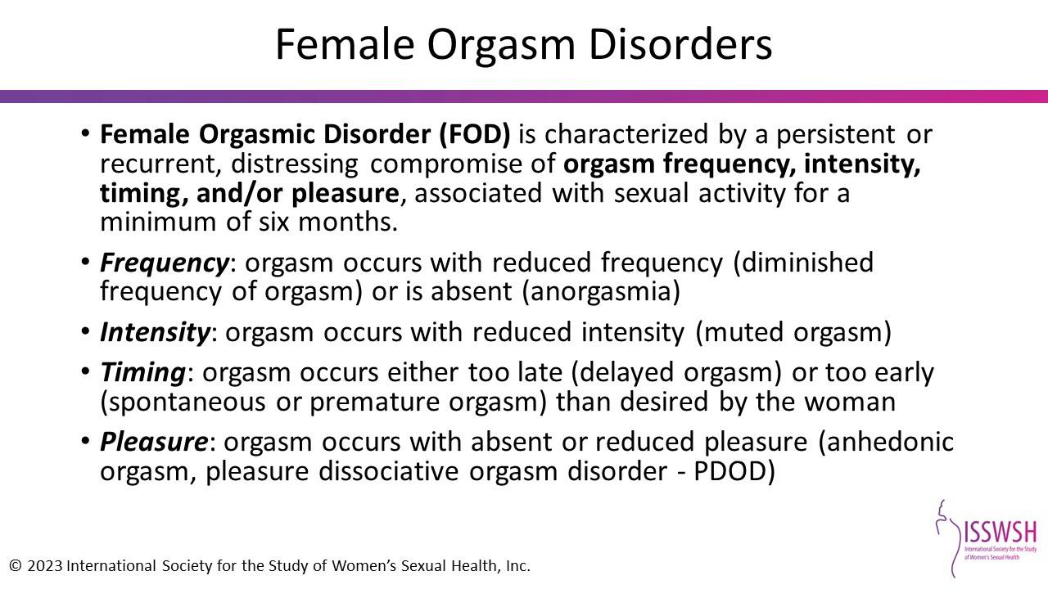
Notes:
References:
Parish, SJ, Goldstein AT, Goldstein SW et al. Toward a more evidence-based nosology and nomenclature for female sexual dysfunctions – part 2. J Sex Med. 2016 Dec;13(12):1888-1906.

Slide 11
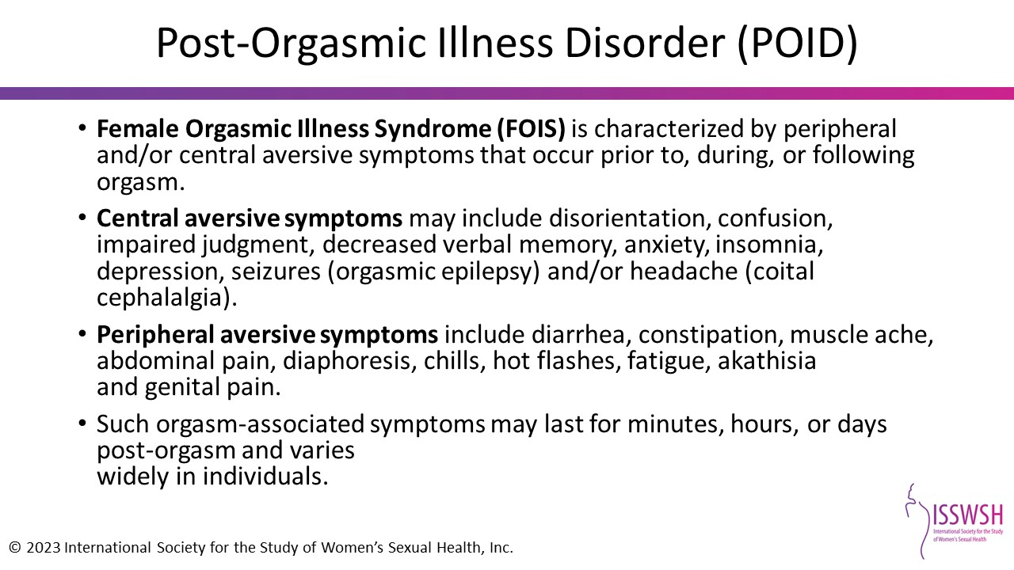
Notes:
References:
Parish, SJ, Goldstein AT, Goldstein SW et al. Toward a more evidence-based nosology and nomenclature for female sexual dysfunctions--part 2. J Sex Med. 2016 Dec;13(12):1888-1906.

Slide 12
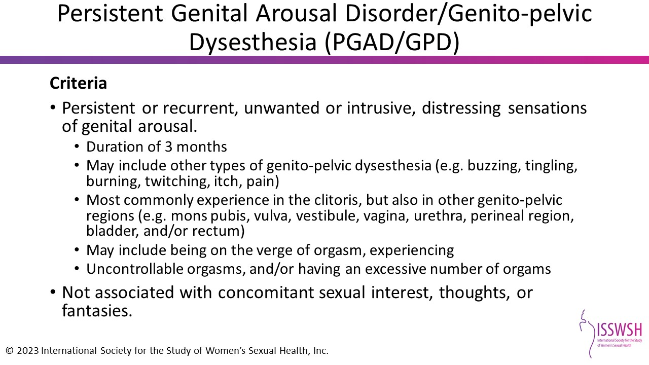
Notes:
References:
Parish et al. J Sex Med 2016;13(12):1888-1906.

Slide 13
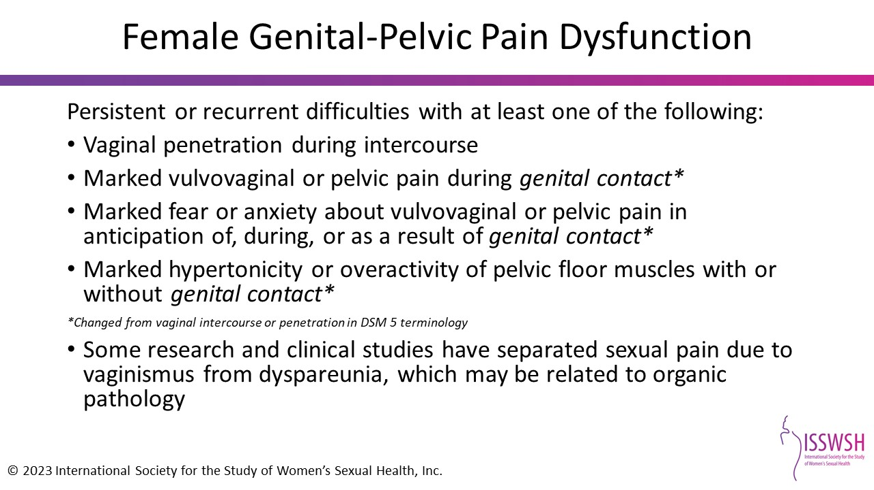
Notes:
Reference:
McCabe MP, Sharlip ID, Atalla E et al. Definitions of sexual dysfunctions in women and men: a consensus statement from the fourth international consultation on sexual medicine 2015. J Sex Med. 2016;13: 135-143.

Slide 14
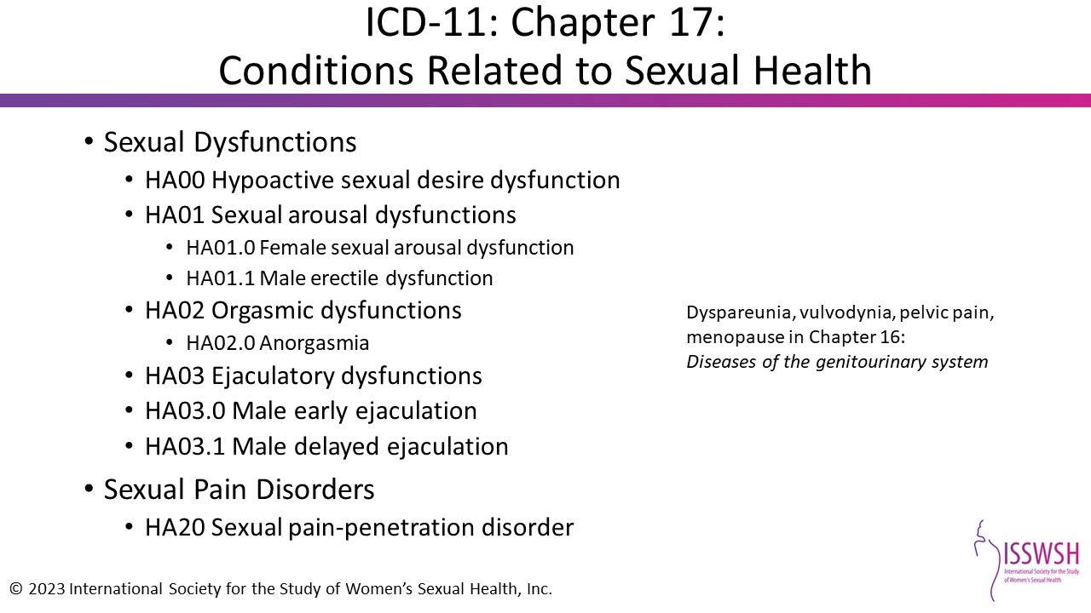
Notes:
*ICD-11 approved by World Health Assembly May 2019 for use by member states in 2022
References:
Parish et. al. Sex Med Rev 2020 Aug 13; online ahead of print.

Slide 15
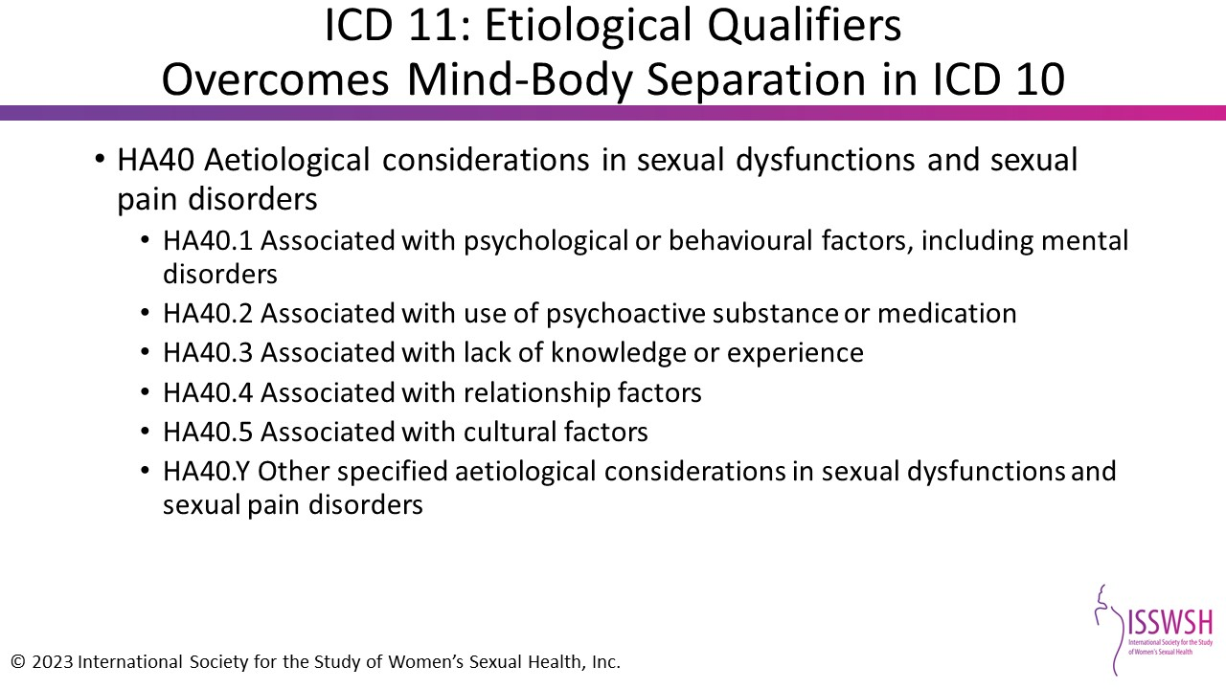
Notes:
References:
ICD-11 for Mortality and Morbidity Statistics (Version : 09/2020)

Slide 16
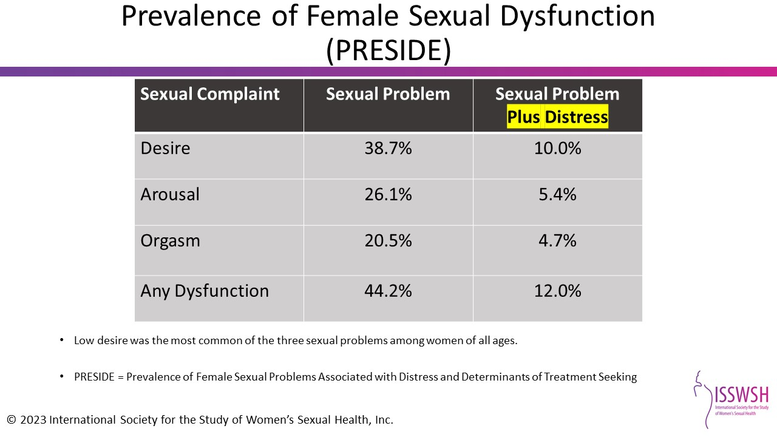
Notes:
PRESIDE
31,581/50,002 women (63%) >18 years from representative US panel; mean age 49 years old (range, 18-102 years); 81% white; 58% >high school education; 54% employed; 70% with current partner; 62% premenopausal. Changes in Sexual Functioning Questionnaire (CSFQ) and Female Sexual Distress Scale (FSDS) utilized. Unadjusted population-based prevalence of desire disorder was 10.0% and was reduced to 6.3% for those without concurrent depression, leading to an estimate of 3.7% for those with both conditions present.¹
Johannes CB, Clayton AH, Odom DM, et al. Distressing sexual problems in United States women revisited: prevalence after accounting for depression. J Clin Psychiatry. 2009;70:1698-1706.
Reference:
Shifren JL, Monz BU, Russo PA, Segreti A, Johannes CB. Sexual problems and distress in United States women: prevalence and correlates. Obstet Gynecol 2008;112: 970-978.

Slide 17
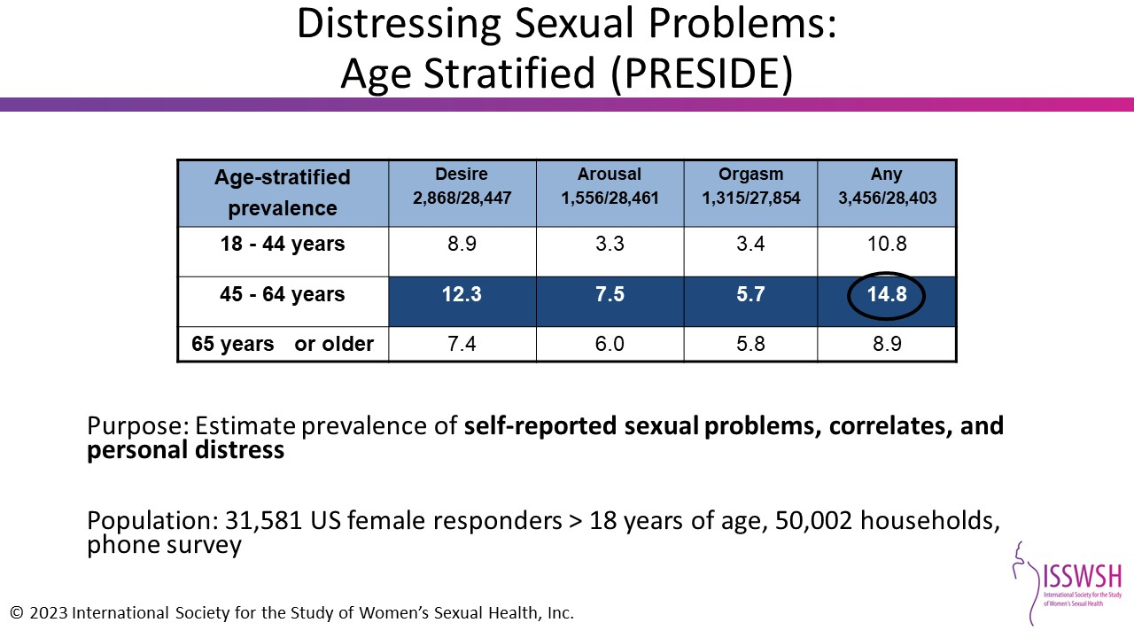
Notes:
References:
Shifren JL, et al. Obstet Gynecol. 2008;112:970-978.

Slide 18
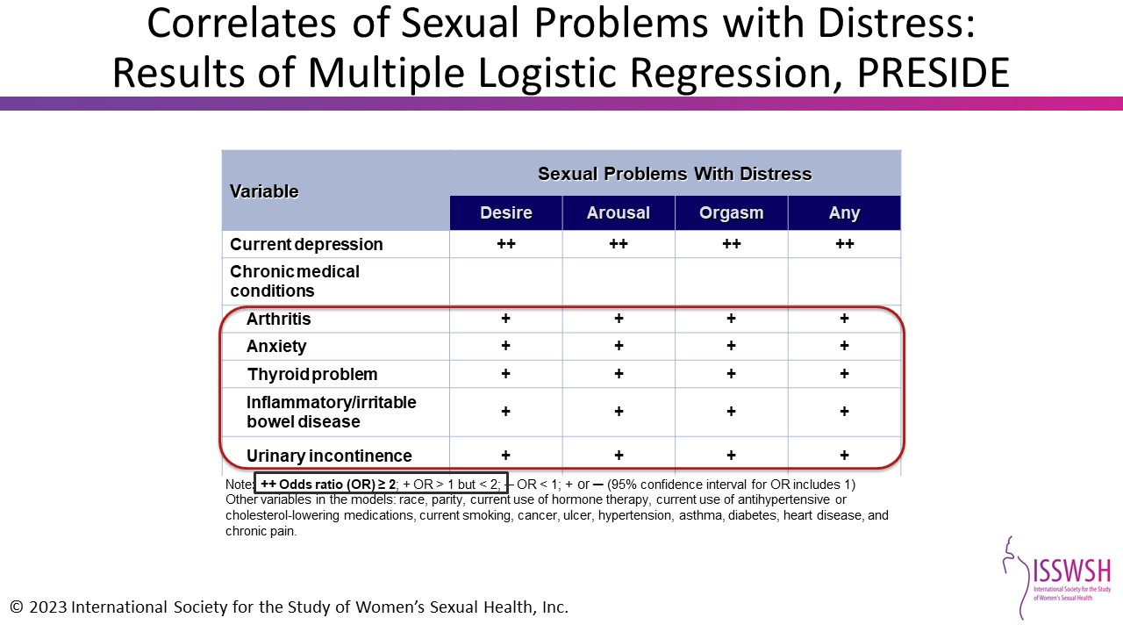
Notes:
References:
Shifren et al., Obstet & Gynecol, 2008; 112:970.

Slide 19
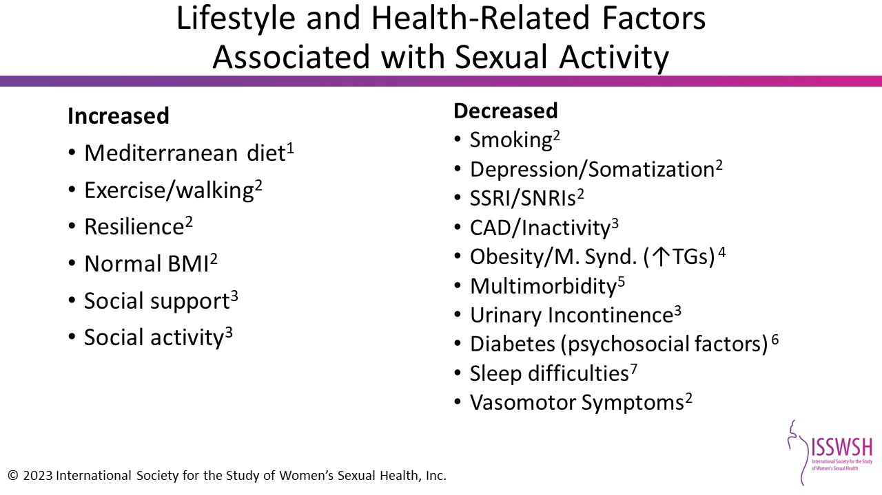
Notes:
SSRI/SNRI= selective serotonin reuptake inhibitor/serotonin norepinephrine reuptake inhibitor
CAD= coronary artery disease
TG= triglycerides
Met S= metabolic syndrome
References:
1.ISSM. http://www.issm.info/news/sex-health-headlines/mediterranean-diet-might-improve-sexual-function-in-men-and-women-with-type/.
2. McCall-Hosenfeld JS, et al. J Gen Intern Med. 2008;23(12):2000-2009.
3. Bach LE, et al. J Sex Med. 2013;10:2671-2678.
4. Alvisi S, et al. J Sex Med. 2014;11:2020-2028.
5. Appa AA, et. al. J Sex Med. 2014;11:2744-2755.
6. Pontiroli AE, et al. J Sex Med. 2013;10:1044-1051.
7. Kling JM, et al. Menopause. 2017;24;604-612.

Slide 20
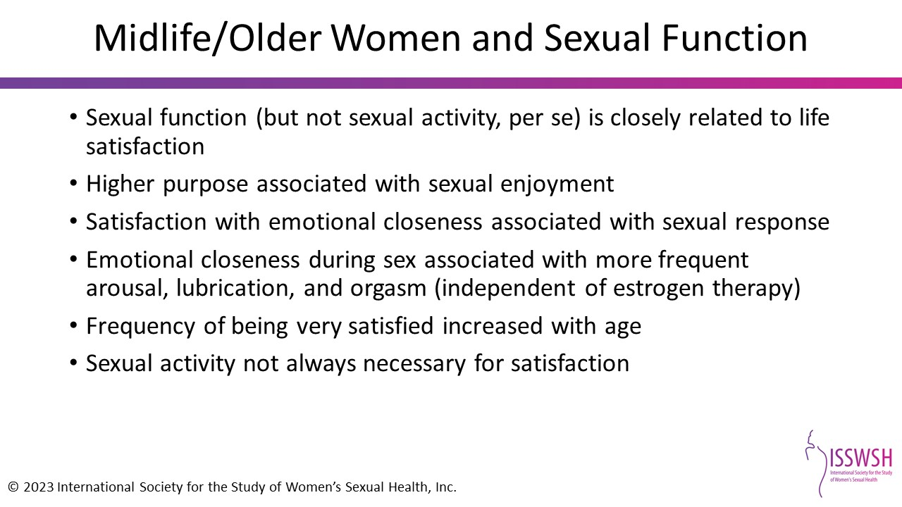
Notes:
References:
Prairie BA, Scheier MF, Matthews KA et al. A higher sense of purpose in life is associated with sexual enjoyment in midlife women. Menopause 2011;18:839-844.
Trompeter SE, Bettencourt R, Barrett-Connor E. Sexual activity and satisfaction in healthy community-dwelling older women. Am J Med 2012;37-43.
Ornat L, Martinez-Dearth R, Munoz A et al. Sexual function, satisfaction with life and menopausal symptoms in middle-aged women. Maturitas 2013;75:261-269.

Slide 21
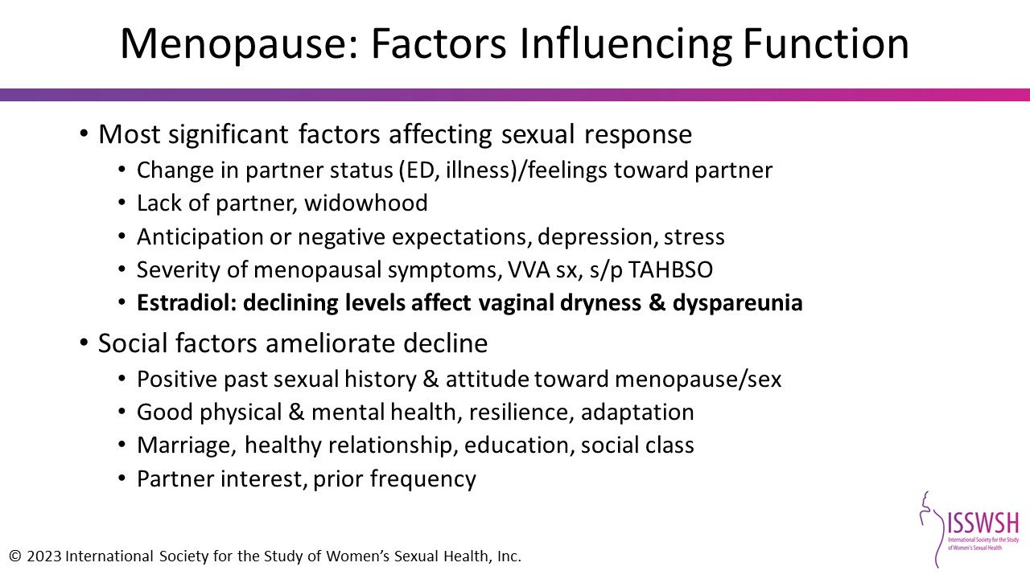
Notes:
References:
Dennerstein L, Hayes R. J Sex Med 2005;2(suppl 3):118-132.
Prarie et al. Menopause 2011;18:839-844.
Thomas et al. Menopause 2017;25:286-292.
Lonnee-Hoffman et al. J Sex Med 2014;11:2029-2038.
Ornat et al. Maturitas 2013;75:261-9.
Ringa et al. J Sex Med 2013;10:2399-2408.
Bell et al. Sex Med Rev 2017;5:52-80.
Avis et al. Menopause 2017;24:379-390.
Avis et al. Menopause 2018;11:1244-1235

Slide 22
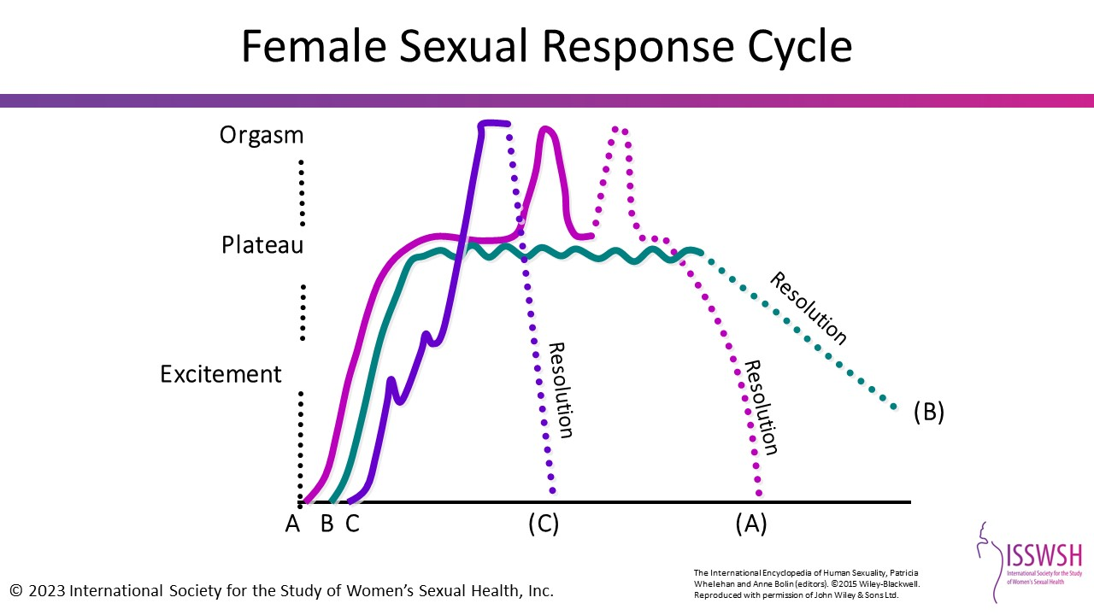
Notes:
The International Encyclopedia of Human Sexuality, Patricia Whelehan and Anne Bolin (editors). ©2015 Wiley-Blackwell.
Reproduced with permission of John Wiley & Sons Ltd.
Sex response is a natural phenomenon in which sensory stimulation leads to increased peripheral blood flow and vasocongestion. Genital tissues and breasts are most obviously affected. With continuing stimulation, there is a build-up of muscle tension and the development of a “plateau” phase that leads to orgasm. During orgasm, there is a brain discharge, widespread muscle contraction, and increased cardiac output. Resolution follows orgasm with return to the unstimulated state. The essential components of sex response depend upon adequate functioning of nerves, arteries, and muscles.
Reference:
Everaerd, W. 2015. Sexual response cycle. The International Encyclopedia of Human Sexuality. 1115–1354.

Slide 23
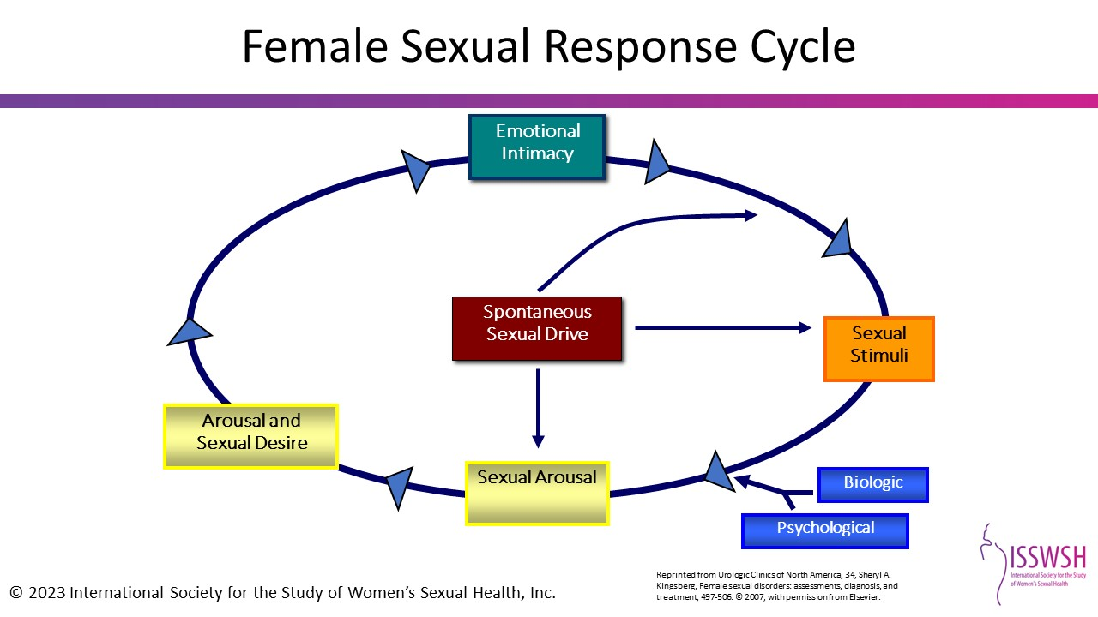
Notes:
Reprinted from Urologic Clinics of North America, 34, Sheryl A. Kingsberg, Female sexual disorders: assessments, diagnosis, and treatment, 497-506. © 2007, with permission from Elsevier.
Female Sexual Response Cycle
And now Rosemary Basson offers an alternative model to understanding the sexual response cycle that suggests that for women, it is not so linear and that for many women, desire comes after arousal and that many women begin from a point of sexual neutrality. Arousal may come from a conscious decision or as a result of seduction or suggestion from a partner. This is extremely important to understand because you can then normalize this reality for your patients who have come to believe that because the initial drive has gone they are no longer sexual beings and to reassure their partners that it is not that they have lost desirability.
(e.g. analogy of going to the gym—)
So, Sexual neutrality or being receptive to rather than initiating sexual activity is considered a normal variation of female sexual functioning. This is very important for you to keep in mind as I review the female sexual dysfunctions, particularly hypoactive sexual desire disorder.
This slide graphically illustrates “normal” female sexual response. Women’s desire has a large responsive (receptive) component that is driven by intimacy and is circular in nature. When any one (or more than one) aspect or phase of the cycle is absent, the patient may experience one or more sexual dysfunctions. Satisfaction is an essential component of the sexual response cycle. Instead of a linear relationship with orgasm as the end point, a cyclic concept with satisfaction as the focus appears to be more appropriate in females.
The cycle: A woman starts out desire-neutral. If the patient experiences adequate emotional intimacy with her partner, she may seek or be receptive to sexual stimuli. Receptivity to sexual stimuli allows the woman to move from sexual neutrality to arousal. If the mind continues to process the stimuli on to further arousal, sexual desire will encourage the woman to move forward to sexual satisfaction and orgasm. This positive outcome fosters intimacy and reinforces sexual motivation.
Reference:
Kingsberg SA, Janata JW. Female sexual disorders: assessment, diagnosis, and treatment. Urol Clin N Am 2007;34:497-506.

Slide 24
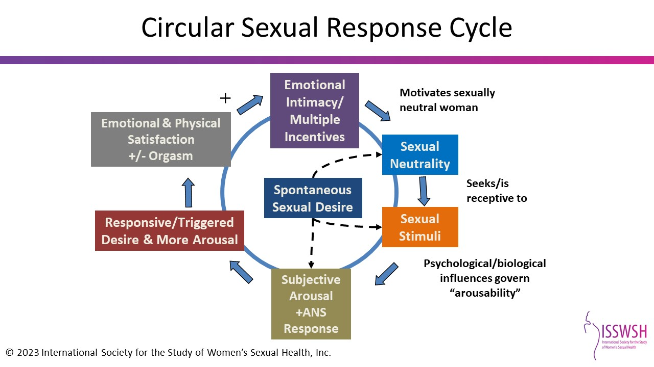
Notes:
References:
Basson. J Sex Martial Ther 2001.

Slide 25
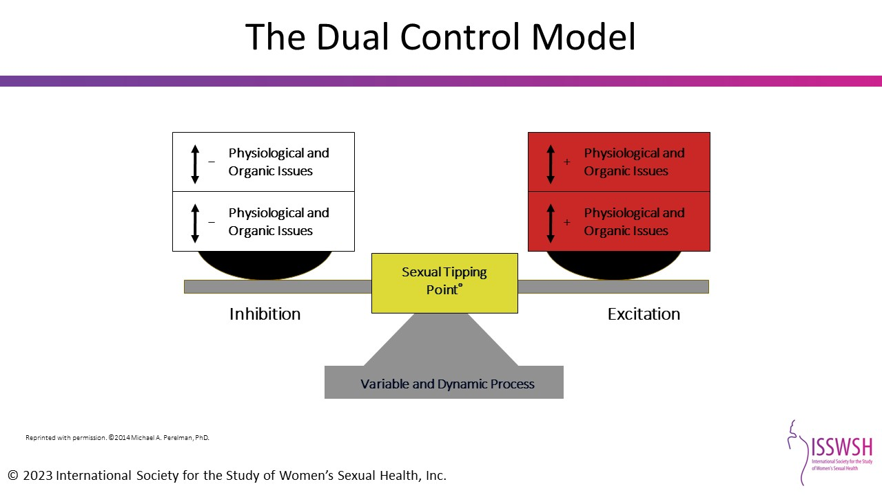
Notes:
Reprinted with permission. ©2014 Michael A. Perelman, PhD.
References:
Pfaus JG. Pathways of sexual desire. J Sex Med. 2009;6:1506-1533.
Perelman, MA. A new combination treatment for premature ejaculation: a sex therapist's perspective. J Sex Med. 2011;3(6):1004-1012.

Slide 26
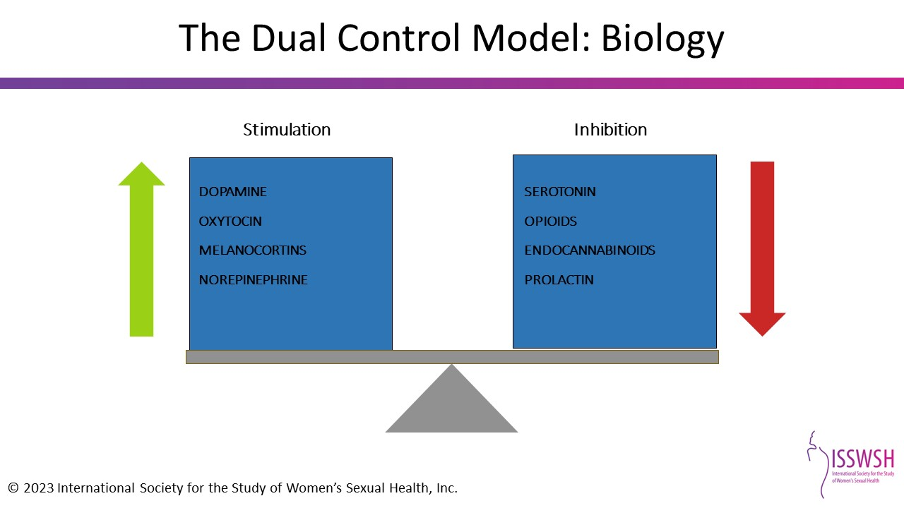
Notes:
References:
Pfaus JG. Pathways of sexual desire. J Sex Med. 2009;6:1506-1533.
Bancroft J, Graham CA, Janssen E, Sanders SA. The dual control model: current status and future directions. J Sex Res. 2009;46(2-3):121-142.

Slide 27
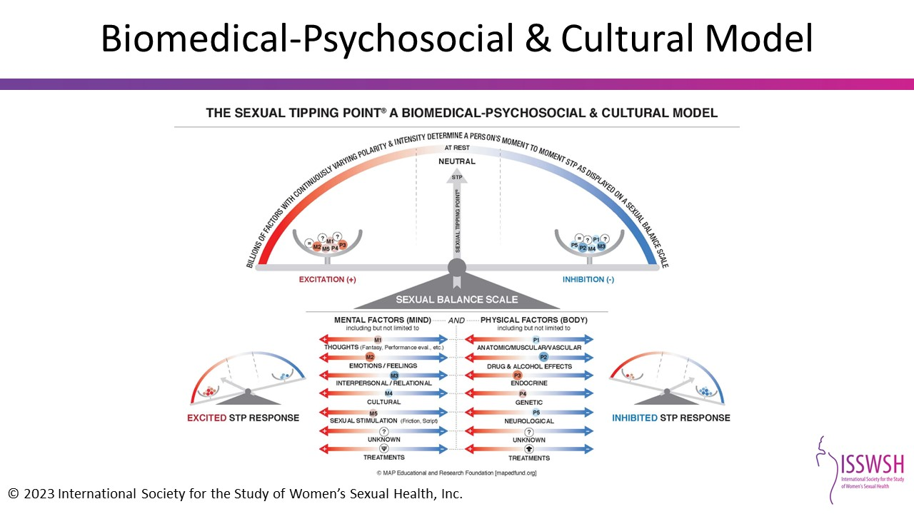
Notes:
This image is provided courtesy of Michael A. Perelman, Ph.D. and is based on the Sexual Tipping Point Model® owned by and used with the permission of the MAP Education & Research Foundation (mapedfund.org).

Slide 28
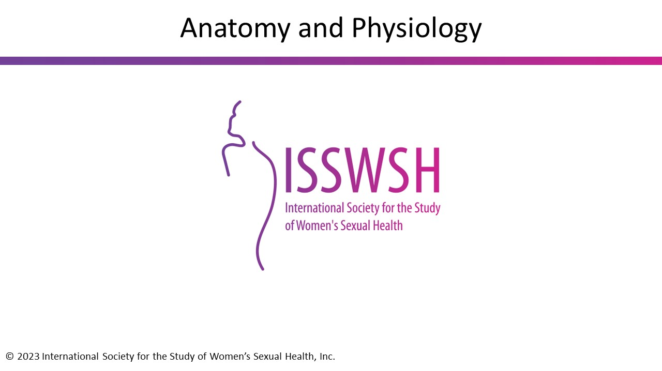

Slide 29
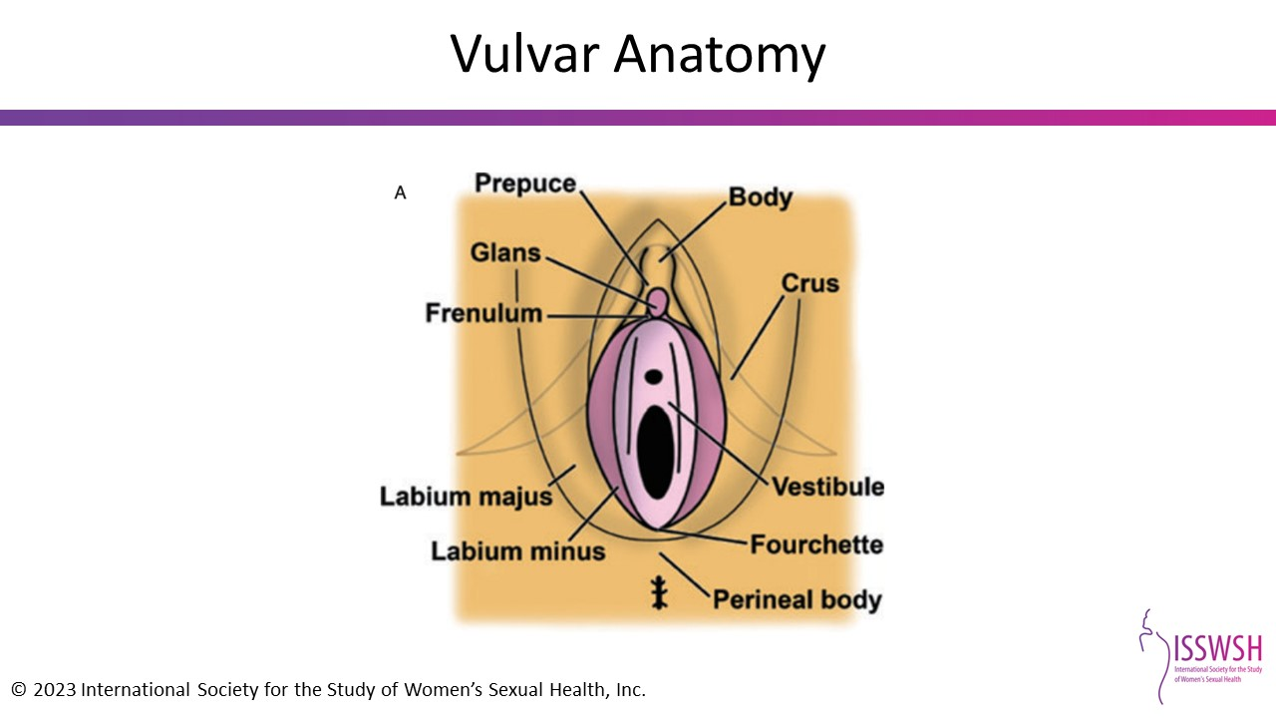
Notes:
References:
O'Connell, Helen E., et al. "The anatomy of the distal vagina: towards unity." The journal of sexual medicine 5.8 (2008): 1883-1891.

Slide 30
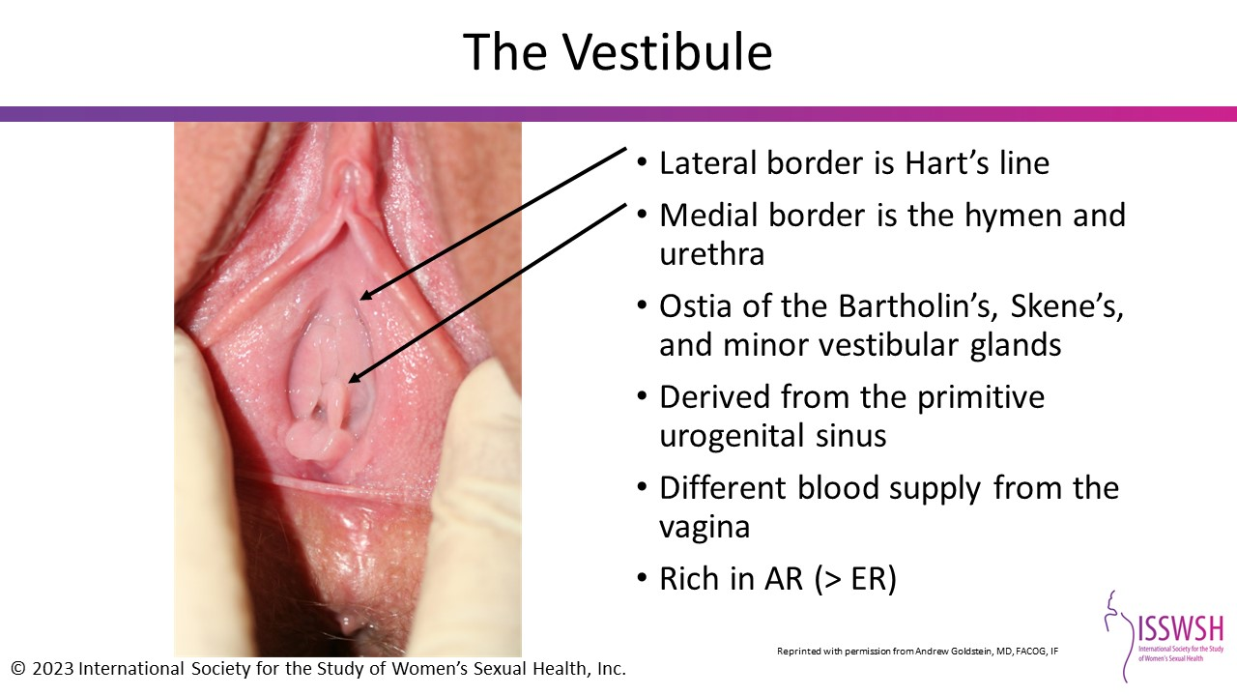
Notes:
Reprinted with permission from Andrew Goldstein, MD, FACOG, IF
AR= androgen receptor; ER= estrogen receptor
References:
Traish, Abdulmaged M., et al. "Role of androgens in female genitourinary tissue structure and function: implications in the genitourinary syndrome of menopause." Sexual medicine reviews 6.4 (2018): 558-571.

Slide 31
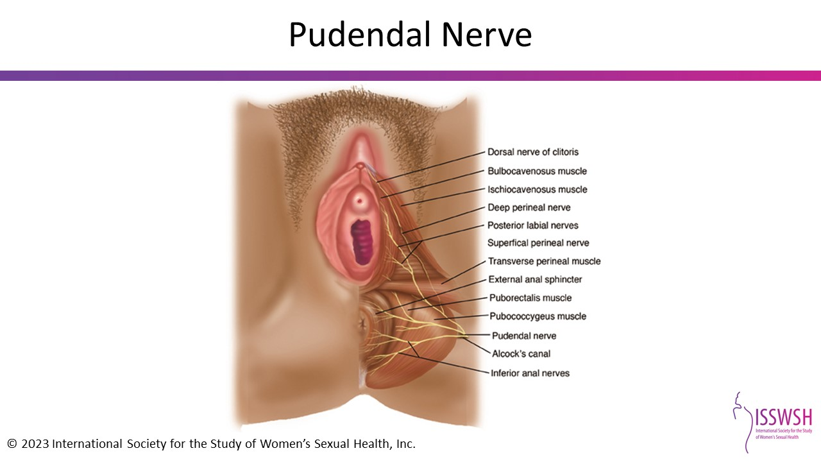
Notes:
Reprinted with permission from Andrew Goldstein, MD, FACOG, IF

Slide 32
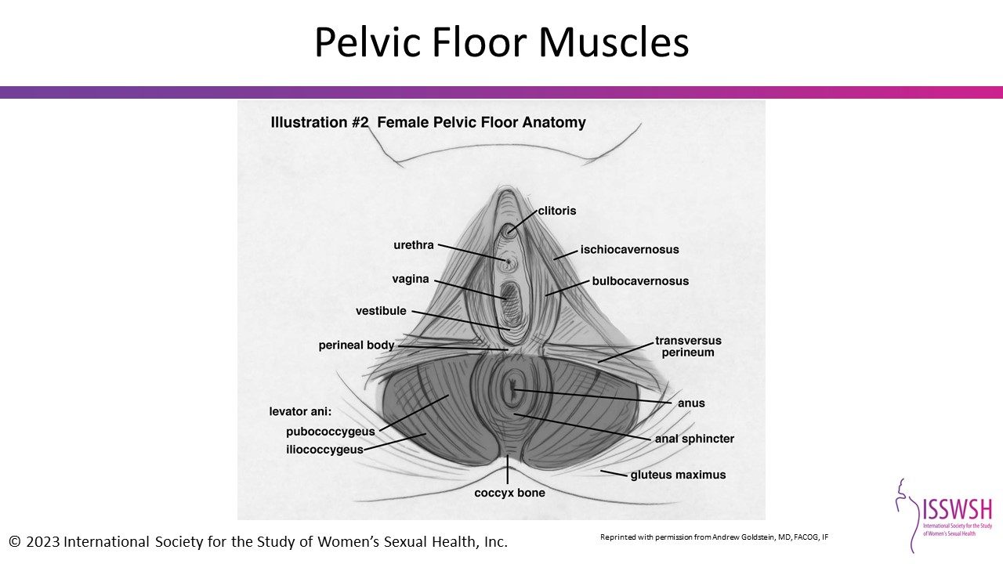
Reprinted with permission from Andrew Goldstein, MD, FACOG, IF
Notes:
Reprinted with permission from Andrew Goldstein, MD, FACOG, IF
This image was published in the Journal of Sexual Medicine, Vol 46. Bancroft J, Graham CA, Janssen E, Sanders SA. The dual control model: current status and future directions. Copyright Elsevier 2009.

Slide 33
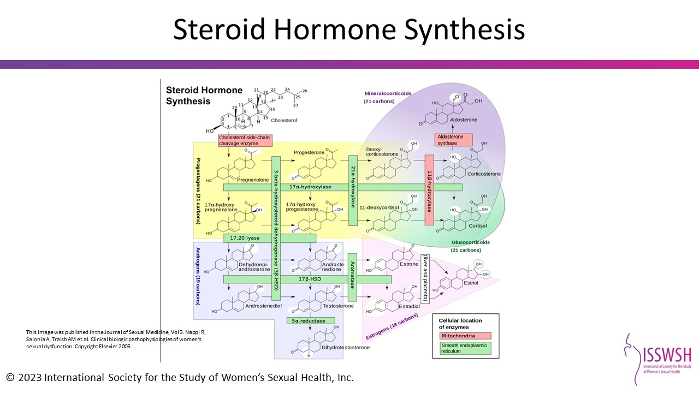
Notes:
This image was published in the Journal of Sexual Medicine, Vol 3. Nappi R, Salonia A, Traish AM et al. Clinical biologic pathophysiologies of women's sexual dysfunction. Copyright Elsevier 2005.
Reference:
Nappi R, Salonia A, Traish AM et al. Clinical biologic pathophysiologies of women's sexual dysfunction. J Sex Med 2005;2: 4-25.

Slide 34
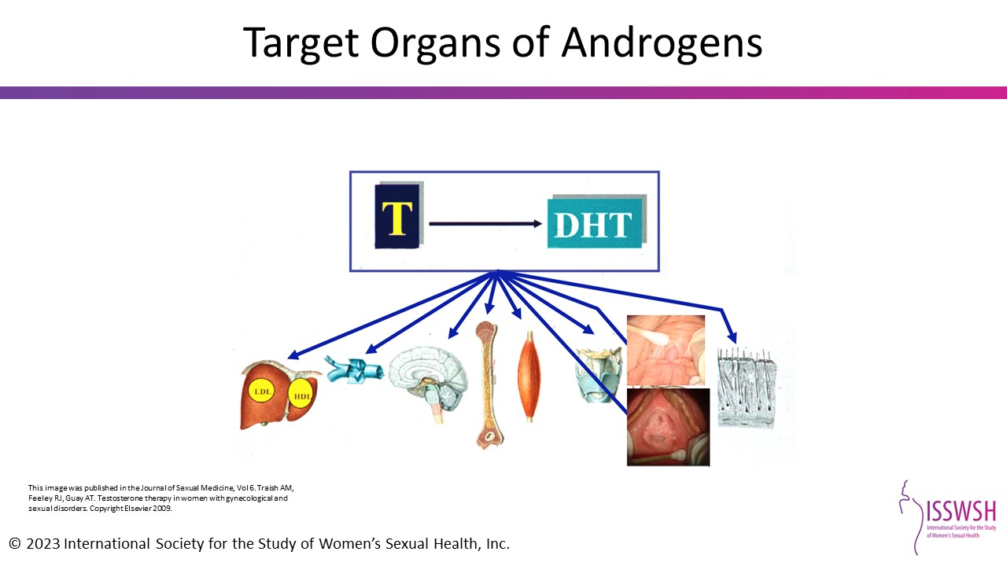
Notes:
This image was published in the Journal of Sexual Medicine, Vol 6. Traish AM, Feeley RJ, Guay AT. Testosterone therapy in women with gynecological and sexual disorders. Copyright Elsevier 2009.
Reference:
Traish AM, Feeley RJ, Guay AT. Testosterone therapy in women with gynecological and sexual disorders: a triumph of clinical endocrinology from 1938 to 2008. J Sex Med. 2009;6:334-51.

Slide 35
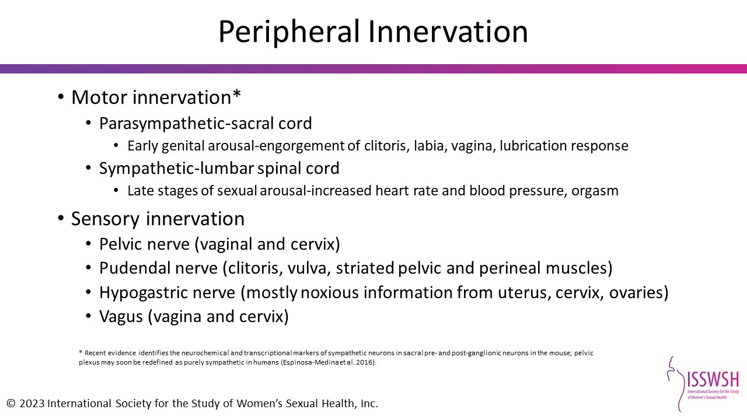
Notes:
References:
Nappi R, Salonia A, Traish AM et al. Clinical biologic pathophysiologies of women's sexual dysfunction. J Sex Med 2005;2: 4-25.
Espinosa-Medina I, Saha O, Boismoreau F, et al. The sacral autonomic outflow is sympathetic. Science. 2016;354:893-7.

Slide 36
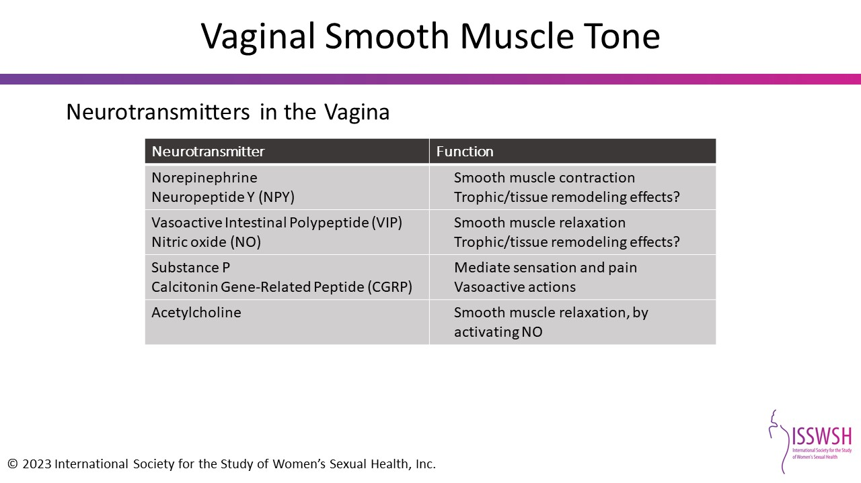
Notes:
References:
Nappi R, Salonia A, Traish AM et al. Clinical biologic pathophysiologies of women's sexual dysfunction. J Sex Med 2005;2: 4-25.
Uckert S, Albrecht K, Kuczyk MA et al. Phosphodiesterase type 1, calcitonin gene-related peptide and vasoactive intestinal polypeptide are involved in the control of human vaginal arterial vessels. Eur J Obstet Gynecol Reprod Biol. 2013;169(2):283-286.
Kellogg DL, Zhao JL, Coey U, Green JV. Acetylcholine-induced vasodilation is mediated by nitric oxide and prostaglandins in human skin. J Appl Physiol. 1985;98(2):629-632.

Slide 37
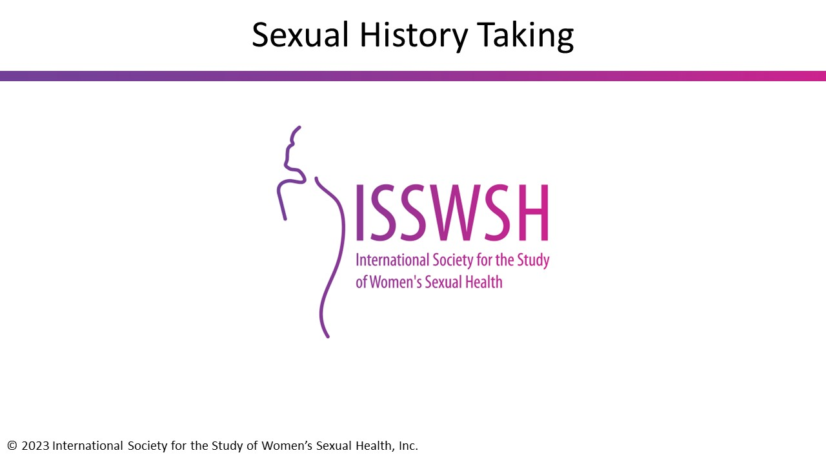

Slide 38
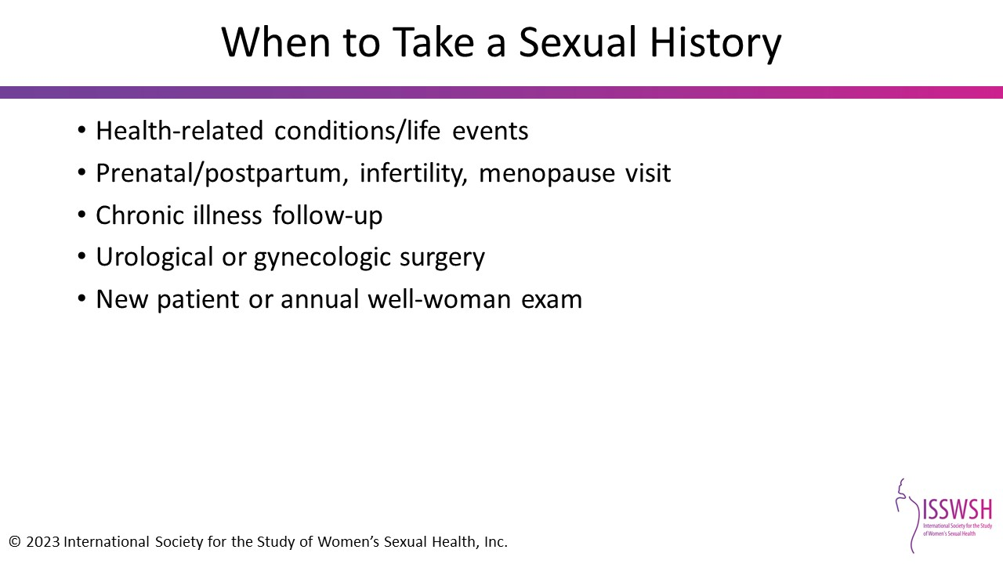
Notes:
Reference:
Basson R. Sexuality and sexual disorders. Clin Updat Women's Health Care. 2003;1:1-84.

Slide 39
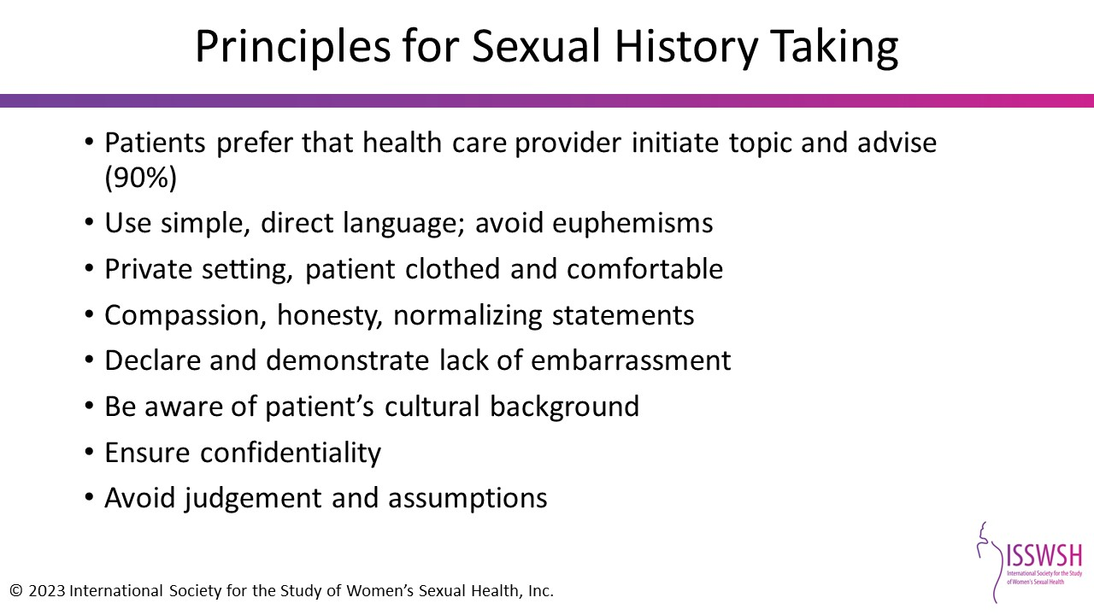
Notes:
Reference:
Athanasiadis L, Papaharitou S, Salpiggidis G et al. Education physicians to treat erectile dysfunction patients: development and evaluation of a course on communication and management strategies. J Sex Med 2006;3(1):47-55.
Sadovsky R, Nusbaum M. Sexual health inquiry and support is a primary care priority. J Sex Med. 2006;3(1);3-11.

Slide 40
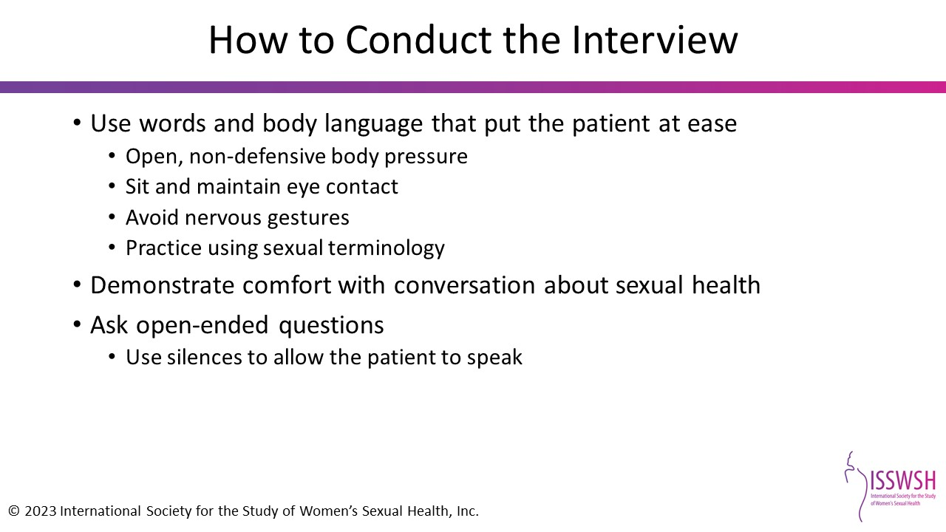
Notes:
Your physical demeanor is an important ingredient in a successful encounter.
Choose words and use body language that put the patient at ease. Specifically, you should keep your body posture open and non-defensive: for example, avoid crossing your arms. You should sit during the interview so you are talking with the patient at eye level, and you should maintain appropriate eye contact while you speak to her, rather than looking only at the chart as you take notes. Also, be sure to avoid nervous gestures, such as jiggling your keys in your pocket, clicking your pen open and closed, or tapping your foot.
It is also important that you choose language that is appropriate to the age, ethnicity, and culture of the patient. It can be helpful to practice using sexual terminology to make sure you are comfortable with it. In any case, you should avoid using slang, especially vulgar terminology, as well as “medicalese” as much as possible.
Finally, be sure to ask open-ended questions rather than questions that will elicit just a “Yes” or “No” and use silences to allow the patient to continue to speak or elaborate on a statement. Listening is as important a part of communicating as talking.

Slide 41
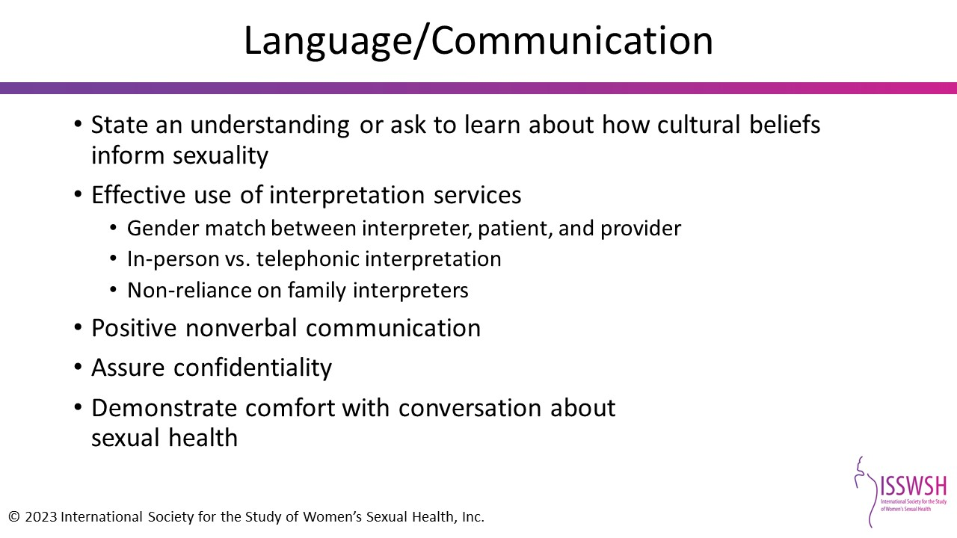
Notes:
References:
Katz A. "Where I come from, we don't talk about that": exploring sexuality culture among Blacks, Asians and Hispanics. AWHONN Lifelines 2002;6(6):533-536.

Slide 42
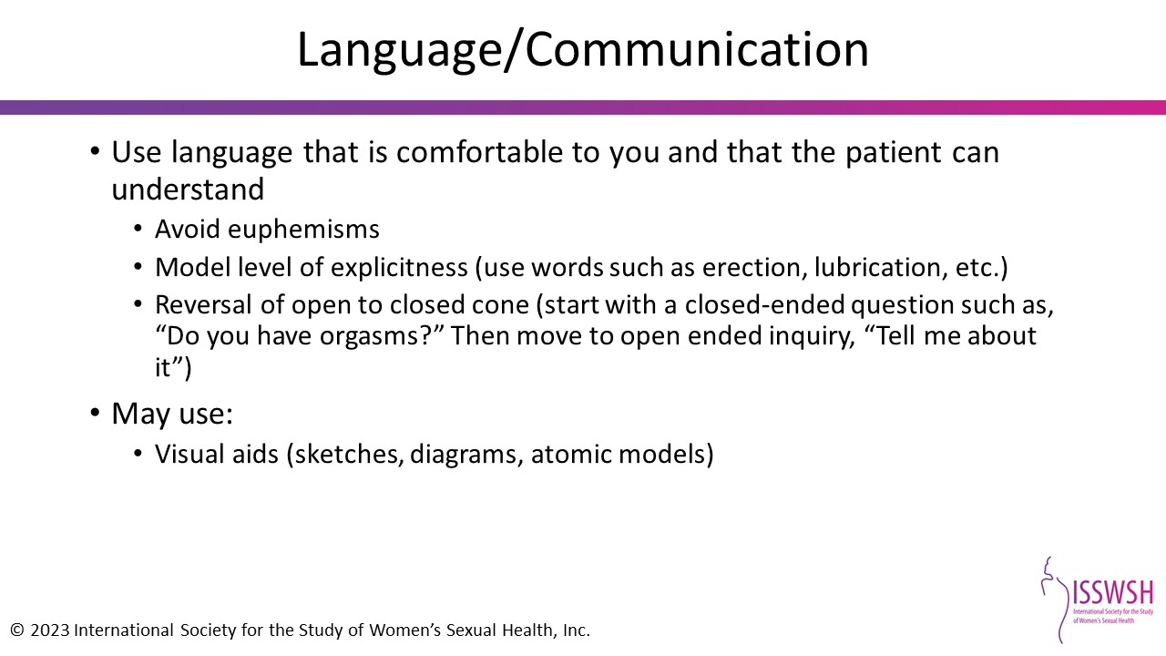

Slide 43
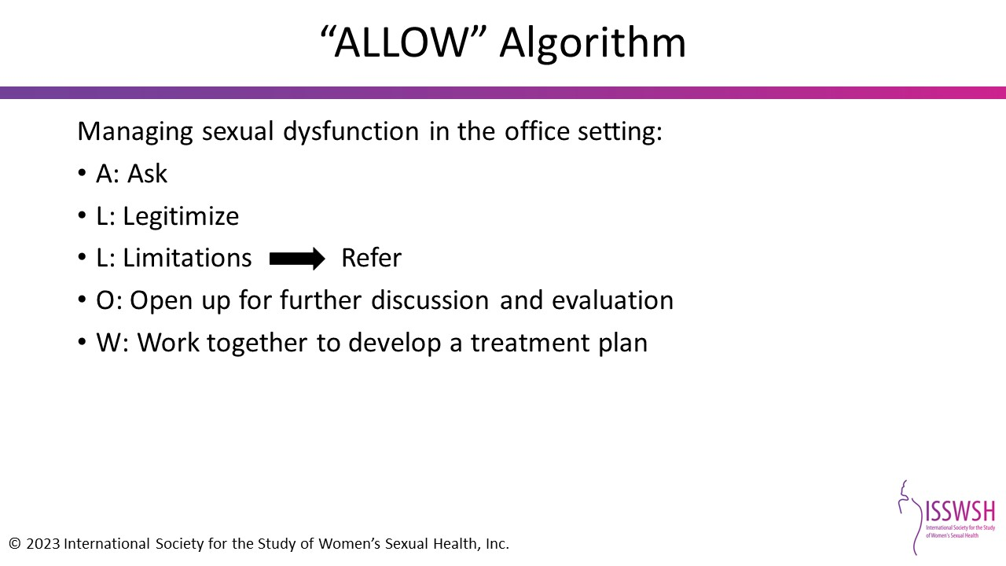
Notes:
Reference:
Sadovsky R, Mulhall JP. The potential value of erectile dysfunction inquiry and management. Int J Clin Pract. 2003;57(7):601-608.

Slide 44
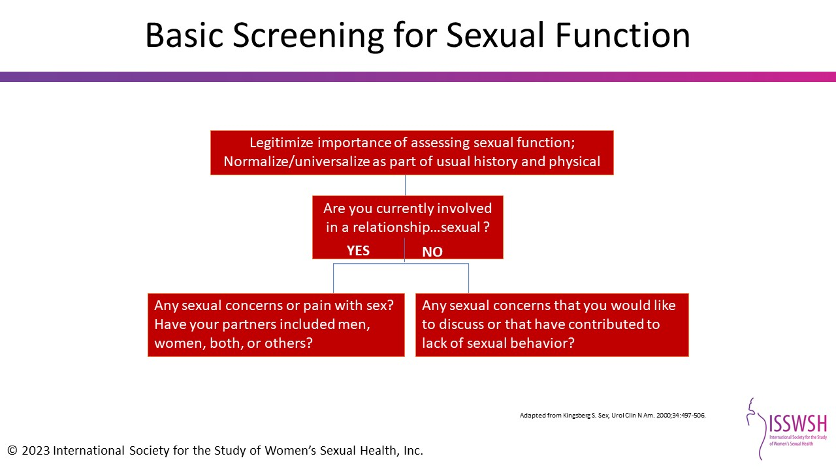
Notes:
Reference:
Kingsberg SA. Taking a sexual history. Obstet Gynecol Clin N Am 2006;33: 535-547.

Slide 45
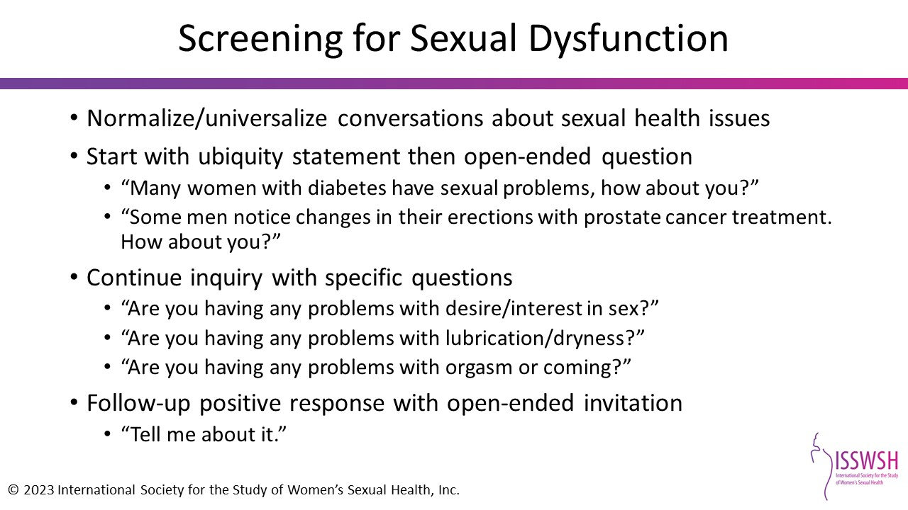
Notes:
Reference:
Sadovsky R, Wahila A, Enecilla M, Cosiquien R, Tipu O, Etheridge-Otey J. Sexual problems among a specific population of minority women aged 40-80 years attending a primary care practice. J Sex Med 2011;3:795-803.

Slide 46
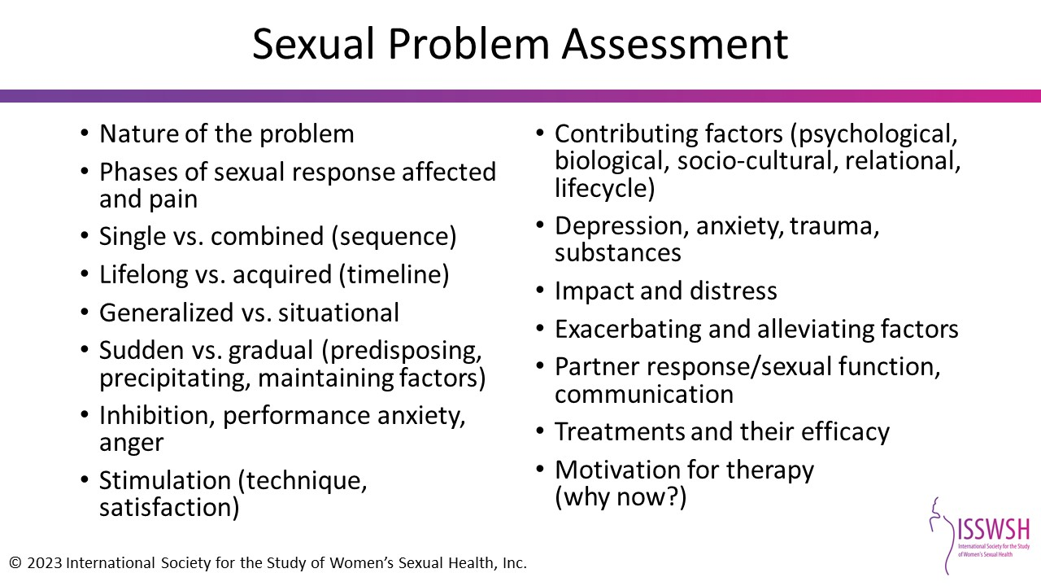
Notes:
Reference:
Sadovsky R, Wahila A, Enecilla M, Cosiquien R, Tipu O, Etheridge-Otey J. Sexual problems among a specific population of minority women aged 40-80 years attending a primary care practice. J Sex Med. 2011;3:795-803.

Slide 47
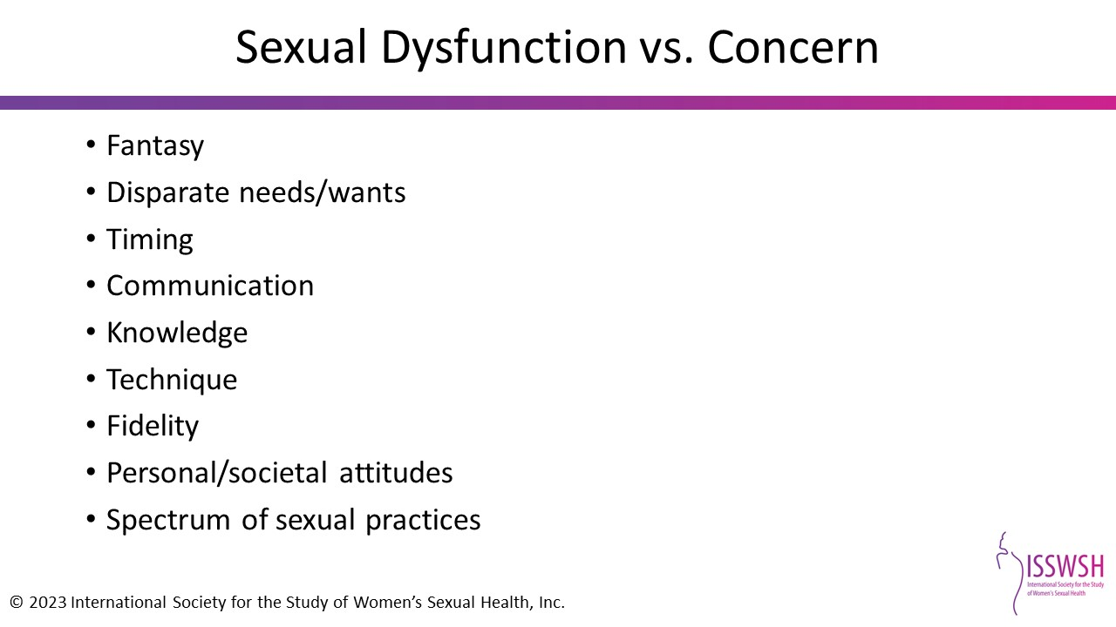
Notes:
Reviewing these areas will help differentiate if something is a sexual dysfunction vs a concern.

Slide 48
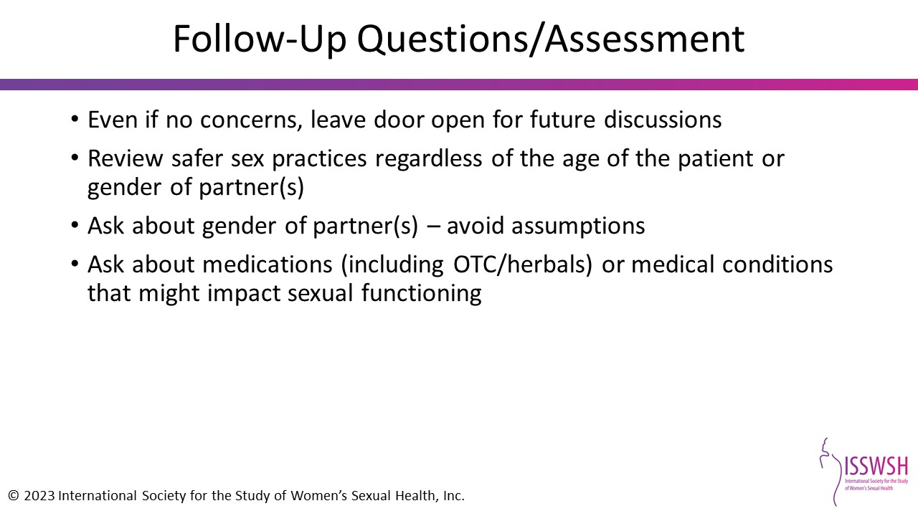

Slide 49
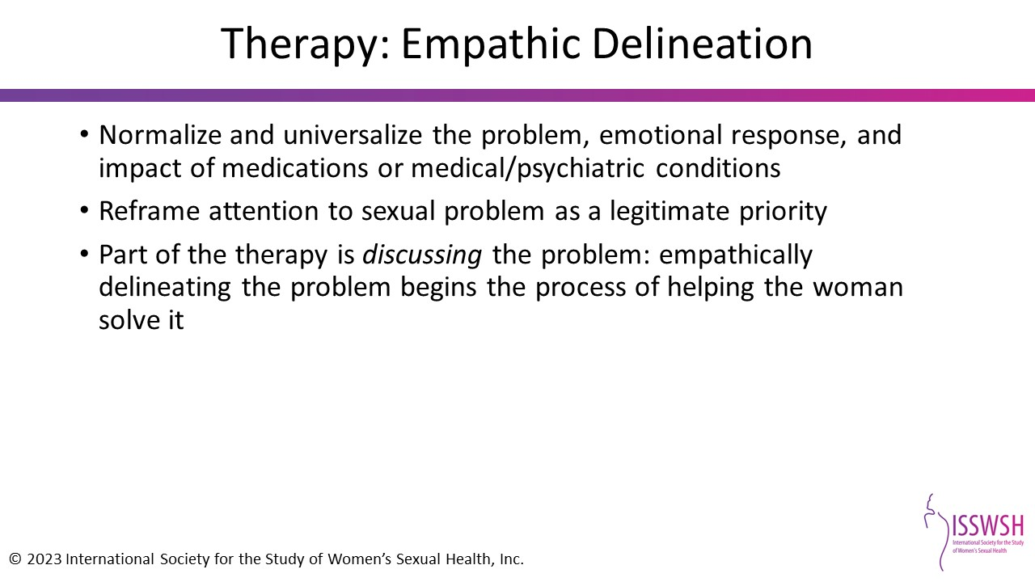

Slide 50
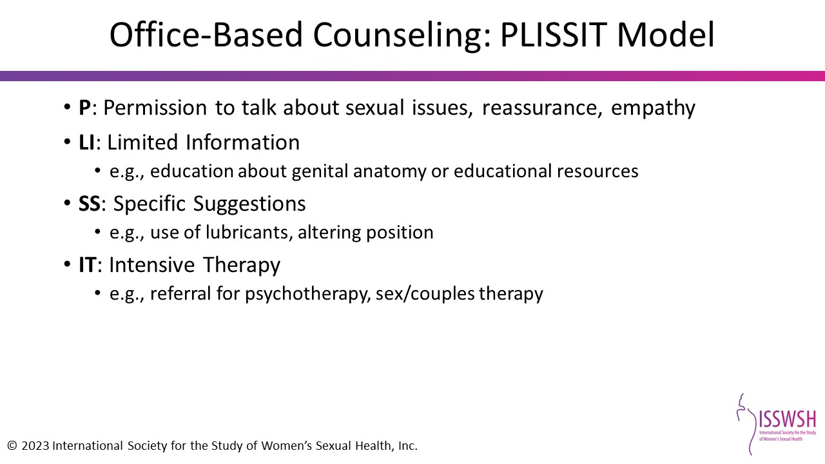
Notes:
Reference:
Annon JS. The PLISSIT model: a proposed conceptual scheme for the behavioral treatment of sexual problems. J Sex Educ Ther. 1976;2(2):1-15.

Slide 51

Notes:
Since approximately half of all encounters end with the patient unable to repeat the plan of action, it is important to insure that the patient understands and agrees with the plan. One technique that can assist with "closing the loop" is the "Ask-Tell-Ask" method. This technique is a CONVERSATION. Let’s go through it together.
ASK - Ask the patient to describe his/her current understanding of the issue. This will help you craft your message to take into account the patient’s level of knowledge, emotional state and degree of education.
TELL - Tell the patient in straightforward language what you need to communicate—the bad news, good news, treatment options, or other information. A useful guideline is not to give more than three pieces of information at a time—provide it in “chunks.” Try to avoid medical jargon.
ASK - Ask the patient what he/she understood you just said. This gives you the opportunity to check her understanding. Did she get the facts straight? Is her understanding appropriate? Did she hear what was said? Consider asking the patient to restate what was said in her own words. This will give her a chance to ask questions, which will tell you where to go next—what details to elaborate, what implications to discuss, what things to repeat. For example, you could say, “Who are you going to tell about this visit when you get home?” or “To make sure I did a good job of explaining this to you, can you tell me what you are going to say?”
FACULTY NOTE:
Research done by Kemp, Floyd & McCord-Duncan in 2008 showed that patients prefer to restate their understanding of health information, a finding that should be reassuring for those of us who might otherwise fear putting patients "on the spot".
Reference:
Kemp EC, Floyd MR, McCord-Duncan E, Lang F. Patients prefer the method of "tell back-collaborative inquiry" to assess understanding of medical information. J Am Board Fam Pract. 2008;21(1):24-30.

Slide 52

Notes:
A variety of validated tools are available to assess FSD; the three shown on this slide are those that are most relevant to the PCP
These tools are included on the CD that participants will receive.
The Decreased Sexual Desire Screener (DSDS) is a validated, diagnostic instrument that specifically identifies generalized acquired HSDD in pre-, peri-, and postmenopausal women.^{1,2}
The Female Sexual Function Index (FSFI) is a validated instrument that assesses key dimensions of sexual function in adult women and identifies women at risk for FSD.^{3,4}
The Female Sexual Distress Scale-Revised (FSDS-R) is a validated tool that distinguishes between women with and without FSD and effectively measures sexually related personal distress.⁵
References:
1. Clayton AH, Goldfischer ER, Goldstein I et al. Validation of the decreased sexual desire screener (DSDS): a brief diagnostic instrument for generalized acquired female hypoactive sexual desire disorder (HSDD). J Sex Med. 2009;6(3):730-738.
2. Clayton AH, et al. Poster Presentation. ISSWSW. 2007
3. Meston CM. Validation of the female sexual dysfunction index (FSFI) in women with female orgasmic disorder and in women with hypoactive sexual desire disorder. J Sex Marital Ther. 2003;29(1):39-46.
4. Rosen R, Brown C, Heiman J. et al. The female sexual function index (FSFI): a multidimensional self-report instrument for the assessment of female sexual function. J Sex Marital Ther. 2000;26(2):191-208.
5. DeRogatis L, Clayton A, Lewis-D'Agostino D, Wunderlich G. Validation of the female sexual distress scale-revised for assessing distress in women with hypoactive sexual desire disorder. J Sex Med. 2008;5(2):357-364.
Further Reading:
Isidori AM, Pozza C, Esposito K, et al. Development and validation of a 6-item version of the female sexual function index (FSFI) as a diagnostic tool for female sexual dysfunction. J Sex Med. 2010;7(3);1139-46.
Maseroli E, Fanni E, Fambrini M, et al. Bringing the body of the iceberg to the surface: the Female Sexual Dysfunction Index (FSDI-6) in the screening of female sexual dysfunction. J Endocrinol Invest. 2016;39(4):401-409.

Slide 53

Notes:
References:
Rosen R, et al. J Sex Marital Ther 2000;26(2):191-208.
Echeverry, BS, et al. J Sex Med 2010;7:2664.

Slide 54

Notes:
References:
1. DeRogatis LR, et al. J Sex Marital Ther. 2002;28(4):317-330.
2. DeRogatis LR, et al. J Sex Med. 2008;5(2):357-364.

Slide 55


Slide 56


Slide 57

Notes:
References:
Parish et al. Mayo Clin Proc. 2019 May;94(5):842-856.

Slide 58

Notes:
References:
Parish et al. Mayo Clinic Proceedings, in press.

Slide 59

Notes:
References:
Parish et al. Mayo Clinic Proceedings, in press.

Slide 60

Notes:
References:
Parish et al. Mayo Clinic Proceedings, in press.

Slide 61

Notes:
References:
Parish et al. Mayo Clinic Proceedings, in press.

Slide 62

Notes:
References:
Parish et al. Mayo Clinic Proceedings, in press.

Slide 63

Notes:
References:
Parish et al. Mayo Clinic Proceedings, in press.

Slide 64

Notes:
References:
Parish et al. Mayo Clinic Proceedings, in press.

Slide 65

Notes:
References:
Parish et al. Mayo Clinic Proceedings, in press.

Slide 66

Notes:
References:
Parish et al. Mayo Clinic Proceedings, in press.

Slide 67

Notes:
References:
Parish et al. Mayo Clinic Proceedings, in press.

Slide 68

Notes:
References:
Parish et al. Mayo Clinic Proceedings, in press.

Slide 69

Notes:
References:
Parish et al. Mayo Clinic Proceedings, in press.

Slide 70

Notes:
References:
Parish et al. Mayo Clinic Proceedings, in press.

Slide 71

Notes:
References:
Parish et al. Mayo Clinic Proceedings, in press.

Slide 72


Slide 73


Slide 74


Slide 75


Slide 76


Slide 77


Slide 78


Slide 79

Notes:
References:
Conron KJ, Mimiaga MJ, Landers SJ. A population-based study of sexual orientation identity and gender differences in adult health. Am J Public Health. 2010 Oct;100(10):1953-60. doi: 10.2105/AJPH.2009.174169. Epub 2010 Jun 1. PMID: 20516373; PMCID: PMC2936979.
Herbenick D, Reece M, Schick V, Sanders SA, Dodge B, Fortenberry JD. Sexual behavior in the United States: results from a national probability sample of men and women ages 14-94. J Sex Med. 2010 Oct;7 Suppl 5:255-65. doi: 10.1111/j.1743-6109.2010.02012.x. PMID: 21029383.
Flores, AR, Herman JL, Gates GJ, Brown, TNT. HOW MANY ADULTS IDENTIFY AS TRANSGENDER IN THE UNITED STATES? The Williams Institute, June 2016

Slide 80


Slide 81

Notes:
Reference:
Lindley LL, et al. STDs among sexually active female college students: does sexual orientation make a difference? Perspect Sex Reprod Health. 2008 Dec;40(4):212-7.
Institute of Medicine (US). Lesbian health: current assessment and directions for the future. Washington, DC: National Academy Press; 1999.

Slide 82


Slide 83


Slide 84


Slide 85


Slide 86

Notes:
Reference:
https://whatweknow.inequality.cornell.edu/topics/lgbt-equality/

Slide 87

Notes:
Reference:
King M, Semlyen J, Tai SS, Killaspy H, Osborn D, Popelyuk D, Nazareth I. A systematic review of mental disorder, suicide, and deliberate self harm in lesbian, gay and bisexual people. BMC Psychiatry. 2008 Aug 18;8:70.

Slide 88

Notes:
Reference:
Shipherd, J. C., Berke, D., & Livingston, N. A. (2019). Trauma recovery in the transgender and gender diverse community: Extensions of the Minority Stress Model for treatment planning. Cognitive and Behavioral Practice, 26(4), 629–646.v

Slide 89


Slide 90

Notes:
References:
Twenge JM, Sherman RA, Wells BE. Changes in American Adults' Reported Same-Sex Sexual Experiences and Attitudes, 1973-2014. Arch Sex Behav. 2016 Oct;45(7):1713-30. doi: 10.1007/s10508-016-0769-4. Epub 2016 Jun 1. PMID: 27251639.
Schick V, Herbenick D, Rosenberger JG, Reece M. Prevalence and characteristics of vibrator use among women who have sex with women. J Sex Med. 2011 Dec;8(12):3306-15. doi: 10.1111/j.1743-6109.2011.02503.x. Epub 2011 Oct 7. PMID: 21981632.
Lau JT, Kim JH, Tsui HY. Prevalence and factors of sexual problems in Chinese males and females having sex with the same-sex partner in Hong Kong: a population-based study. Int J Impot Res. 2006 Mar-Apr;18(2):130-40. doi: 10.1038/sj.ijir.3901368. PMID: 16079902.

Slide 91

Notes:
References:
Twenge JM, Sherman RA, Wells BE. Changes in American Adults' Reported Same-Sex Sexual Experiences and Attitudes, 1973-2014. Arch Sex Behav. 2016 Oct;45(7):1713-30. doi: 10.1007/s10508-016-0769-4. Epub 2016 Jun 1. PMID: 27251639.
Schick V, Herbenick D, Rosenberger JG, Reece M. Prevalence and characteristics of vibrator use among women who have sex with women. J Sex Med. 2011 Dec;8(12):3306-15. doi: 10.1111/j.1743-6109.2011.02503.x. Epub 2011 Oct 7. PMID: 21981632.
Lau JT, Kim JH, Tsui HY. Prevalence and factors of sexual problems in Chinese males and females having sex with the same-sex partner in Hong Kong: a population-based study. Int J Impot Res. 2006 Mar-Apr;18(2):130-40. doi: 10.1038/sj.ijir.3901368. PMID: 16079902.

Slide 92

Notes:
References:
Cohen and Byers J Sex res 2014, Obedin Maliver et al J Sex Med 2019 ; Flynn et al PLOS One 2017
Twenge JM, Sherman RA, Wells BE. Changes in American Adults' Reported Same-Sex Sexual Experiences and Attitudes, 1973-2014. Arch Sex Behav. 2016 Oct;45(7):1713-30. doi: 10.1007/s10508-016-0769-4. Epub 2016 Jun 1. PMID: 27251639.
Schick V, Herbenick D, Rosenberger JG, Reece M. Prevalence and characteristics of vibrator use among women who have sex with women. J Sex Med. 2011 Dec;8(12):3306-15. doi: 10.1111/j.1743-6109.2011.02503.x. Epub 2011 Oct 7. PMID: 21981632.
Lau JT, Kim JH, Tsui HY. Prevalence and factors of sexual problems in Chinese males and females having sex with the same-sex partner in Hong Kong: a population-based study. Int J Impot Res. 2006 Mar-Apr;18(2):130-40. doi: 10.1038/sj.ijir.3901368. PMID: 16079902.

Slide 93


Slide 94

Notes:
References:
Lindley et al J LGBT Res, ACOG Committee Opinon 525 2012
Becasen JS, Denard CL, Mullins MM, Higa DH, Sipe TA. Estimating the Prevalence of HIV and Sexual Behaviors Among the US Transgender Population: A Systematic Review and Meta-Analysis, 2006-2017. Am J Public Health. 2019 Jan;109(1):e1-e8. doi: 10.2105/AJPH.2018.304727. Epub 2018 Nov 29. PMID: 30496000; PMCID: PMC6301428.

Slide 95


Slide 96

Notes:
References:
Mravack, Sally A. (July 2006)."Primary Care for Lesbians and Bisexual Women", American Family Physician 74 (2) p. 279–286.

Slide 97

Notes:
References:
https://www.cdc.gov/hiv/basics/prep.html

Slide 98

Notes:
References:
CDC

Slide 99

Notes:
References:
O'Hanlan KA, Crum CP. Human papillomavirus-associated cervical intraepithelial neoplasia following lesbian sex. Obstet Gynecol. 1996 Oct;88(4 Pt 2):702-3. doi: 10.1016/0029-7844(96)00206-2. PMID: 8841259.
Marrazzo JM, Koutsky LA, Kiviat NB, Kuypers JM, Stine K. Papanicolaou test screening and prevalence of genital human papillomavirus among women who have sex with women. Am J Public Health. 2001 Jun;91(6):947-52. doi: 10.2105/ajph.91.6.947. PMID: 11392939; PMCID: PMC1446473.
Turo R, Jallad S, Prescott S, Cross WR. Metastatic prostate cancer in transsexual diagnosed after three decades of estrogen therapy. Can Urol Assoc J. 2013 Jul-Aug;7(7-8):E544-6. doi: 10.5489/cuaj.175. PMID: 24032068; PMCID: PMC3758950.
Miksad RA, Bubley G, Church P, Sanda M, Rofsky N, Kaplan I, Cooper A. Prostate cancer in a transgender woman 41 years after initiation of feminization. JAMA. 2006 Nov 15;296(19):2316-7. doi: 10.1001/jama.296.19.2316. PMID: 17105793.

Slide 100

Notes:
References:
O'Hanlan KA, Crum CP. Human papillomavirus-associated cervical intraepithelial neoplasia following lesbian sex. Obstet Gynecol. 1996 Oct;88(4 Pt 2):702-3. doi: 10.1016/0029-7844(96)00206-2. PMID: 8841259.
Marrazzo JM, Koutsky LA, Kiviat NB, Kuypers JM, Stine K. Papanicolaou test screening and prevalence of genital human papillomavirus among women who have sex with women. Am J Public Health. 2001 Jun;91(6):947-52. doi: 10.2105/ajph.91.6.947. PMID: 11392939; PMCID: PMC1446473.
Turo R, Jallad S, Prescott S, Cross WR. Metastatic prostate cancer in transsexual diagnosed after three decades of estrogen therapy. Can Urol Assoc J. 2013 Jul-Aug;7(7-8):E544-6. doi: 10.5489/cuaj.175. PMID: 24032068; PMCID: PMC3758950.
Miksad RA, Bubley G, Church P, Sanda M, Rofsky N, Kaplan I, Cooper A. Prostate cancer in a transgender woman 41 years after initiation of feminization. JAMA. 2006 Nov 15;296(19):2316-7. doi: 10.1001/jama.296.19.2316. PMID: 17105793.

Slide 101

Notes:
References:
Diamant, A.L., et al., Health behaviors, health status, and access to and use of health care: a population-based study of lesbian, bisexual, and heterosexual women. Arch Fam Med, 2000. 9(10): p. 1043-51.

Slide 102

Notes:
References:
Diamant, A.L., et al., Health behaviors, health status, and access to and use of health care: a population-based study of lesbian, bisexual, and heterosexual women. Arch Fam Med, 2000. 9(10): p. 1043-51.
Wingo E, Ingraham N, Roberts SCM. Reproductive Health Care Priorities and Barriers to Effective Care for LGBTQ People Assigned Female at Birth: A Qualitative Study. Womens Health Issues. 2018 Jul-Aug;28(4):350-357. doi: 10.1016/j.whi.2018.03.002. Epub 2018 Apr 13. PMID: 29661698.

Slide 103

Notes:
References:
Sobecki-Rausch JN, Brown O, Gaupp CL. Sexual Dysfunction in Lesbian Women: A Systematic Review of the Literature. Semin Reprod Med. 2017 Sep;35(5):448-459. doi: 10.1055/s-0037-1604455. Epub 2017 Oct 26. PMID: 29073684.

Slide 104

Notes:
References:
Peixoto MM, Nobre P. Dysfunctional sexual beliefs: a comparative study of heterosexual men and women, gay men, and lesbian women with and without sexual problems. J Sex Med. 2014 Nov;11(11):2690-700. doi: 10.1111/jsm.12666. Epub 2014 Aug 13. PMID: 25117861.
Peixoto MM, Nobre P. Personality Traits, Sexual Problems, and Sexual Orientation: An Empirical Study. J Sex Marital Ther. 2016;42(3):199-213. doi: 10.1080/0092623X.2014.985352. Epub 2014 Dec 22. PMID: 25405957.
Sobecki-Rausch JN, Brown O, Gaupp CL. Sexual Dysfunction in Lesbian Women: A Systematic Review of the Literature. Semin Reprod Med. 2017 Sep;35(5):448-459. doi: 10.1055/s-0037-1604455. Epub 2017 Oct 26. PMID: 29073684.
Flynn KE, Lin L, Weinfurt KP. Sexual function and satisfaction among heterosexual and sexual minority U.S. adults: A cross-sectional survey. PLoS One. 2017 Apr 12;12(4):e0174981. doi: 10.1371/journal.pone.0174981. PMID: 28403193; PMCID: PMC5389646.
Kerckhof ME, Kreukels BPC, Nieder TO, Becker-Hébly I, van de Grift TC, Staphorsius AS, Köhler A, Heylens G, Elaut E. Prevalence of Sexual Dysfunctions in Transgender Persons: Results from the ENIGI Follow-Up Study. J Sex Med. 2019 Dec;16(12):2018-2029. doi: 10.1016/j.jsxm.2019.09.003. Epub 2019 Oct 24. Erratum in: J Sex Med. 2020 Apr;17(4):830. PMID: 31668732.

Slide 105

Notes:
References:
Sobecki-Rausch JN, Brown O, Gaupp CL. Sexual Dysfunction in Lesbian Women: A Systematic Review of the Literature. Semin Reprod Med. 2017 Sep;35(5):448-459. doi: 10.1055/s-0037-1604455. Epub 2017 Oct 26. PMID: 29073684.
Peixoto MM, Nobre P. Prevalence of sexual problems and associated distress among lesbian and heterosexual women. J Sex Marital Ther. 2015;41(4):427-39. doi: 10.1080/0092623X.2014.918066. Epub 2014 Jun 13. PMID: 24794229.
Blair KL, Pukall CF, Smith KB, Cappell J. Differential Associations of Communication and Love in Heterosexual, Lesbian, and Bisexual Women's Perceptions and Experiences of Chronic Vulvar and Pelvic Pain. J Sex Marital Ther. 2015;41(5):498-524. doi: 10.1080/0092623X.2014.931315. Epub 2014 Aug 25. PMID: 24918840.

Slide 106


Slide 107


Slide 108

Notes:
References:
Parkinson, J. (2016, January 7). The significance of Sarah Baartman. BBC News. https://www.bbc.com/news/magazine-35240987.
Cynthia Prather, Taleria R. Fuller, William L. JeffriesIV, Khiya J. Marshall, A. Vyann Howell, Angela Belyue-Umole, and Winifred King.Health Equity.Dec 2018.249-259.http://doi.org/10.1089/heq.2017.0045
Lennard, N. (2020, September 17). The long, disgraceful history of american attacks on brown and black women's reproductive systems. The Intercept. https://theintercept.com/2020/09/17/forced-sterilization-ice-us-history/.
The Jezebel STEREOTYPE. The Jezebel Stereotype - Anti-black Imagery - Jim Crow Museum - Ferris State University. (n.d.). https://www.ferris.edu/HTMLS/news/jimcrow/jezebel/index.htm.
Public Broadcasting Service. (2020, November 19). Unwanted sterilization and eugenics programs in the United States. PBS. https://www.pbs.org/independentlens/blog/unwanted-sterilization-and-eugenics-programs-in-the-united-states/.
Sims, Y. (2020, August 20). Blaxploitation movies. Encyclopedia Britannica. https://www.britannica.com/art/blaxploitation-movie
Memishi, A. (2018, August 21). The rise and fall of video vixen. The Femme Oasis. https://www.thefemmeoasis.com/music/the-rise-and-fall-of-video-vixen/000005am.
Sartin JS. J. Marion Sims, the father of gynecology: hero or villain? South Med J. 2004 May;97(5):500-5. doi: 10.1097/00007611-200405000-00017. PMID: 15180027.

Slide 109

Adapted from: Prather et al, J Women’s Health 2016
Notes:
COVID-19 INTERSECTS THROUGH ALL OF THESE LEVELS: (timely illustration of health inequity that played out throughout the pandemic – with downstream effects that will have implications for generations to come)
Societal/population health – Structural racism, pandemic preparedness, anti-immigration policies/rhetoric, lack of PPH/sick leave/insurance coverage limits/Medicaid expansion
Community health – COVID-19 community illness exposure, access to social safety net services/resources, social/community norms around PPE use/social distancing, COVID-19 testing/vaccine uptake/herd immunity/crisis communication
Interpersonal/family health – patient-provider interactions, social stigma/myths/taboo, cultural context, multi-generational households, social networks, implicit bias/racial discrimination/microaggressions, fear/distrust/cultural disconnect, lack of empathy, ‘othering’
Individual Health – access to care, acculturation, language barriers, health/computer literacy, disease co-morbidities, behavioral health, safety/security
References:
Prather, C., Fuller, T. R., Marshall, K. J., & Jeffries, W. L., 4th (2016). The Impact of Racism on the Sexual and Reproductive Health of African American Women. Journal of women's health (2002), 25(7), 664–671. https://doi.org/10.1089/jwh.2015.5637
Cynthia Prather, Taleria R. Fuller, Khiya J. Marshall, and William L. JeffriesIV.Journal of Women's Health.Jul 2016.664-671.http://doi.org/10.1089/jwh.2015.5637
Internalized racism – may impact sexual and reproductive health by promoting psychological distress, substance use, and physical health conditions that contribute to pregnancy-related complications, and affect behavioral decisions which may impact high risk sexual behavior and exposure to HIV/STIs. It may also manifest in low self-worth, low self-confidence and depression. Negative societal stereotypes targeting African-American women can unfavorably affect their sexual health. Low self-esteem is linked with engaging in risky sexual behaviors.
Young African-American women who perceive negative sexual stereotypes in the media are more likely than others to have multiple sex partners.
Peterson S. Wingood GM et al. Images of sexual stereotypes in rap videos and the health of AA female adolescents. J Women’s Health 2007; 16: 1157-1164.

Slide 110

Notes:
References:
Prather et al J Women’s Health 2016; Logan et al, Qual Health Research, 2021
*Peterson et al. J Women’s Health 2007
Logan, R. G., Daley, E. M., Vamos, C. A., Louis-Jacques, A., & Marhefka, S. L. (2021). “When is health care actually going to BE Care?” the lived experience of family planning care among young black women. Qualitative Health Research, 31(6), 1169–1182. https://doi.org/10.1177/1049732321993094

Slide 111

Notes:
References:
Prather et al J Women’s Health 2016; Logan et al, Qual Health Research, 2021
Logan, R. G., Daley, E. M., Vamos, C. A., Louis-Jacques, A., & Marhefka, S. L. (2021). "When Is Health Care Actually Going to Be Care?" The Lived Experience of Family Planning Care Among Young Black Women. Qualitative health research, 31(6), 1169–1182. https://doi.org/10.1177/1049732321993094

Slide 112

Notes:
References:
Prather et al J Women’s Health 2016; Logan et al, Qual Health Research, 2021
Logan, R. G., Daley, E. M., Vamos, C. A., Louis-Jacques, A., & Marhefka, S. L. (2021). "When Is Health Care Actually Going to Be Care?" The Lived Experience of Family Planning Care Among Young Black Women. Qualitative health research, 31(6), 1169–1182. https://doi.org/10.1177/1049732321993094

Slide 113

Notes:
References:
Prather et al J Women’s Health 2016; Logan et al, Qual Health Research, 2021
Texas Law now bans abortions after 6 wks GA – 9/1/21 - Texas Law That Bans Abortion After About 6 Weeks Takes Effect : NPR
Logan, R. G., Daley, E. M., Vamos, C. A., Louis-Jacques, A., & Marhefka, S. L. (2021). “When is health care actually going to BE Care?” the lived experience of family planning care among young black women. Qualitative Health Research, 31(6), 1169–1182. https://doi.org/10.1177/1049732321993094
Prather, C., Fuller, T. R., Marshall, K. J., & Jeffries, W. L., 4th (2016). The Impact of Racism on the Sexual and Reproductive Health of African American Women. Journal of women's health (2002), 25(7), 664–671. https://doi.org/10.1089/jwh.2015.5637
Cynthia Prather, Taleria R. Fuller, Khiya J. Marshall, and William L. JeffriesIV.Journal of Women's Health.Jul 2016.664-671.http://doi.org/10.1089/jwh.2015.5637
Here are just a few examples:
Black and other Women of color stated that they experienced or feared judgement about their reproductive decisions when speaking to medical professionals.
Black Women have described providers as impersonal and ignoring and invalidating their pain.
Although Black Women use family planning services at a higher rate, they encounter poorer quality care than White Women.
Institutional racism reinforces personally mediated and internalized racism by promoting attitudes, practices, beliefs and policies that give an advantage to whites and disadvantage to other racial groups.
Although policies may be instrumental in creating societal change conducive to health equity, institutional racism is a root cause of racial disparities in health outcomes.
Racially discriminatory policies affect healthcare access, treatment, and delivery of quality care, as well as housing, employment, and educational opportunities, and disparate sentencing laws towards African Americans.

Slide 114

Notes:
References:
World Health Organization, 2006

Slide 115

Notes:
Cultural competency workshops as part of 3rd year clinical clerkships

Slide 116

Notes:
Discuss the fall-out of the COVID-19 pandemic, disproportionately impacting Community of Color – and how this also manifested with resultant vaccine hesitancy and structural (including lack of access – transportation, language, job loss, lack of paid sick leave, loss of housing, etc) barriers to vaccine uptake.

Slide 117

Notes:
References:
Johnson-Agbakwu, et al. J Racial Ethnic Health Disparities, 2020
Let’s push the envelope to demand greater rigor in the conduction of research/clinical trials inclusive of communities of color
Cultivate cultural health capital – examine the structure of visits, information-sharing, counseling practices, including information delivery, and how clinicians and staff help patients navigate visits.
Cultural health capital fosters relationship-building, and ultimately may reduce persistent health inequities.
Institutions can enhance care experiences by exploring their role in naming, acknowledging, and dismantling systemic and structural inequities that perpetuate disadvantage
Cultural health capital influences decision-making, satisfaction, and health care utilization.
Future research should assess the cumulative and long-term effects of cultural health capital to determine how it might be leverage to reduce long-standing health care inequities and outcomes.
(Logan et al Qual Health Research, 2021)

Slide 118

Notes:
References:
Johnson-Agbakwu, et al. J Racial Ethnic Health Disparities, 2020
Silence and complicity are both corrosive and destructive

Slide 119

Notes:
References:
Adapted from: Alisha Moreland-Capuia, MD (HOME | Dr. AMC (dralishamorelandcapuia.com) )

Slide 120


Slide 121

Notes:
Reference:
WHO (World Health Organization), global prevalence database (201.3) using World Bank regions.24

Slide 122


Slide 123


Slide 124

Notes:
References:
Hotline Statistics | National Human Trafficking Hotline, 2021
Here are the 10 states with the highest rates of human trafficking:
Nevada (7.50 per 100k)
Mississippi (4.99 per 100k)
Florida (4.08 per 100k)
Georgia (3.85 per 100k)
Ohio (3.84 per 100k)
Delaware (3.84 per 100k)
California (3.80 per 100k)
Missouri (3.78 per 100k)
Michigan (3.64 per 100k)
Texas (3.63 per 100k)

Slide 125


Slide 126

Notes:
References:
Fukushima AI et al, Int J Human Rights in Healthcare, 2020

Slide 127

Notes:
References:
NGO Statement on Women at Risk/International Council of Voluntary Agencies, 2006
There are myriad human rights violations against displaced women and girls throughout all stages of displacement. Risk is high for all displaced persons, but especially for refugee women and girls.
There is also a systemic failure of international protection measures to avoid further exposure to violence, exploitation, sexual abuse and death

Slide 128

Notes:
References:
NGO Statement on Women at Risk/International Council of Voluntary Agencies, 2006
In determining the criteria for resettlement there are challenges women/girls face that are specific to gender/sex.
Although resettlement criteria for ‘women-at-risk’ has been established by UNHCR, problems with its execution continues namely due to:
Confusion over the definition of who constitutes a ‘woman-at-risk’
Inconsistency between UNHCRs resettlement criteria and the ones various countries are applying
Failures in implementation due in part to lack of adequate training of all staff involved in resettlement processes
Disregard of rape and sexual abuse as sufficient grounds for resettlement
A culture of distrust of refugees’ stories
Disbelief in the extent of the abuses women and girls are facing
Lack of access to resettlement
Lack of access to education
Poor quality physical, social, and legal protection
Slow response time among resettlement countries

Slide 129

Notes:
References:
UNHCR: Resettlement and Women-at-Risk, 2013
Threats to safety may be defined by the culture and local context, and a woman’s personal circumstances
Case Example – Lost Girls of Sudan (p 9 – UN – Women in Asylum and Refugee Resettlement Processes)

Slide 130


Slide 131

Notes:
Sexual violence is particularly underreported in African communities for several reasons:
African refugees are hesitant to seek help from law enforcement because of:
The history of discriminatory and oppressive treatment from authorities in refugee camps.
Fear/threat of deportation especially given current aggressive federal policies/rhetoric that are anti-refugee/anti-immigrant
Victim-blaming, stigma and shame survivors and their families may experience from their own community if they report.
African religious values stress the importance of forgiveness and maintaining the traditional family structure
Limited English language proficiency may lead refugees not to speak with members outside of their own community, and consequently have limited access to services available for sexual violence survivors
Lack of education, information and resources on sexual health and violence

Slide 132

Notes:
There is often silence about sexual violence in immigrant and refugee communities.
Silence leads to denial, non-reporting, or hesitancy in seeking services.
As Sexual Health Care Providers, we have a role to create safe spaces for open dialogue, where we can first provide support, prevent future sexual violence, and support survivors’ journey to recovery and healing.

Slide 133

Notes:
References:
2015 National Center on Domestic Violence, Trauma & Mental Health
Promote individual safety, healing, and well-being
Build trust and create safe spaces
Normalize responses to trauma
Integrate a system-wide trauma-informed approach across all levels of the practice, institution or agency

Slide 134

Notes:
References:
Pulverman CS, Kilimnik CD, Meston CM. The Impact of Childhood Sexual Abuse on Women's Sexual Health: A Comprehensive Review. Sex Med Rev 2018;6-188-200.

Slide 135

Notes:
References:
Talli Rosenbaum, AASECT CERTIFIED SEX THERAPIST, https://tallirosenbaum.com/

Slide 136


Slide 137


Slide 138


Slide 139


Slide 140


Slide 141


Slide 142


Slide 143

Notes:
References:
1(Laumann et al The Social organization of sexuality : Sexual practices in the United States. Chicago: University of Chicago Press:1994
(William Littile , Introduction to Sociology -2016 and www.sara-nasserzadeh.com

Slide 144

PewResearch.org
Notes:
References:
Pew Research Data :The RLS, conducted in 2007 and 2014, surveys more than 35,000 Americans from all 50 states about their religious affiliations, beliefs and practices, and social and political views.

Slide 145


Slide 146

Notes:
References:
Natasha Helfer LCMFT, CST-S , annual meeting 2022

Slide 147

Notes:
References:
Rahman, S. Sex Med Rev 2018 Oct;6(4):535-547.

Slide 148


Slide 149

Notes:
References:
Levand, M. A. (2021). Sexual science and the Catholic church: Areas of common ground. American Journal of Sexuality Education, 16(1), 124-139.

Slide 150

Notes:
References:
Talli Yehuda Rosenbaum, Msc Individual and Couples Therapy and Sex Therapist

Slide 151

Notes:
References:
Natasha Helfer, LCMT , CST-S

Slide 152


Slide 153


Slide 154


Slide 155


Slide 156

Notes:
Female sexual problems associated with personal distress occur in adult women ages 18 and above. The most prevalent sexual problem for all ages is decreased sexual desire accompanied by personal distress.
These conclusions are from the Prevalence of Female Sexual Problems Associated with Distress and Determinants of Treatment Seeking, or PRESIDE, study by Shifren and colleagues which was a cross-sectional, population-based survey of 31,581 US women respondents ≥18 years that assessed the prevalence of sexual problems, problems accompanied by personal distress.
The study identified 3,456 women aged 18 years and over with self-reported sexual desire, arousal, and orgasm disorders that caused personal distress.
Levels of sexually related personal distress were measured with the Female Sexual Distress Scale (FSDS).
Overall, sexual problems associated with distress were reported in 12% of women surveyed.
This corresponded to 1 in 8 women between 45 and 64 years old who had distress associated with lack of desire, and 1 in 15 with arousal and orgasm problems.
Sexual problems associated with distress increased with age, peaked in middle age, then declined in the older years. Although distress associated with decreased sexual desire declined among older patients, their level of decreased desire remained. Notably, there was a decline in all endpoints after age 50-59.
Reference:
Shifren JL, Monz BU, Russo PA, Segreti A, Johannes CB. Sexual problems and distress in United States women. Obstet Gynecol. 2008;112(5):970-978.

Slide 157

Notes:
References:
Shifren JL, Monz BU, Russo PA, Segreti A, Johannes CB. Sexual problems and distress in United States women: prevalence and correlates. Obstet Gynecol 2008;112: 970-978.
Leiblum SR, Koochaki PE, Rodenberg CA, Barton IP, Rosen RC. Hypoactive sexual desire disorder in postmenopausal women: US results from the Women's International Study of Health and Sexuality (WISHeS). Menopause 2006;1:46-56.

Slide 158

Notes:
This survey by Leiblum and colleagues called The Women’s International Study on Health and Sexuality, or WISHeS, was a cross-sectional survey among a national population sample of 952 US women aged 20 to 70 with varying reproductive status conducted in 2000.
These prevalence data are broken down according to menopausal status and age.
For women 20 to 49 years old with decreased sexual desire and distress who were premenopausal and surgically postmenopausal, the prevalence was 14% and 26%, respectively. The percentage of surgically menopausal women 20 to 49 years old with decreased desire and distress was significantly greater than the percentage of premenopausal women (26% vs 14%, P=0.002).
For women 50 to 70 years old who were naturally postmenopausal and surgically postmenopausal, the prevalence rates were 9% and 14%, respectively.
OBJECTIVE: Determine prevalence of decreased sexual desire with distress among US women by reproductive status and age
NOT DETERMINED: Whether decreased sexual desire with distress was primary or secondary to another illness
POPULATION: 2,122 US women age 20-70 years
RESULTS: Of the 2,122 US women 20-70 years of age who returned the questionnaire, data from 952 premenopausal and surgically and naturally postmenopausal women with current sexual partners who completed the entire questionnaire were analyzed, as shown in the slide.
References:
Leiblum SR, Koochaki PE, Rodenberg CA, Barton IP, Rosen RC. Hypoactive desire disorder in postmenopausal women: US results from the Women’s International Study of Health and Sexuality (WISHeS). Menopause. 2006;13(1):46-56.

Slide 159

Notes:
Reference:
Leiblum SR, Koochaki PE, Rodenberg CA, Barton IP, Rosen RC. Hypoactive sexual desire disorder in postmenopausal women: US results from the Women's International Study of Health and Sexuality (WISHeS). Menopause 2006;1:46-56.

Slide 160

Notes:
Reference:
Maserejian NN, Shifren JL, Parish SJ, et al. The presentation of hypoactive sexual desire disorder in premenopausal women. J Sex Med. 2010;7(10):3439-3448.

Slide 161

Notes:
Reference:
Maserejian NN, Shifren J, Parish SJ, et al. Sexual arousal and lubrication problems in women with clinically diagnosed hypoactive sexual desire disorder: preliminary findings from the hypoactive sexual desire disorder registry for women. J Sex Marital Ther. 2012;38(1):41-62.

Slide 162

Notes:
Reference:
Maserejian NN, Parish S, Shifren J, et al. Healthcare utilization in women diagnosed with hypoactive sexual desire disorder: interim baseline results from the HSDD registry for women. J Womens Health. 2010;19(11):2001-2009.

Slide 163

Notes:
Reference:
Maserejian NN, Parish S, Shifren J, et al. Healthcare utilization in women diagnosed with hypoactive sexual desire disorder: interim baseline results from the HSDD registry for women. J Womens Health. 2010;19(11):2001-2009.

Slide 164

Notes:
Reference:
Maserejian NN, Parish S, Shifren J, et al. Healthcare utilization in women diagnosed with hypoactive sexual desire disorder: interim baseline results from the HSDD registry for women. J Womens Health. 2010;19(11):2001-2009.

Slide 165

Notes:
Reference:
Kingsberg SA. Attitudinal survey of women living with low sexual desire. J Womens Health. 2014;23(10):817-823.

Slide 166

Notes:
The Decreased Sexual Desire Screener, called the DSDS, is a validated diagnostic tool for generalized, acquired HSDD.
The validity of the DSDS was shown to be an appropriately sensitive and specific brief instrument for the diagnosis of generalized acquired HSDD in women, independent of menopausal status, in a prospective nontreatment multicenter study by Clayton and colleagues that enrolled 263 women at 27 centers in North America.
DSDS was specifically developed for use by clinicians not necessarily trained in FSD to identify generalized acquired HSDD in pre-, peri- and postmenopausal women in a time-efficient manner.
Looking closely at the screener itself, we see the following.
If a patient answers “NO” to any of questions 1 through 4 [read questions from the slide if necessary], the diagnosis of acquired HSDD does not apply.
If a patient answers “YES” to all questions 1 through 4 and clinicians verified “NO” to all factors in question 5 [read factors from slide where necessary], the patient has generalized acquired HSDD.
If the patient “YES” to all questions 1 through 4 and “YES” to any of the factors in question 5, the clinician must use his/her best judgment to determine the diagnosis.
Of the 165 subjects with a diagnosis of HSDD by standard diagnostic interview, 138 were diagnosed with HSDD by the DSDS. Thus, the DSDS had a sensitivity of 0.836 (95% CI: 0.771, 0.889). Of the 98 subjects diagnosed as not having HSDD by the standard diagnostic interview, 86 were diagnosed as not having HSDD by the DSDS. Thus, the DSDS had a specificity of 0.878 (95% CI: 0.796 to 0.935).
Reference:
Clayton AH, Goldfischer ER, Goldstein I, Derogatis L, Lewis-D’Agostino DJ, Pyke R. Validation of the Decreased Sexual Desire Screener (DSDS): a brief diagnostic instrument for generalized acquired female Hypoactive Sexual Desire Disorder (HSDD). J Sex Med. 2009;6:730-738.

Slide 167

Notes:
Reference:
Clayton AH. Epidemiology and neurobiology of female sexual dysfunction. J Sex Med.2007; 4(supplement 4):260-268.

Slide 168


Slide 169

Notes:
Reference:
Clayton AH et al. The International Society for the Study of Women’s Sexual Health Process of Care for Management of Hypoactive Sexual Desire Disorder in Women. Mayo Clin Proc. 2018;93(4):467-487.

Slide 170
Notes:
References:
Parish, SJ, Goldstein AT, Goldstein SW et al. Toward a more evidence-based nosology and nomenclature for female sexual dysfunctions—part 2. J Sex Med. 2016 Dec;13(12):1888-1906.

Slide 171

Notes:
References:
Zheng et al. J Sex Med 2020;17:1885-1895.

Slide 172

Notes:
Reference:
Clayton AH et al. The International Society for the Study of Women’s Sexual Health Process of Care for Management of Hypoactive Sexual Desire Disorder in Women. Mayo Clin Proc. 2018;93(4):467-487.

Slide 173

Notes:
Reference:
Clayton AH et al. The International Society for the Study of Women’s Sexual Health Process of Care for Management of Hypoactive Sexual Desire Disorder in Women. Mayo Clin Proc. 2018;93(4):467-487.

Slide 174

Notes:
The first step is to initiate the sexual history taking by asking permission and using a screening question such as are there sexual concerns you wish to discuss?
If the woman reports low sexual interest, the Decreased Sexual Desire Screener should be administered.
References:
Clayton et al. Mayo Clin Proc. 2018;93(4):467-487.

Slide 175

Notes:
Reference:
Clayton AH et al. Validation of the Decreased Sexual Desire Screener (DSDS): A Brief Diagnostic Instrument for Generalized Acquired Female Hypoactive Sexual Desire Disorder (HSDD). J Sex Med. 2009;6(3):730-738.

Slide 176

Notes:
Education, counseling, and/or referral are recommended for women with lifelong and situational low sexual desire/interest.
Education is employed for women with and without modifiable risk factors.
Modifiable risk factors should be addressed.
References:
Clayton et al. Mayo Clin Proc. 2018;93(4):467-487.

Slide 177

Notes:
References:
Parish SJ, Hahn SR. Sex Med Rev 2016;4:103-120.

Slide 178

Notes:
Among the findings, one-third of the 1088 premenopausal women had symptoms or a clinical diagnosis of depression.
References:
Adapted from Clayton et al. Mayo Clin Proc. 2018;93(4):467-487.

Slide 179

Notes:
References:
Clayton et al. Mayo Clin Proc. 2018;93(4):467-487.

Slide 180

Notes:
References:
Clayton et al. Mayo Clin Proc. 2018;93(4):467-487.

Slide 181

Notes:
References:
Clayton et al. Mayo Clin Proc. 2018;93(4):467-487.

Slide 182

Notes:
References:
Clayton et al. Mayo Clin Proc. 2018;93(4):467-487.

Slide 183

Notes:
Education, counseling, and/or referral are recommended for women with lifelong and situational low sexual desire/interest.
Education is employed for women with and without modifiable risk factors.
Modifiable risk factors should be addressed.
References:
Clayton et al. Mayo Clin Proc. 2018;93(4):467-487.

Slide 184

Notes:
Women without remaining modifiable risk factors are stratified by menopausal status for consideration of evidenced based therapeutic interventions. The difference between options for premenopausal and post-menopausal women is the inclusion of hormonal therapy for the latter. Late reproductive age women may be included in the post-menopausal group, shown in the small notation.
References:
Clayton et al. Mayo Clin Proc. 2018;93(4):467-487.

Slide 185

Notes:
Reference:
Clayton AH et al. The International Society for the Study of Women’s Sexual Health Process of Care for Management of Hypoactive Sexual Desire Disorder in Women. Mayo Clin Proc. 2018;93(4):467-487.

Slide 186

Notes:
References:
Clayton et al. Mayo Clin Proc 2017;93:467-487.

Slide 187

Notes:
Reference:
Clayton AH et al. The International Society for the Study of Women’s Sexual Health Process of Care for Management of Hypoactive Sexual Desire

Slide 188

Notes:
Reference:
Stahl SM, Sommer B, Allers KA. Multifunctional pharmacology of flibanserin: possible mechanism of therapeutic action in hypoactive sexual desire disorder. J Sex Med. 2011;8(1):15-27.

Slide 189

Notes:
Reference:
Joffe HV, Chang C, Sewell C, et al. FDA approval of flibanserin--treating hypoactive sexual desire disorder. New Engl J Med. 2016;374(2):101-104.

Slide 190

Notes:
References:
Fisher WA, Pyke RE. Sex Med Rev 2017.
Simon et al. J Sex Med 2019 Sep 12.
Milheiser et al. 2019 Sep 10.

Slide 191

Notes:
References:
Fisher WA, Pyke RE. Sex Med Rev 2017.
Division Summary, phase 3 placebo-controlled trials
Clayton et al. J Sex Med 2018;15:43-151.

Slide 192

Notes:
References:
Derogatis LR, Komer L, Katz M, et al. Treatment of hypoactive sexual desire disorder in premenopausal women: efficacy of flibanserin in the VIOLET Study. J Sex Med. 2012;9(4):1074-1085.
Katz M, DeRogatis LR, Ackerman R, et al. Efficacy of flibanserin in women with hypoactive sexual desire disorder: results from the BEGONIA trial. J Sex Med. 2013;10(7):1807-1815.
Thorp J, Simon J, Dattani D, et al. Treatment of hypoactive sexual desire disorder in premenopausal women: efficacy of flibanserin in the DAISY study. J Sex Med. 2012;9(3):793-804.
Sprout Pharmaceuticals. Flibanserin for the treatment of hypoactive sexual desire disorder in premenopausal women. Advisory committee briefing document. NDA 022526. June 4, 2015. http://www.fda.gov/downloads/advisorycommittees/committeesmeetingmaterials/drugs/drugsafetyandriskmanagementadvisorycommittee/ucm449090.pdf

Slide 193

Notes:
References:
Derogatis LR, Komer L, Katz M, et al. Treatment of hypoactive sexual desire disorder in premenopausal women: efficacy of flibanserin in the VIOLET Study. J Sex Med. 2012;9(4):1074-1085.
Katz M, DeRogatis LR, Ackerman R, et al. Efficacy of flibanserin in women with hypoactive sexual desire disorder: results from the BEGONIA trial. J Sex Med. 2013;10(7):1807-1815.
Thorp J, Simon J, Dattani D, et al. Treatment of hypoactive sexual desire disorder in premenopausal women: efficacy of flibanserin in the DAISY study. J Sex Med. 2012;9(3):793-804.
Sprout Pharmaceuticals. Flibanserin for the treatment of hypoactive sexual desire disorder in premenopausal women. Advisory committee briefing document. NDA 022526. June 4, 2015. http://www.fda.gov/downloads/advisorycommittees/committeesmeetingmaterials/drugs/drugsafetyandriskmanagementadvisorycommittee/ucm449090.pdf

Slide 194

Notes:
References:
Derogatis LR, Komer L, Katz M, et al. Treatment of hypoactive sexual desire disorder in premenopausal women: efficacy of flibanserin in the VIOLET Study. J Sex Med. 2012;9(4):1074-1085.
Katz M, DeRogatis LR, Ackerman R, et al. Efficacy of flibanserin in women with hypoactive sexual desire disorder: results from the BEGONIA trial. J Sex Med. 2013;10(7):1807-1815.
Thorp J, Simon J, Dattani D, et al. Treatment of hypoactive sexual desire disorder in premenopausal women: efficacy of flibanserin in the DAISY study. J Sex Med. 2012;9(3):793-804.
Sprout Pharmaceuticals. Flibanserin for the treatment of hypoactive sexual desire disorder in premenopausal women. Advisory committee briefing document. NDA 022526. June 4, 2015. http://www.fda.gov/downloads/advisorycommittees/committeesmeetingmaterials/drugs/drugsafetyandriskmanagementadvisorycommittee/ucm449090.pdf

Slide 195

Notes:
Reference:
Joffe HV, Chang C, Sewell C, et al. FDA approval of flibanserin--treating hypoactive sexual desire disorder. New Engl J Med. 2016;374(2):101-104.

Slide 196

Notes:
Reference:
Derogatis LR, Komer L, Katz M, et al. Treatment of hypoactive sexual desire disorder in premenopausal women: efficacy of flibanserin in the VIOLET Study. J Sex Med. 2012;9(4):1074-1085.
Katz M, DeRogatis LR, Ackerman R, et al. Efficacy of flibanserin in women with hypoactive sexual desire disorder: results from the BEGONIA trial. J Sex Med. 2013;10(7):1807-1815.
Thorp J, Simon J, Dattani D, et al. Treatment of hypoactive sexual desire disorder in premenopausal women: efficacy of flibanserin in the DAISY study. J Sex Med. 2012;9(3):793-804.

Slide 197

Notes:
Reference:
Sicard E, Raimondo D, Vittitiw J, Yuan J, Kissling R. Effect of alcohol administered with flibanserin on dizziness, syncope, and hypotension in healthy, premenopausal women. [Poster] 23rd Congress of the World Association for Sexual Health, Prague, Czech Republic, May 2017.

Slide 198

Notes:
Reference:
Sicard E, Raimondo D, Vittitiw J, Yuan J, Kissling R. Effect of alcohol administered with flibanserin on dizziness, syncope, and hypotension in healthy, premenopausal women. [Poster] 23rd Congress of the World Association for Sexual Health, Prague, Czech Republic, May 2017.

Slide 199

Notes:
Reference:
Sicard E, Raimondo D, Vittitiw J, Yuan J, Kissling R. Effect of alcohol administered with flibanserin on dizziness, syncope, and hypotension in healthy, premenopausal women. [Poster] 23rd Congress of the World Association for Sexual Health, Prague, Czech Republic, May 2017.

Slide 200

Notes:
References:
Kingsberg et al. Obstet Gynecol 2019 Oct 8. [Epub ahead of print]

Slide 201

Notes:
Slides provided as a courtesy of AMAG Pharmaceuticals, Inc.
Abbreviations: HSDD=hypoactive sexual desire disorder; OLE=open-label extension; PBO=placebo

Slide 202

Notes:
Slides provided as a courtesy of AMAG Pharmaceuticals, Inc.
MRC-BMT-US-00058 06/19

Slide 203

Notes:
Slides provided as a courtesy of AMAG Pharmaceuticals, Inc.
FSDS-DAO=female sexual distress scale-desire/arousal/orgasm; FSFI=female sexual function index; HSDD=hypoactive sexual desire disorder

Slide 204

Notes:
Slides provided as a courtesy of AMAG Pharmaceuticals, Inc.
Abbreviations: AA=African American; BMI=body mass index; SD=standard deviation.

Slide 205

Notes:
Slides provided as a courtesy of AMAG Pharmaceuticals, Inc.

Slide 206

Notes:
Slides provided as a courtesy of AMAG Pharmaceuticals, Inc.
Abbreviation: FSFI=Female Sexual Function Index

Slide 207

Notes:
Slides provided as a courtesy of AMAG Pharmaceuticals, Inc.
Abbreviation: FSDS-DAO=Female Sexual Distress Scale-Desire/Arousal/Orgasm

Slide 208

Notes:
Slides provided as a courtesy of AMAG Pharmaceuticals, Inc.

Slide 209

Notes:
References:
Poels S, Bloemers J, van Rooij K, et al. Toward personalized sexual medicine (part 2): testosterone combined with a PDE5 inhibitor increases sexual satisfaction in women with HSDD and FSAD, and a low sensitive system for sexual cues. J Sex Med 2013;10(3):810-23.
van Rooij K, Poels S, Bloemers J, et al. Toward personalized sexual medicine (part 3): testosterone combined with a Serotonin1A receptor agonist increases sexual satisfaction in women with HSDD and FSAD, and dysfunctional activation of sexual inhibitory mechanisms. J Sex Med 2013;10(3):824-37.

Slide 210

Notes:
References:
Clayton AH et al. The International Society for the Study of Women’s Sexual Health Process of Care for Management of Hypoactive Sexual Desire Disorder in Women. Mayo Clin Proc. 2018;93(4):467-487.

Slide 211


Slide 212

Notes:
References:
Parish et al. J Sex Med 2016;13(12):1888-1906

Slide 213


Slide 214

Notes:
References:
Giraldi, Annamaria, et al. "Female sexual arousal disorders." The Journal of Sexual Medicine 10.1 (2013): 58-73.

Slide 215

Notes:
References:
Giraldi, Annamaria, et al. "Female sexual arousal disorders." The Journal of Sexual Medicine 10.1 (2013): 58-73.

Slide 216

Notes:
References:
Giraldi, Annamaria, et al. "Female sexual arousal disorders." The Journal of Sexual Medicine 10.1 (2013): 58-73.

Slide 217

Notes:
References:
Giraldi, Annamaria, et al. "Female sexual arousal disorders." The Journal of Sexual Medicine 10.1 (2013): 58-73.

Slide 218

Notes:
References:
Kingsberg SA, Janata JW. Female sexual disorders: assessment, diagnosis, and treatment. Urol Clin North Am. 2007;34:497-506.
Simon JA, Reape KZ, Wininger S, Hait H. Randomized, multicenter, double-blind, placebo-controlled trial to evaluate the efficacy and safety of synthetic conjugated estrogens B for the treatment of vulvovaginal atrophy in healthy postmenopausal women. Fertil Steril. 2008;90:1132-1138.

Slide 219


Slide 220


Slide 221


Slide 222


Slide 223

Notes:
Reference:
Goldstein, Irwin, et al. "International Society for the Study of Women’s Sexual Health (ISSWSH) Review of Epidemiology and Pathophysiology, and a Consensus Nomenclature and Process of Care for the Management of Persistent Genital Arousal Disorder/Genito-Pelvic Dysesthesia (PGAD/GPD)." The Journal of Sexual Medicine (2021).

Slide 224

Notes:
Reference:
Goldstein, Irwin, et al. "International Society for the Study of Women’s Sexual Health (ISSWSH) Review of Epidemiology and Pathophysiology, and a Consensus Nomenclature and Process of Care for the Management of Persistent Genital Arousal Disorder/Genito-Pelvic Dysesthesia (PGAD/GPD)." The Journal of Sexual Medicine (2021).

Slide 225

Notes:
Reference:
Goldstein, Irwin, et al. "International Society for the Study of Women’s Sexual Health (ISSWSH) Review of Epidemiology and Pathophysiology, and a Consensus Nomenclature and Process of Care for the Management of Persistent Genital Arousal Disorder/Genito-Pelvic Dysesthesia (PGAD/GPD)." The Journal of Sexual Medicine (2021).

Slide 226

Notes:
Reference:
Goldstein, Irwin, et al. "International Society for the Study of Women’s Sexual Health (ISSWSH) Review of Epidemiology and Pathophysiology, and a Consensus Nomenclature and Process of Care for the Management of Persistent Genital Arousal Disorder/Genito-Pelvic Dysesthesia (PGAD/GPD)." The Journal of Sexual Medicine (2021).

Slide 227

Notes:
Reference:
Goldstein, Irwin, et al. "International Society for the Study of Women’s Sexual Health (ISSWSH) Review of Epidemiology and Pathophysiology, and a Consensus Nomenclature and Process of Care for the Management of Persistent Genital Arousal Disorder/Genito-Pelvic Dysesthesia (PGAD/GPD)." The Journal of Sexual Medicine (2021).

Slide 228

Notes:
Reference:
Goldstein, Irwin, et al. "International Society for the Study of Women’s Sexual Health (ISSWSH) Review of Epidemiology and Pathophysiology, and a Consensus Nomenclature and Process of Care for the Management of Persistent Genital Arousal Disorder/Genito-Pelvic Dysesthesia (PGAD/GPD)." The Journal of Sexual Medicine (2021).

Slide 229

Notes:
Reference:
Goldstein, Irwin, et al. "International Society for the Study of Women’s Sexual Health (ISSWSH) Review of Epidemiology and Pathophysiology, and a Consensus Nomenclature and Process of Care for the Management of Persistent Genital Arousal Disorder/Genito-Pelvic Dysesthesia (PGAD/GPD)." The Journal of Sexual Medicine (2021).

Slide 230

Notes:
Reference:
Goldstein, Irwin, et al. "International Society for the Study of Women’s Sexual Health (ISSWSH) Review of Epidemiology and Pathophysiology, and a Consensus Nomenclature and Process of Care for the Management of Persistent Genital Arousal Disorder/Genito-Pelvic Dysesthesia (PGAD/GPD)." The Journal of Sexual Medicine (2021).

Slide 231

Notes:
Reference:
Goldstein, Irwin, et al. "International Society for the Study of Women’s Sexual Health (ISSWSH) Review of Epidemiology and Pathophysiology, and a Consensus Nomenclature and Process of Care for the Management of Persistent Genital Arousal Disorder/Genito-Pelvic Dysesthesia (PGAD/GPD)." The Journal of Sexual Medicine (2021).

Slide 232

Notes:
Reference:
Goldstein, Irwin, et al. "International Society for the Study of Women’s Sexual Health (ISSWSH) Review of Epidemiology and Pathophysiology, and a Consensus Nomenclature and Process of Care for the Management of Persistent Genital Arousal Disorder/Genito-Pelvic Dysesthesia (PGAD/GPD)." The Journal of Sexual Medicine (2021).

Slide 233

Notes:
Reference:
Goldstein, Irwin, et al. "International Society for the Study of Women’s Sexual Health (ISSWSH) Review of Epidemiology and Pathophysiology, and a Consensus Nomenclature and Process of Care for the Management of Persistent Genital Arousal Disorder/Genito-Pelvic Dysesthesia (PGAD/GPD)." The Journal of Sexual Medicine (2021).

Slide 234

Notes:
Reference:
Goldstein, Irwin, et al. "International Society for the Study of Women’s Sexual Health (ISSWSH) Review of Epidemiology and Pathophysiology, and a Consensus Nomenclature and Process of Care for the Management of Persistent Genital Arousal Disorder/Genito-Pelvic Dysesthesia (PGAD/GPD)." The Journal of Sexual Medicine (2021).

Slide 235

Notes:
Reference:
Goldstein, Irwin, et al. "International Society for the Study of Women’s Sexual Health (ISSWSH) Review of Epidemiology and Pathophysiology, and a Consensus Nomenclature and Process of Care for the Management of Persistent Genital Arousal Disorder/Genito-Pelvic Dysesthesia (PGAD/GPD)." The Journal of Sexual Medicine (2021).

Slide 236

Notes:
Reference:
Goldstein, Irwin, et al. "International Society for the Study of Women’s Sexual Health (ISSWSH) Review of Epidemiology and Pathophysiology, and a Consensus Nomenclature and Process of Care for the Management of Persistent Genital Arousal Disorder/Genito-Pelvic Dysesthesia (PGAD/GPD)." The Journal of Sexual Medicine (2021).

Slide 237

Notes:
Reference:
Goldstein, Irwin, et al. "International Society for the Study of Women’s Sexual Health (ISSWSH) Review of Epidemiology and Pathophysiology, and a Consensus Nomenclature and Process of Care for the Management of Persistent Genital Arousal Disorder/Genito-Pelvic Dysesthesia (PGAD/GPD)." The Journal of Sexual Medicine (2021).

Slide 238

Notes:
Reference:
Goldstein, Irwin, et al. "International Society for the Study of Women’s Sexual Health (ISSWSH) Review of Epidemiology and Pathophysiology, and a Consensus Nomenclature and Process of Care for the Management of Persistent Genital Arousal Disorder/Genito-Pelvic Dysesthesia (PGAD/GPD)." The Journal of Sexual Medicine (2021).

Slide 239

Notes:
Reference:
Goldstein, Irwin, et al. "International Society for the Study of Women’s Sexual Health (ISSWSH) Review of Epidemiology and Pathophysiology, and a Consensus Nomenclature and Process of Care for the Management of Persistent Genital Arousal Disorder/Genito-Pelvic Dysesthesia (PGAD/GPD)." The Journal of Sexual Medicine (2021).

Slide 240

Notes:
Reference:
Goldstein, Irwin, et al. "International Society for the Study of Women’s Sexual Health (ISSWSH) Review of Epidemiology and Pathophysiology, and a Consensus Nomenclature and Process of Care for the Management of Persistent Genital Arousal Disorder/Genito-Pelvic Dysesthesia (PGAD/GPD)." The Journal of Sexual Medicine (2021).

Slide 241

Notes:
Reference:
Goldstein, Irwin, et al. "International Society for the Study of Women’s Sexual Health (ISSWSH) Review of Epidemiology and Pathophysiology, and a Consensus Nomenclature and Process of Care for the Management of Persistent Genital Arousal Disorder/Genito-Pelvic Dysesthesia (PGAD/GPD)." The Journal of Sexual Medicine (2021).

Slide 242

Notes:
Reference:
Goldstein, Irwin, et al. "International Society for the Study of Women’s Sexual Health (ISSWSH) Review of Epidemiology and Pathophysiology, and a Consensus Nomenclature and Process of Care for the Management of Persistent Genital Arousal Disorder/Genito-Pelvic Dysesthesia (PGAD/GPD)." The Journal of Sexual Medicine (2021).

Slide 243

Notes:
Reference:
Goldstein, Irwin, et al. "International Society for the Study of Women’s Sexual Health (ISSWSH) Review of Epidemiology and Pathophysiology, and a Consensus Nomenclature and Process of Care for the Management of Persistent Genital Arousal Disorder/Genito-Pelvic Dysesthesia (PGAD/GPD)." The Journal of Sexual Medicine (2021).

Slide 244

Notes:
Reference:
Goldstein, Irwin, et al. "International Society for the Study of Women’s Sexual Health (ISSWSH) Review of Epidemiology and Pathophysiology, and a Consensus Nomenclature and Process of Care for the Management of Persistent Genital Arousal Disorder/Genito-Pelvic Dysesthesia (PGAD/GPD)." The Journal of Sexual Medicine (2021).

Slide 245

Notes:
Reference:
Goldstein, Irwin, et al. "International Society for the Study of Women’s Sexual Health (ISSWSH) Review of Epidemiology and Pathophysiology, and a Consensus Nomenclature and Process of Care for the Management of Persistent Genital Arousal Disorder/Genito-Pelvic Dysesthesia (PGAD/GPD)." The Journal of Sexual Medicine (2021).

Slide 246

Notes:
Reference:
Goldstein, Irwin, et al. "International Society for the Study of Women’s Sexual Health (ISSWSH) Review of Epidemiology and Pathophysiology, and a Consensus Nomenclature and Process of Care for the Management of Persistent Genital Arousal Disorder/Genito-Pelvic Dysesthesia (PGAD/GPD)." The Journal of Sexual Medicine (2021).

Slide 247

Notes:
Reference:
Goldstein, Irwin, et al. "International Society for the Study of Women’s Sexual Health (ISSWSH) Review of Epidemiology and Pathophysiology, and a Consensus Nomenclature and Process of Care for the Management of Persistent Genital Arousal Disorder/Genito-Pelvic Dysesthesia (PGAD/GPD)." The Journal of Sexual Medicine (2021).

Slide 248

Notes:
Reference:
Goldstein, Irwin, et al. "International Society for the Study of Women’s Sexual Health (ISSWSH) Review of Epidemiology and Pathophysiology, and a Consensus Nomenclature and Process of Care for the Management of Persistent Genital Arousal Disorder/Genito-Pelvic Dysesthesia (PGAD/GPD)." The Journal of Sexual Medicine (2021).

Slide 249

Notes:
Reference:
Goldstein, Irwin, et al. "International Society for the Study of Women’s Sexual Health (ISSWSH) Review of Epidemiology and Pathophysiology, and a Consensus Nomenclature and Process of Care for the Management of Persistent Genital Arousal Disorder/Genito-Pelvic Dysesthesia (PGAD/GPD)." The Journal of Sexual Medicine (2021).

Slide 250


Slide 251


Slide 252


Slide 253

Notes:
References:
Salonia et al J Sex Med 2010

Slide 254

Notes:
References:
Komisaruk et al The Psychologist 2018

Slide 255

Notes:
References:
Kelling, Joseph A., et al. "Anatomical dissection of the dorsal nerve of the clitoris." Aesthetic surgery journal 40.5 (2020): 541-547.

Slide 256

Notes:
References:
Kingsberg S, et al J Sex Med 2017 In press

Slide 257

Notes:
References:
Kingsberg S et al J Sex Med 2017 In Press

Slide 258

Notes:
References:
Kingsberg S et al J Sex Med 2017 In Press

Slide 259


Slide 260

Notes:
References:
Aerts, Leen, et al. "Retrospective Study of the Prevalence and Risk Factors of Clitoral Adhesions: Women's Health Providers Should Routinely Examine the Glans Clitoris." Sexual medicine 6.2 (2018): 115-122.

Slide 261

Notes:
References:
Kennedy SH, Eisfeld BS, Dickens SE, et al. Antidepressant-induced sexual dysfunction during treatment with moclobemide, paroxetine, sertraline, and venlafaxine. J Clin Psychiatry. 2000;61(4):276-281.
Clayton AH, Balon R. The impact of mental illness and psychotropic medications on sexual functioning: the evidence and management (CME). J Sex Med. 2009;6(5):1200-1211.

Slide 262

Notes:
References:
Balon R. SSRI-association sexual dysfunction. Am J Psychiatry. 2000;163(9):1504-1509.
Taylor MJ, Rudkin L, Hawton K. Strategies for managing antidepressant-induced sexual dysfunction: systematic review of randomised controlled trials. J Affect Disord. 2005;88(3):241-254.
Clayton AH, Warnock JK, Kornstein SG, et al. A placebo-controlled trial of bupropion SR as an antidote for selective serotonin reuptake inhibitor-induced sexual dysfunction. J Clin Psychiatry. 2004;65(1):62-67.
Nurnberg HG, Hensley PL, Heiman JR, et al. Sildenafil treatment of women with antidepressant-association sexual dysfunction: a randomized controlled trial. JAMA. 2008;300(4):395-404.
Fooladi E, Bell RJ, Jane F, et al. Testosterone improves antidepressant- emergent loss of libido in women: findings from a randomized, double-blind, placebo-controlled trial. J Sex Med. 2014;11(3):831-839.
Laan E, Rellini AH, Barnes T. Standard operating procedures for female orgasmic disorder: consensus of the international society for sexual medicine. J Sex Med. 2013;10(1):74-82.

Slide 263

Notes:
References:
Balon R. SSRI-association sexual dysfunction. Am J Psychiatry. 2000;163(9):1504-1509.
Taylor MJ, Rudkin L, Hawton K. Strategies for managing antidepressant-induced sexual dysfunction: systematic review of randomised controlled trials. J Affect Disord. 2005;88(3):241-254.
Clayton AH, Warnock JK, Kornstein SG, et al. A placebo-controlled trial of bupropion SR as an antidote for selective serotonin reuptake inhibitor-induced sexual dysfunction. J Clin Psychiatry. 2004;65(1):62-67.
Nurnberg HG, Hensley PL, Heiman JR, et al. Sildenafil treatment of women with antidepressant-association sexual dysfunction: a randomized controlled trial. JAMA. 2008;300(4):395-404.
Fooladi E, Bell RJ, Jane F, et al. Testosterone improves antidepressant- emergent loss of libido in women: findings from a randomized, double-blind, placebo-controlled trial. J Sex Med. 2014;11(3):831-839.
Laan E, Rellini AH, Barnes T. Standard operating procedures for female orgasmic disorder: consensus of the international society for sexual medicine. J Sex Med. 2013;10(1):74-82.

Slide 264

Notes:
Reference:
Laan E, Rellini AH, Barnes T. Standard operating procedures for female orgasmic disorder: consensus of the International Society for Sexual Medicine. J Sex Med. 2013;10:74-82.

Slide 265

Notes:
Reference:
Jayne C, Gago BA. Diagnosis and treatment of female sexual arousal disorder. Clin Obstet Gynecol. 2009;52(4):6750681.

Slide 266

Notes:
Reference:
North American Menopause Society. (2014). Menopause practice: a clinician's guide (5th ed.).

Slide 267

Notes:
Reference:
North American Menopause Society. (2014). Menopause practice: a clinician's guide (5th ed.).

Slide 268

Notes:
Orgasmic Disorder: Treatment Options
Anorgasmia is responsive to therapy.
Treatment of orgasmic disorder relies on minimizing sexual inhibition and maximizing sexual stimulation. Stimulation may include self-stimulation and techniques similar to Kegel exercises to teach muscular control of sexual tension. Orgasmic disorder may also be caused by medications or chronic disease (Phillips 2000).
If orgasmic disorder is caused by a medication (Maurice 1999)
Decrease dosage
Change regimen
Use alternate drugs (e.g., buspirone).
References:
Maurice WL. Sexual Medicine in Primary Care. St Louis, Mo: Mosby; 1999:160-169.
Phillips NA. Female sexual dysfunction: evaluation and treatment. Am Fam Physician. 2000;62:127-136, 141-142.

Slide 269


Slide 270

Notes:
Reference:
Bornstein J, Goldstein AT, Stockdale CK, et al. 2015 ISSVD, ISSWSH and IPPS consensus terminology and classification of persistent vulvar pain and vulvodynia. Obstet Gynecol. 2016;127(4):745-751.

Slide 271

Notes:
Reference:
Bornstein J, Goldstein AT, Stockdale CK, et al. 2015 ISSVD, ISSWSH and IPPS consensus terminology and classification of persistent vulvar pain and vulvodynia. Obstet Gynecol. 2016;127(4):745-751.

Slide 272

Notes:
Reference:
Bornstein J, Goldstein AT, Stockdale CK, et al. 2015 ISSVD, ISSWSH and IPPS consensus terminology and classification of persistent vulvar pain and vulvodynia. Obstet Gynecol. 2016;127(4):745-751.

Slide 273


Slide 274

Reprinted with permission of f Andrew Goldstein, MD, FACOG, IF
Notes:
Reprinted with permission of Andrew Goldstein, MD, FACOG, IF

Slide 275

Reprinted with permission of f Andrew Goldstein, MD, FACOG, IF
Notes:
Reprinted with permission of Andrew Goldstein, MD, FACOG, IF

Slide 276

Reprinted with permission of Andrew Goldstein, MD, FACOG, IF
Notes:
References:
Simon J, Goldstein I, Kim N, Davis S, Kellogg-Spadt S, Lowenstein L, Pinkerton J, Stuenkel C, Traish A, Archer D, Bachmann G, Goldstein A, Nappi R, Vignozzi L. The role of androgens in the treatment of genitourinary syndrome of menopause (GSM): International Society for the Study of Women's Sexual Health (ISSWSH) expert consensus panel review. Menopause. 2018 Jul;25(7):837-847.

Slide 277

Notes:
References:
Bazin S, Bouchard C, Brisson J, et al. Vulvar vestibulitis syndrome: an exploratory case-control study. Obstet Gynecol. 1994;83(1):47-50.
Johannesson U, Blomgren B, Rylander E, Bohm-Starke N. The vulval vestibular mucosa--morphological effects of oral contraceptives and menstrual cycle. Br J Dermatol. 2007;157(3):487-493.

Slide 278

Notes:
Reference:
Goldstein AT, Burrows L. Vulvodynia (CME). J Sex Med. 2008;5(1):5-15.

Slide 279

Notes:
Reference:
Goldstein AT, Burrows L. Vulvodynia (CME). J Sex Med. 2008;5(1):5-15.

Slide 280

Notes:
References:
Burrows LJ, Klingman D, Pukall CF, et al. Umbilical hypersensitivity in women with primary vestibulodynia. J Reprod Med. 2008;53(6):413-6.
Bohm-Starke N, Hilliges M, Falconer C, et al: Neurochemical characterization of the vestibular nerves in women with vulvar vestibulitis syndrome. Gynecol Obstet Invest 1999;48(4):270–275.

Slide 281

Notes:
References:
Harlow BL. Allergic reactions and risk of vulvodynia. Ann Epidemiol. 2009;19(11):771-777.
Gerber S, Bongiovanni AM, Ledger WJ, Witkin SS. A deficiency in interferon-α production in women with vulvar vestibulitis. Am J Obstet Gynecol. 2002;186(3):361-364.
Foster DC, Piekarz KH, Murant TI, et al. Enhanced synthesis of proinflammatory cytokines by vulvar vestibular fibroblasts: implications for vulvar vestibulitis. Am J Obstet Gynecol. 2007;196(4):346.e1-346.e8.
Bornstein J, Cohen Y, Zarfati D, et al. Involvement of heparanase in the pathogenesis of localized vulvodynia. Int J Gynecol Pathol. 2008;27(1):136-141.

Slide 282

Notes:
References:
Brown CS, Bachmann GA, Wan J, Foster DC; Gabapentin (GABA) Study Group. Gabapentin for the Treatment of Vulvodynia: A Randomized Controlled Trial. Obstet Gynecol. 2018 Jun;131(6):1000-1007. doi: 10.1097/AOG.0000000000002617. PMID: 29742655; PMCID: PMC6020139.
Bachmann GA, Brown CS, Phillips NA, Rawlinson LA, Yu X, Wood R, Foster DC; Gabapentin Study Group. Effect of gabapentin on sexual function in vulvodynia: a randomized, placebo-controlled trial. Am J Obstet Gynecol. 2019 Jan;220(1):89.e1-89.e8. doi: 10.1016/j.ajog.2018.10.021. Epub 2018 Oct 24. PMID: 30365922; PMCID: PMC6310649.
Steinberg AC, Oyama IA, Rejba AE, Kellogg-Spadt S, Whitmore KE. Capsaicin for the treatment of vulvar vestibulitis. Am J Obstet Gynecol. 2005 May;192(5):1549-53. doi: 10.1016/j.ajog.2004.10.626. PMID: 15902156.3. Goldstein et al, 2016 J Sex Med
Goldstein AT, Pukall CF, Brown C, Bergeron S, Stein A, Kellogg-Spadt S. Vulvodynia: Assessment and Treatment. J Sex Med. 2016 Apr;13(4):572-90. doi: 10.1016/j.jsxm.2016.01.020. Epub 2016 Mar 25. PMID: 27045258.
Farajun Y, Zarfati D, Abramov L, Livoff A, Bornstein J. Enoxaparin treatment for vulvodynia: a randomized controlled trial. Obstet Gynecol. 2012 Sep;120(3):565-72. doi: 10.1097/AOG.0b013e3182657de6. PMID: 22914465.5. Boardman et al 2008, Obstet Gynecol
Boardman LA, Cooper AS, Blais LR, Raker CA. Topical gabapentin in the treatment of localized and generalized vulvodynia. Obstet Gynecol. 2008 Sep;112(3):579-85. doi: 10.1097/AOG.0b013e3181827c77. PMID: 18757655.
Nyirjesy P, Sobel JD, Weitz MV, Leaman DJ, Small MJ, Gelone SP. Cromolyn cream for recalcitrant idiopathic vulvar vestibulitis: results of a placebo controlled study. Sex Transm Infect. 2001 Feb;77(1):53-7. doi: 10.1136/sti.77.1.53. PMID: 11158692; PMCID: PMC1758319.
Kamdar N, Fisher L, MacNeill C. Improvement in vulvar vestibulitis with montelukast. J Reprod Med. 2007 Oct;52(10):912-6. PMID: 17977165.

Slide 283

Notes:
References:
Bohm-Starke N, Hilliges M, Falconer C, Rylander E. Neurochemical characterization of the vestibular nerves in women with vulvar vestibulitis syndrome. Gynecol Obstet Invest. 1999;48(4):270-275.
Tympanidis P, Terenghi G, Dowd P. Increased innervation of the vulval vestibule in patients with vulvodynia. Br J Dermatol. 2003;148(5):1021-1027.
Typamidis P, Casula MA, Yiangou Y, et al. Increased vanilloid receptor VR1 innervation in vulvodynia. Eur J Pain. 2004;8(2):129-133.
Goldstein AT, Klingman D, Christopher K, et al. Surgical treatment of vulvar vestibulitis syndrome: outcome assessment derived from a postoperative questionnaire. J Sex Med. 2006;3(5):923-931.

Slide 284

Notes:
Reference:
Goldstein AT, Klingman D, Christopher K, et al. Surgical treatment of vulvar vestibulitis syndrome: outcome assessment derived from a postoperative questionnaire. J Sex Med. 2011;3(5):923-931.

Slide 285

Notes:
Reference:
Goldstein A. Perineoplasty and vaginal advancement flap for vulvar granuloma fissuratum. J Sex Med. 2011;8(11):2984-2987.

Slide 286


Slide 287


Slide 288


Slide 289

Notes:
References:
Bornstein J, Goldstein AT, Stockdale CK, Bergeron S, Pukall C, Zolnoun D, Coady D; consensus vulvar pain terminology committee of the International Society for the Study of Vulvovaginal Disease (ISSVD), the International Society for the Study of Women's Sexual Health (ISSWSH), and the International Pelvic Pain Society (IPPS). 2015 ISSVD, ISSWSH and IPPS Consensus Terminology and Classification of Persistent Vulvar Pain and Vulvodynia. Obstet Gynecol. 2016 Apr;127(4):745-751. doi: 10.1097/AOG.0000000000001359. PMID: 27008217.
American Psychiatric Association. Diagnostic and statistical manual of mental disorders. 5th ed. Washington, DC: American Psychiatric Association; 2013.
Basson R, Althof S, Davis S, et al. Summary of the recommendations on sexual dysfunctions in women. J Sex Med 2004;1:24-34.
Pacik PT. Vaginismus: review of current concepts and treatment using Botox injections, bupivacaine injections, and progressive dilation under anesthesia. Aesthetic Plast Surg 2011;35:1160-1164.
Pacik PT. Understanding and treating vaginismus: a multimodal approach. Int Urogynecol J 2014;25:1613-1620.

Slide 290

Notes:
Reference:
Pacik PT. Understanding and treating vaginismus: a multimodal approach. Int Urogynecol J 2014;25:1613-1620.

Slide 291

Notes:
References:
Abbott JA et al. Botulinum toxin type A for chronic pain and pelvic floor spasm in women: a randomized controlled trial. Obstet Gynecol 2006:108:915-923.
Ghasisadeh S and Nikzad M. Botulinum toxin in the treatment of refractory vaginismus. Obstet Gynecol 2004;104:922-925.
Pacik PT, Geletta S. Vaginismus treatment: clinical trials follow up 241 patients. Sex Med 2017;5:e114-e123.
Pacik PT. Vaginismus: review of current conceptsw and treatment using Botox injections, bupivacaine injections, and progressive dilation with the patient under anesthesia. Aesthetic Plast Surg 2011;35:1160-1164.
Halder GE et al. Botox combined with myofascial release physical therapy as a treatment for myofascial pelovic pain. Investig Clin Urol 2017;58:134-139.

Slide 292

Notes:
Reference:
Goldstein AT, Burrows LJ, and Kellogg-Spadt, S. Intralevator injection of botulinum toxin for the treatment of hypertonic pelvic floor dysfunction and vestibulodynia. J Sex Med. 2011;8:1287-1290.

Slide 293


Slide 294

Notes:
References:
Rosen RC, Barsky JL. Normal sexual response in women. Obstet Gynecol Clin North Am. 2006; 33(4):515-526.
Althof SE, Leiblum SR, Chevret-Measson M, et al. Psychological and interpersonal dimensions of sexual function and dysfunction. J Sex Med. 2005;2(6):793-800.

Slide 295


Slide 296


Slide 297

Notes:
References:
Bao et al. J Sex Med 2019;7(2):227-234; Yong et al. J Sex Med 2015;12(1):219-2

Slide 298

Notes:
References:
Pukall et al. J Sex Med 2016;13:291-304

Slide 299

Notes:
References:
Yong. Sex Med Rev 2017;5(4):495-507, with permission from Elsevier. DOI:https://www.sciencedirect.com/science/article/abs/pli/S205005211730069C

Slide 300

Notes:
Reference:
Williams et al. Reprod Sci 2016;23(7):892-901 by Springer Nature Leclair et al. Obstet Gynocol. 2011:117(6):1307-1313 (open access)

Slide 301

Notes:
Reference:
First published in: Peng et al. Reprod Sci 2018’ 25(4):540-549 by Springer nature Tommola et al. Am J Obstet Gynecol 2016:215:768.e1-8.

Slide 302

Notes:
Reference:
Peng, Alotaibi et al. Hum Reprod 2020;35(4):901-910; Foster andhasday. Obstet Gynecol 1997;89(2):291-6 Eva et al. J Reprod Med 2007; 52: 379-384, Foster al. Am J Obstet Gynecol 2007;196(4):346.e1-8

Slide 303

Notes:
Reference:
Peng, Alotaibi et al. Hum Reprod 2020;35(4):901-910. Reproduced by permission of Oxford University Press: http://academic.oup.com/humrep: Created with BioRender.com

Slide 304

Notes:
Reference:
Gerber et al. Eur J Obstet Gynecol Reprod Biol 2003;26:107(1):74-7; Jeremias et al. Am J Obstet Gynecol 2000;182(2):283-5 Gajhbiye et al. Reprod Sci 2018;25(9):1307-1317;

Slide 305


Slide 306

Notes:
Reference:
Tokushige et al. Fertil Steril 2009;92(4):1234-1239 Farajun et al. Obset Gynecol 2012;120(3):565-72. Nyirjesy et al. Sex Transm Inf 2001;77:53-57

Slide 307


Slide 308


Slide 309


Slide 310

Reprinted with permission of Andrew Goldstein, MD, FACOG, IF
Notes:
Reprinted with permission of Andrew Goldstein, MD, FACOG, IF

Slide 311

Notes:
References:
Krapf JM, Mitchell L, Holton MA, Goldstein AT. Vulvar Lichen Sclerosus: Current Perspectives. Int J Womens Health. 2020;12:11-20. Published 2020 Jan 15. doi:10.2147/IJWH.S191200
Harrington CI, Dunsmore IR. An investigation into the incidence of auto-immune disorders in patients with lichen sclerosus and atrophicus. Br J Dermatol. 1981;104(5):563-566.
Goldstein, AT, Marinoff SC, Christopher K, Srodon M. Prevalence of vulvar lichen sclerosus in a general gynecology practice. J Reprod Med. 2005;50(7):477-480.

Slide 312

Notes:
Reference:
Krapf JM, Mitchell L, Holton MA, Goldstein AT. Vulvar Lichen Sclerosus: Current Perspectives. Int J Womens Health. 2020;12:11-20. Published 2020 Jan 15. doi:10.2147/IJWH.S191200
Gagne HM, Dalton VK, Haefner HK, Patel DA. Vulvar pain and sexual function in patients with lichen sclerosus. J Repro Med. 2007;52(2).

Slide 313


Slide 314


Slide 315

Notes:
Reprinted with permission of Andrew Goldstein, MD, FACOG, IF

Slide 316

Notes:
Reprinted with permission of Andrew Goldstein, MD, FACOG, IF

Slide 317

Notes:
Reprinted with permission of Andrew Goldstein, MD, FACOG, IF

Slide 318

Notes:
Reprinted with permission of Andrew Goldstein, MD, FACOG, IF

Slide 319

Notes:
Reprinted with permission of Andrew Goldstein, MD, FACOG, IF

Slide 320

Notes:
References:
Bornstein J, Heifetz S, Kellner Y, et al. Clobetasol dipropionate 0.05% versus testosterone propionate 2% topical application for severe vulvar lichen sclerosus. Am J Obstet Gynecol. 1998;178(1):80-84.
Goldstein AT, Marinoff SC, Christopher K. Pimecrolimus for the treatment of vulvar lichen sclerosis: a report of 4 cases. J Reprod Med. 2004;49(10):778-780.

Slide 321

Notes:
References:
https://www.accessdata.fda.gov/drugsatfda_docs/label/2021/214900s000lbl.pdf

Slide 322


Slide 323

Notes:
Reference:
Flynn AN, King M, Rieff M, et al. Patient satisfaction of surgical treatment of clitoral phimosis and labial adhesions caused by lichen sclerosus. Sexual Medicine. 2015;3(4):251-255.

Slide 324

Notes:
Reprinted with permission of Andrew Goldstein, MD, FACOG, IF

Slide 325


Slide 326

Notes:
Reprinted with permission of Libby Edwards

Slide 327

Notes:
Reprinted with permission of Andrew Goldstein, MD, FACOG, IF

Slide 328


Slide 329

Notes:
Reprinted with permission of Andrew Goldstein, MD, FACOG, IF

Slide 330

Notes:
Reference:
Lynch PJ. Lichen simplex chronicus (atopic/neurodermatitis) of the anogenital region. Dermatol Ther. 2004;17(1):8-19.

Slide 331
Lichen Simplex Chronicus: Clinical Presentation
End stage of itch-scratch cycle
Symptoms and exam findings
Intense pruritus, temporary relief with scratching
Thick, lichenified skin, erythema – mainly of labia majora
May exhibit erosions, fissuring, broken hairs, alopecia, exaggerated skin marking
May be superinfected with yeast or bacteria
Pathology
Hyperkeratosis, spongiosis, acanthosis, and chronic dermal inflammatory infiltrate

Slide 332

Notes:
Reprinted with permission of Andrew Goldstein, MD, FACOG, IF

Slide 333


Slide 334

Notes:
Reprinted with permission of Andrew Goldstein, MD, FACOG, IF

Slide 335


Slide 336

Notes:
Reprinted with permission of Andrew Goldstein, MD, FACOG, IF

Slide 337


Slide 338


Slide 339


Slide 340

Notes:
Reference:
Kingsberg SA, Rezaee RL. Hypoactive sexual desire in women. Menopause. 2013;20(12):1284-1300.

Slide 341

Notes:
References:
Prairie BA, Scheier MF, Matthews KA et al. A higher sense of purpose in life is associated with sexual enjoyment in midlife women. Menopause 2011;18:839-844.
Trompeter SE, Bettencourt R, Barrett-Connor E. Sexual activity and satisfaction in healthy community-dwelling older women. Am J Med 2012;37-43.
Ornat L, Martinez-Dearth R, Munoz A et al. Sexual function, satisfaction with life and menopausal symptoms in middle-aged women. Maturitas 2013;75:261-269.

Slide 342

Notes:
Reference:
Lindau ST, Schumm LP, Laumann EO, et al. A study of sexuality and health among older adults in the United States. N Engl J Med. 2007;357(8):762-774.
Adena M. Galinsky, Martha K. McClintock, Linda J. Waite, Sexuality and Physical Contact in National Social Life, Health, and Aging Project Wave 2, The Journals of Gerontology: Series B, Volume 69, Issue Suppl_2, November 2014, Pages S83–S98, https://doi.org/10.1093/geronb/gbu072

Slide 343

Notes:
Reference:
Lonnee-Hoffmann RAM, Dennerstein L, Lehert P, Szoeke C. Sexual function in the late postmenopause: a decade of follow-up in a population-based cohort of Australian women. J Sex Med. 2014;11(8):2029-2038.

Slide 344

Notes:
Reference:
Dennerstein L, Randolph J, Taffe J, et al. Hormones, mood, sexuality, and the menopausal transition. Fertil Steril. 2002;77(Supplement 4):42-48.

Slide 345

Notes:
Reference:
Dennerstein L, Lehert P, Burger H. The relative effects of hormones and relationship factors on sexual function of women through the natural menopausal transition. Fertil Steril. 2005;84(1):174-180.

Slide 346

Notes:
In a longitudinal, population-based study of 438 women aged 45 to 55 years, Dennerstein et al¹ found that the percentage of women reporting vaginal dryness increased progressively as women approached and passed through menopause.
In premenopause, only 3% of women reported vaginal dryness compared with 25% of women postmenopausal by 1 year and 47% of women postmenopausal by 3 years.
Reference:
Dennerstein L, Dudley EC, Hopper JL, et al. A prospective population-based study of menopausal symptoms. Obstet Gynecol. 2000;96(3):351-358.

Slide 347

Notes:
References:
Kingsberg SA, Wysocki S, Magnus L, Krychman ML. Vulvar and vaginal atrophy in postmenopausal women: findings from the REVIVE (Real women's Views of treatment options for menopausal vaginal changEs) survey. J Sex Med. 2013;10(7):1790-1799.
Nappi RE, Kokot-Kierepa M. Vaginal health: insights, views & attitudes (VIVA)--results from an international survey. Climateric. 2012;15(1):36-44.
Simon JA, Nappi RE, Kingsberg SA, et al. Clarifying vaginal atrophy’s impact on sex and relationships (CLOSER) survey: emotional and physical impact of vaginal discomfort on North American postmenopausal women and their partners. Menopause. 2013;21(2):1-6.
Nappi RE, Kingsberg S, Maamari R, Simon J. The CLOSER (CLarifying vaginal atrophy's impact On Sex and RElationships) survey: implications of vaginal discomfort in postmenopausal women and in male partners. J Sex Med. 2013;10(9):2232-2241.
Nappi RE, Kokot-Kierepa M. Women's voices in the menopause: results from an international survey on vaginal atrophy. Maturitas. 2010;67(3):233-238.
Parish SJ, Krychman ML, Kellogg-Spadt S, Simon JA, Kingsberg SA. Impact of vulvovaginal health on postmenopausal women: a review of surveys on symptoms of vulvovaginal atrophy. Int J Womens Health. 2013;5:437-447.
Kingsberg SA, Krychman M, Graham S, Bernick B, Mirkin S. The Women's EMPOWER Survey: Identifying Women's Perceptions on Vulvar and Vaginal Atrophy and Its Treatment. J Sex Med. 2017 Mar;14(3):413-424. doi: 10.1016/j.jsxm.2017.01.010. Epub 2017 Feb 12. PMID: 28202320.
Kingsberg SA, Larkin L, Krychman M, Parish SJ, Bernick B, Mirkin S. WISDOM survey: attitudes and behaviors of physicians toward vulvar and vaginal atrophy (VVA) treatment in women including those with breast cancer history. Menopause. 2019 Feb;26(2):124-131. doi: 10.1097/GME.0000000000001194. PMID: 30130293; PMCID: PMC6365251.

Slide 348

Notes:
Reference:
Nappi RE, Kokot-Kierepa M. Women's voices in the menopause: results from an international survey on vaginal atrophy. Maturitas. 2010;67(3):233-238.

Slide 349


Slide 350

Notes:
Reference:
Parish SJ, Krychman ML, Kellogg-Spadt S, Simon JA, Kingsberg SA. Impact of vulvovaginal health on postmenopausal women: a review of surveys on symptoms of vulvovaginal atrophy. Int J Womens Health. 2013;5:437-447.

Slide 351

Notes:
References:
North American Menopause Society. (2014). Menopause practice: a clinician's guide (5th ed.).
Portman DJ, Gass MLS, Genitourinary syndrome of menopause: new terminology for vulvovaginal atrophy from the International Society for the Study of Women's Sexual Health and the North American Menopause Society. Menopause. 2014;21(10):1063-1068.
Sturdee, DW, Panay N. Recommendations for the management of postmenopausal vaginal atrophy. Climacteric. 2010;13(6):509-522.

Slide 352

Notes:
Reference:
Freedman MA. Menopause Management. 2008;17:9-13.

Slide 353

Notes:
The acidic environment in vaginal tissues before menopause encourages the predominance of lactobacillus and discourages growth of pathogenic bacteria. After menopause, with the loss of estrogen, the vagina becomes atrophic and more alkaline, encouraging the growth of pathogenic bacteria, which can migrate to the urinary tract.
A common example is Escherichia coli, which flourishes in conditions of higher pH. Many postmenopausal patients experience multiple irritative urinary tract infections.
References:
Davila GW, Singh A, Karapanagiotou I, et al. Are women with urogenital atrophy symptomatic? Am J Obstet Gynecol. 2002;188(2):382-388.
Simunic V, Banovic I, Ciglar S, et al. Local estrogen treatment in patients with urogenital symptoms. Int J Gynecol Obstet. 2003;82(2):187-197.
Raz R. Postmenopausal women with recurrent UTI. Int J Antimicrob Agents. 2001;17(4):269-271.
References
Davila G, Singh A , Karapanagiotou I, et al. Are women with vaginal atrophy symptomatic? Am J Obstet Gynecol. 2002;188:382-388.
Maloney C, Oliver M. Effect of local conjugated estrogens on vaginal pH in elderly women. Journal of the American Medical Directors Society. 2005;2:51-55.
Simunic V, Banovic I, Ciglar S et al. Local estrogen treatment in patients with urogenital symptoms. Int J Gynaecol Obstet. 2003;82:187-197.
Raz R. Postmenopausal women with recurrent UTI. Int J Antimicrob Agents. 2001;17:269-271.

Slide 354

Notes:
Reprinted with permission of Lila Nactigall, MD

Slide 355

Notes:
Reference:
North American Menopause Society. (2014). Menopause practice: a clinician's guide (5th ed.).

Slide 356

Notes:
Reference:
The North American Menopause Society (NAMS). The 2020 genitourinary syndrome of menopause position statement of The North American Menopause Society. Menopause. 2020 Sep;27(9):976-992. doi: 10.1097/GME.0000000000001609. PMID: 32852449.

Slide 357

Notes:
References:
The North American Menopause Society (NAMS). The 2020 genitourinary syndrome of menopause position statement of The North American Menopause Society. Menopause. 2020 Sep;27(9):976-992. doi: 10.1097/GME.0000000000001609. PMID: 32852449.
Kingsberg SA, Kellogg S, Krychman M. Treating dyspareunia caused by vaginal atrophy: a review of treatment options using vaginal estrogen therapy. Int J Womens Health. 2009;1:105-111.
Hutcherson HY, Kingsberg SA, Krychman ML. A positive approach to female sexual health: a summary report. Female Patient. 2009;(suppl Apr):1-6.

Slide 358

Notes:
Optimal pH for a vaginal moisturizer is 3.5-4.5, and optimal osmolality is 380-1200 mOsm/kg as recommended by the WHO to minimize the risk of mucosal damage. Other ingredients such as parabens, glycerin, and propylene glycol can also be irritating to vaginal tissues.
Reference:
The North American Menopause Society (NAMS). The 2020 genitourinary syndrome of menopause position statement of The North American Menopause Society. Menopause. 2020 Sep;27(9):976-992. doi: 10.1097/GME.0000000000001609. PMID: 32852449.
Edwards D, Panay N. Treating vulvovaginal atrophy/genitourinary syndrome of menopause: how important is vaginal lubrication and moisturizer composition? Climacteric 2016;19:2,151-161

Slide 359

Notes:
Reference:
Archer DF. Efficacy and tolerability of local estrogen therapy for urogenital atrophy. Menopause. 2010;17(1):194-203.
The 2020 genitourinary syndrome of menopause position statement of The North American Menopause Society. Menopause. 2020; 27(9):976-992.

Slide 360

Notes:
Reference:
Simon J, Nachtigall L, Gut R, et al. Effective treatment of vaginal atrophy with an ultra-low dose estradiol vaginal tablet. Obstet Gynecol. 2008;112(5):1053-1060.
The North American Menopause Society (NAMS). The 2020 genitourinary syndrome of menopause position statement of The North American Menopause Society. Menopause. 2020 Sep;27(9):976-992. doi: 10.1097/GME.0000000000001609. PMID: 32852449.

Slide 361

Notes:
Reference:
Goldstein, SR, Bachmann GA, Koninckx PR, et al. Ospemifene 12-month safety and efficacy in postmenopausal women with vulvar and vaginal atrophy. Climacteric. 2014;17(2):173-183.
Simon J, Portman D, Mabey RG. Long-term safety of ospemifene (52-week extension) in the treatment of vulvar and vaginal atrophy in hysterectomized postmenopausal women. Maturitas. 2014;77(3):274-281.
Berga SL. Profile of ospemifene in the breast. Reprod Sci. 2013;20(10):1130-1136.
The North American Menopause Society (NAMS). The 2020 genitourinary syndrome of menopause position statement of The North American Menopause Society. Menopause. 2020 Sep;27(9):976-992. doi: 10.1097/GME.0000000000001609. PMID: 32852449.

Slide 362

Notes:
References:
Labrie F, Archer DF, Koltun W et al. Efficacy of intravaginal dehydroepiandrosterone (DHEA) on moderate to severe dyspareunia and vaginal dryness, symptoms of vulvovaginal atrophy, and of the genitourinary syndrome of menopause. Menopause. 2016;23(3):243-256.
Labrie F, Diamond P, Cusan L et al. Effect of 12-month dehydroepiandrosterone replacement therapy on bone, vagina, and endometrium in postmenopausal women. J Clin Endocrinol Metab. 1997;82(10):3498-3505.

Slide 363

Notes:
References:
Menopause: The Journal of The North American Menopause Society Vol. 29, No. 8, pp. 957-962

Slide 364

Notes:
Reference:
The North American Menopause Society (NAMS). The 2020 genitourinary syndrome of menopause position statement of The North American Menopause Society. Menopause. 2020 Sep;27(9):976-992. doi: 10.1097/GME.0000000000001609. PMID: 32852449.

Slide 365

Notes:
Reference:
The North American Menopause Society (NAMS). The 2020 genitourinary syndrome of menopause position statement of The North American Menopause Society. Menopause. 2020 Sep;27(9):976-992. doi: 10.1097/GME.0000000000001609. PMID: 32852449.

Slide 366

Notes:
Reference:
Perino A, et al. Vulvo-vaginal atrophy: A new treatment modality using thermo-ablative fractional CO2 laser. Maturitas. 2015;81(4):449.

Slide 367

Notes:
Reference:
Sokol ER, Karram MM. An assessment of the safety and efficacy of a fractional CO₂ laser system for the treatment of vulvovaginal atrophy. Menopause. 2016;23(10):1102-1107.

Slide 368

Notes:
Reference:
Sokol ER, Karram MM. An assessment of the safety and efficacy of a fractional CO₂ laser system for the treatment of vulvovaginal atrophy. Menopause. 2016;23(10):1102-1107.

Slide 369

Notes:
Reference:
Cruz et al. Randomized, double-blind, placebo-controlled clinical trial for evaluating the efficacy of fractional CO₂ laser compared with topical estriol in the treatment of vaginal atrophy in postmenopausal women. Menopause. 2018;25(1):21-28.

Slide 370


Slide 371

Notes:
Reference:
Harlow SD, Gass M, Hall JE, et al. Executive summary of the stages of reproductive aging workshop +10: addressing the unfinished agenda of stating reproductive aging. Menopause. 2012;19(4):387-395.

Slide 372

Notes:
References:
Buster J. In Lobo R. Treatment of Postmenopausal Women. Boston; Lippocott:1999.
Judd HL, Judd GE, Lucas WE, Yes SSC. Endocrine function of the postmenopausal ovary: concentration of androgens and estrogens in ovarian and peripheral vein blood. J Clin Endocrinol Metab. 1974;39(6):1020-1024.

Slide 373

Notes:
References:
Thurston RC, Joffe H. Vasomotor symptoms and menopause: findings from the study of women's health across the nation. Obstet Gynecol Clini North Am. 2011;38(3):489-501.
Jenabi E, Poorolajal J. The association between hot flushes and smoking in midlife women: a meta-analysis. Climacteric. 2015;18(6):797-801.
Avis NE, Crawford SL, Greendale G, et al. Duration of menopausal vasomotor symptoms over the menopause transition. JAMA Intern Med. 2015;175(4):531-539.
Freeman EW, Sammel MD, Sanders RJ. Risk of long-term hot flashes after natural menopause: evidence from the Penn Ovarian Aging Study cohort. Menopause. 2014;21(9):924-932.

Slide 374

Notes:
Reference:
North American Menopause Society. The 2017 hormone therapy position statement of the North American Menopause Society. Menopause. 2017;24(7):728-753.

Slide 375

Notes:
Reference:
North American Menopause Society. The 2017 hormone therapy position statement of the North American Menopause Society. Menopause. 2017;24(7):728-753.

Slide 376

Notes:
Reference:
Writing Group for the Women's Health Initiative Investigators. Risks and benefits of estrogen plus progestin in healthy postmenopausal women: principal results from the women's health initiative randomized controlled trial. JAMA. 2002;288(3):321-333.

Slide 377

Notes:
Reference:
Writing Group for the Women's Health Initiative Investigators. Risks and benefits of estrogen plus progestin in healthy postmenopausal women: principal results from the women's health initiative randomized controlled trial. JAMA. 2002;288(3):321-333.

Slide 378

Notes:
Reference:
Writing Group for the Women's Health Initiative Investigators. Risks and benefits of estrogen plus progestin in healthy postmenopausal women: principal results from the women's health initiative randomized controlled trial. JAMA. 2002;288(3):321-333.

Slide 379

Notes:
Reference:
The Women's Health Initiative Steering Committee. Effects of conjugated equine estrogen in postmenopausal women with hysterectomy: the women's health initiative randomized controlled trial. JAMA. 2004; 291(14):1701-1712.

Slide 380

Notes:
Younger women do better- overall benefit greater than risk. This slide shows, for CHD, invasive breast cancer, stroke, and VTE, the increased or decreased number of events (compared with placebo) per 10,000 women per year that occurred with use of ET among women in various age groups in the WHI ET trial
The table below lists, by age group, the number of events/10,000 women per year for both the ET and placebo groups
Reference:
Hsia J, Langer RD, Manson JE, et al. Conjugated equine estrogens and coronary heart disease: the women's health initiative. Arch Intern Med. 2006;166(3):357-365.
The Women's Health Initiative Steering Committee. Effects of conjugated equine estrogen in postmenopausal women with hysterectomy: the women's health initiative randomized controlled trial. JAMA. 2004;291(14):1701-1712.
Hendrix S, Wassertheil-Smoller S, Johnson KC, et al. Effects of conjugated equine estrogen on stroke in the women's health initiative. Circulation. 2006;113:2425-2434.
Curb JD, Prentice RL, Bray PF, et al. Venous thrombosis and conjugated equine estrogen in women without a uterus. Arch Intern Med. 2006;166(7):772-780.

Slide 381

Notes:
Reference:
North American Menopause Society. The 2017 hormone therapy position statement of the North American Menopause Society. Menopause. 2017;24(7):728-753.

Slide 382

Notes:
Reference:
Writing Group for the Women's Health Initiative Investigators. Risks and benefits of estrogen plus progestin in healthy postmenopausal women: principal results from the women's health initiative randomized controlled trial. JAMA. 2002;288(3):321-333.

Slide 383

Notes:
This large French prospective study included women from the European Prospective Investigation into Cancer and Nutrition (EPIC) cohort. (Fournier 2005) Since 1990, women have completed questionnaires at 24-month intervals.
HT use was categorized by types of estrogen and progestogen and route of administration.
Data from the most recent report showed that use of estrogen alone, compared with no use was associated with a significant increased risk of breast cancer.
The association of estrogen/progestogen combinations with breast cancer risk varied according to the type of progestogen.
The relative risk was 1.00 (0.83-1.22) for estrogen and progesterone, whereas the risk was 1.69 (1.50-1.91) for estrogen combined with synthetic progestins.
Reference:
Fournier A, Berrino F, Clavel-Chapelon F. Unequal risks for breast cancer association with different hormone replacement therapies: results from the E3N cohort study. Breast Cancer Res Treat. 2008;107(1):103-111.
Fournier A, Berrino F, Riboli E, et al. Breast cancer risk in relation to different types of hormone replacement therapy in the E3N-EPIC cohort. Int J Cancer. 2005;114:448-454.
Fournier A, Berrino F, Clavel-Chapelon F. Unequal risks for breast cancer associated with different hormone replacement therapies: results from the E3N cohort study. Breast Cancer Res Treat. 2008;107:103-111.

Slide 384

Notes:
Reference:
North American Menopause Society. The 2017 hormone therapy position statement of the North American Menopause Society. Menopause. 2017;24(7):728-753.

Slide 385


Slide 386

Notes:
Reference:
North American Menopause Society. The 2017 hormone therapy position statement of the North American Menopause Society. Menopause. 2017;24(7):728-753.

Slide 387

Notes:
Reference:
Stuenkel CA, Gass MLS, Manson JE, et al. A decade after the women's health initiative—the experts do agree. Menopause. 2012;19(8):846-847.

Slide 388

Notes:
Reference:
Stuenkel CA, Gass MLS, Manson JE, et al. A decade after the women's health initiative—the experts do agree. Menopause. 2012;19(8):846-847.

Slide 389


Slide 390

Notes:
Reference:
Laughlin GA, Barrett-Connor E, Kirtz-Silverstein D, von Muhlen D. Hysterectomy, oophorectomy, and endogenous sex hormone levels in older women: the Rancho Berardo study. JCEM 2000;85(2):645-651.

Slide 391

Notes:
This figure was published in the Journal of Sexual Medicine, Vol 3.Panzer C, Wise S, Fantini G, et al. Women’s sexual dysfunction: impact of oral contraceptives on sex hormone-binding globulin and androgen levels. Copyright Elsevier 2006.
Reference:
Panzer C, Wise S, Fantini G et al. Women's sexual dysfunction: impact of oral contraceptives on sex hormone-binding globulin and androgen levels: a retrospective study in women with sexual dysfunction. J Sex Med 2006;3(1):104-113.

Slide 392

Notes:
Reference:
Guay A, Munarriz R, Jacobson J et al. Serum androgen levels in healthy premenopausal women with and without sexual dysfunction: Part A. Serum androgen levels in women aged 20-49 years with no complaints of sexual dysfunction. Int J Impot Res 2004;16(2):112-120.

Slide 393

Notes:
This is the first study to demonstrate the early age-related decline of total T, free T, DHEAS, and androstenedione in the context of the full adult female life span.
1500 patients -All androgens show a decline with age. The decline with age is such that the mean total T indicates a decline by 55% between the youngest and oldest groups. Similar comparisons between the two extremes of age demonstrated a fall in mean free T by 49%, a fall in mean DHEAS by 77%, and a fall in mean androstenedione by 64%. SHBG does not appear to vary over the first five decades of adult life and increases minimally in the age group 65–75 yr. The decline in each steroid is steepest in the early reproductive years, with a flattening out in midlife and a tendency for a small increase in the later years. An effect of natural menopause on circulating androgen levels was not seen, contrasting with the sharp decline in estradiol that occurs at this time. From a clinical perspective, this report provides physiological reference ranges
Reference:
Davison SL, Bell R, Donath S et al. Androgen levels in adult females: change s with age, menopause, and oophorectomy. JCEM 2005;90(7):3847-3853.
Wahlin-Jacobsen S, et al. Is there a correlation Between Androgens and Sexual Desire in Women? J Sex Med 2015; 12:358 doi.org/10.1111/jsm.12774.

Slide 394

Notes:
References:
Shifren JL, Braunstein GD, Simon JA, et al. Transdermal testosterone treatment in women with impaired sexual function after oophorectomy. N Engl J Med. 2000;343:682-688.
Braunstein GD, Sundwall DA, Katz M, et al. Safety and efficacy of a testosterone patch for the treatment of hypoactive sexual desire disorder in surgically menopausal women: a randomized, placebo-controlled trial. Arch Intern Med. 2005;165(14):1582-1589.
Buster JE, Kingsberg SA, Aguirre O, et al. Testosterone patch for low sexual desire in surgically menopausal women: a randomized trial. Obstetrics and Gynecology. 2005;105(5):944-952.
Simon J, Braunstein G, Nachtigall L, et al. Testosterone patch increases sexual activity and desire in surgically menopausal women with hypoactive sexual desire disorder. J Clin Endocrinol Metab. 2005;90(9):5226-5233.
Davis S, van der Mooren MJ, van Lunsen RH, et al. Efficacy and safety of a testosterone patch for the treatment of hypoactive sexual desire disorder in surgically menopausal women: a randomized, placebo-controlled trial. Menopause. 2006;13(3):387-396.
Davis SR, Goldstat R, Papalia M, et al. Effects of aromatase inhibition on sexual function and well-being in postmenopausal women treated with testosterone: a randomized, placebo-controlled trial. Menopause. 2006;13(1):37-45.
Shifren JL, Davis SR, Moreau M, et al. Testosterone patch for the treatment of hypoactive sexual desire disorder in naturally menopausal women: results from the INTIMATE NM1 study. Menopause. 2006;13(5):770-779.
Davis S, Moreau M, Kroll R, et al. Testosterone for low libido in postmenopausal women not taking estrogen. N Engl J Med. 2008;359:2005-2017.
Panay N, Al-Azzawi F, Bouchard C, et al. Testosterone treatment of HSDD in naturally menopausal women: the ADORE study. Climacteric. 2010;13(2):121-131.

Slide 395

Notes:
Reference:
Davis S, Braunstein G. Efficacy and safety of testosterone in the management of hypoactive sexual desire disorder in postmenopausal women. J Sex Med. 2012;9(4):1134-1148.

Slide 396


Slide 397


Slide 398


Slide 399


Slide 400


Slide 401


Slide 402

Notes:
References:
Safety and efficacy of testosterone for women: a systematic review and meta-analysis of randomised controlled trial data
Rakibul M Islam, PhD, Robin J Bell, MBBS, Sally Green, PhD, Matthew J Page, PhD, Susan R Davis, MBBS; July 25, 2019

Slide 403

Notes:
References:
Global Consensus Position Statement on the Use of Testosterone Therapy for Women
Climacteric, 22:5, 429-434, September 2, 2019.

Slide 404


Slide 405

Notes:
References:
Vegunta, et al. Androgen Therapy in Women. Journal of Women’s Health, Vol 00, Number 00, 2019.
DOI: 10.1089/jwh.2018.7494
“Female testosterone cream gets tick of approval in win for gender and sexual equality.” Lawley Hormone Solutions, press release; 20 Nov 2020.

Slide 406
Monitoring and Follow-up
Baseline total testosterone should be measured before initiating therapy with repeat level in 3–6 weeks.
Check T levels 6 weeks after dose increase and 2-3 weeks after supraphysiological level and dose decrease.
Monitor for clinical response, assess for signs of androgen excess and decrease dose if side effects occur.
Check serum total testosterone level every 4-6 months to screen for overuse and inherent androgenic consequences.
If no benefit by 6 months, treatment should be ceased.
If testosterone therapy results in improvement of HSDD, consider continuing for 6–12 months and then taking a drug holiday to see if further treatment is still required.
In most cases, ongoing testosterone therapy is needed to maintain the improvement in HSDD.
Notes:
References:
Davis et al. Climacteric, 22:5, 429-434, September 2, 2019.

Slide 407

Notes:
References:
Davis et al. Climacteric, 22:5, 429-434, September 2, 2019.

Slide 408

Notes:
References:
Davis et al. Climacteric, 22:5, 429-434, September 2, 2019.

Slide 409

Notes:
References:
Basson et al. J Sex Med 2010:7:314-3
Shiffren JL, Gass MLS. Menopause 2014;21:1038-1062.
Shiffren Jl. Menopause 2015;10:1147-1149.

Slide 410


Slide 411

Notes:
References:
Andrews FM, Abbey A, Halman J. Is fertility-problem stress different? The dynamics of stress in fertile and infertile couples. Fertil Steril. 1992;57(6):1247-1253.
Boivin J, Takefman JE, Tulandi T, Brender W. Reactions to infertility based on extent of treatment failure. Fertil Steril. 1995;63(4):801-807.
Cousineau TM, Domar A. Psychological impact of infertility. Best Pract Res Obstet Gynecol. 2007;21(2):293-308.
Berger MH, Messore M, Pastuszak AW, Ramasamy R. Association Between Infertility and Sexual Dysfunction in Men and Women. Sex Med Rev. 2016 Oct;4(4):353-365. doi: 10.1016/j.sxmr.2016.05.002. Epub 2016 Jun 4. PMID: 27872029.

Slide 412

Notes:
References:
Nelson CJ, Shindel AW, Naughton CK, et al. Prevalence and predictors of sexual problems, relationship stress, and depression in female partners of infertile couples. J Sex Med. 2008;5(8):1907-1914.
Andrews FM, Abbey A, Halman J. Is fertility-problem stress different? The dynamics of stress in fertile and infertile couples. Fertil Steril. 1992;57(6):1247-1253.
Boivin J, Takefman JE, Tulandi T, Brender W. Reactions to infertility based on extent of treatment failure. Fertil Steril. 1995;63(4):801-807.
Wallach EE, Mahlstedt PP. The psychological component of infertility. Fertil Steril. 1985;43(3):335-346.

Slide 413

Notes:
Reference:
Piva I, Lo Monte G, Graziano A, Marci R. A literature review on the relationship between infertility and sexual dysfunction: does fun end with baby making? Eur J Contracept Reprod Health Care. 2014;19(4):231-237.

Slide 414

Notes:
Reference:
Peng T, Coates R, Maycock B. The impact of fertility on sexuality: a literature review. Australas Med J. 2001;4(11):620-627.

Slide 415

Notes:
Reference:
Boivin J, Appleton TC, Baetens P, et al. Guidelines for counselling in infertility: outline version. Hum Reprod. 2001:16(6):1301-1304.

Slide 416


Slide 417


Slide 418

Notes:
Maguire K et al AJOG 2011

Slide 419

Notes:
Maguire K et al AJOG 2011

Slide 420

Notes:
Reference:
Maguire K et al 2011, Moorman et al 2013

Slide 421

Notes:
Legend:
Angio=angiotensinogen; CBG=cortisol-binding globulin; CEE=conjugated estrogens; EE=ehtinyl estradiol; HDL-C=high density lipoprotein-cholesterol; HF=hot flashes; SHBG=sex hormone-binding globulin

Slide 422


Slide 423


Slide 424


Slide 425

Notes:
References:
Davis AR, Castano PM. Oral Contraceptives and libido in women. Annu Rev Sex Res. 2004; Review
Pastor Z, et al. The Influence of Combined Oral Contraceptives on Female Sexual Desire: A Systematic Review. Eur J Contracept Reprod Health Care. 2013

Slide 426


Slide 427


Slide 428


Slide 429

Notes:
References:
Lunsen, Rik H.w. Van, et al. “Maintaining Physiologic Testosterone Levels during Combined Oral Contraceptives by Adding Dehydroepiandrosterone: II. Effects on Sexual Function. A Phase II Randomized, Double-Blind, Placebo-Controlled Study.” Contraception, vol. 98, no. 1, 2018, pp. 56–62., doi:10.1016/j.contraception.2018.02.014.

Slide 430


Slide 431


Slide 432

Notes:
References:
Gupta J et al Fertil Steril 2012
Brown AJ et al Obstet Gynecol 2012
Antoniou G et al Maturitas 1997
Wong AWY et al Obstet Gynecol 2013

Slide 433


Slide 434


Slide 435


Slide 436


Slide 437


Slide 438


Slide 439


Slide 440

Notes:
References:
Barrett G, Pendry E, Peacock J, et al. Women's sexual health after childbirth. Br J Obstet Gynaecol. 2000;107(2):186-195.
Rogers RG, Borders N, Leeman, LM, Albers LL. Does spontaneous genital tract trauma impact postpartum sexual function? J Midwifery Women's Health. 2009;54(2):98-103.

Slide 441

Notes:
References:
Galazka I, Drosdzol-Cop A, Naworska B, et al. Changes in the sexual function during pregnancy. J Sex Med. 2015:12(2):445-454.
Lowenstein L, Mustafa S, Burke Y. Pregnancy and normal sexual function. Are they compatible? J Sex Med. 2013;10(3):621-622.
Corbacioglu A, Bakir VL, Akbayir O, et al. The role of pregnancy awareness on female sexual function in early gestation. J Sex Med. 2012;9(7):1897-1903.

Slide 442

Notes:
References:
Galazka I, Drosdzol-Cop A, Naworska B, et al. Changes in the sexual function during pregnancy. J Sex Med. 2015:12(2):445-454.
Lowenstein L, Mustafa S, Burke Y. Pregnancy and normal sexual function. Are they compatible? J Sex Med. 2013;10(3):621-622.
Corbacioglu A, Bakir VL, Akbayir O, et al. The role of pregnancy awareness on female sexual function in early gestation. J Sex Med. 2012;9(7):1897-1903.

Slide 443

Notes:
References:
Read J. Sexual problems association with infertility, pregnancy, and ageing. BMJ. 2004;329:559-561.
Reamy KJ, White SE. Dyspareunia in pregnancy. J Psychosom Obstet Gynaecol. 1985;4(4):263-270.

Slide 444

Notes:
Reference:
Sacomori C, Cardoso FL. Sexual initiative and intercourse behavior during pregnancy among Brazilian women: a retrospective study. J Sex Marital Ther. 2010;36(2):124-136.

Slide 445

Notes:
Reference:
Handa VL. Sexual function and childbirth. Semin Perinatol. 2006;30(5):253-256.

Slide 446

Notes:
References:
Handa VL. Sexual function and childbirth. Semin Perinatol. 2006;30(5):253-256.
McKenna KE. The neurophysiology of female sexual function. World J Urol. 2002;20(2):93-100.
Snooks SJ, Swash M, Henry MM, Setchell M. Risk factors in childbirth causing damage to the pelvic floor innervation. Int J Colorectal Dis. 1986;1(1):20-24.

Slide 447

Notes:
References:
Lurie S, Aizenberg M, Sulema V, et al. Sexual function after childbirth by the mode of delivery: a prospective study. Arch Gynecol Obstet. 2013;288(4):785-792.
Safarinejad MR, Kolahi AA, Hosseini L. The effect of the mode of delivery on the quality of life, sexual function, and sexual satisfaction in primiparous women and their husbands. J Sex Med. 2009;6(6):1645-1667.

Slide 448

Notes:
References:
Rosenbaum TY, Padoa, A. Managing pregnancy and delivery in women with sexual pain disorders. J Sex Med. 2012;9(7):1726-1735.
Labrecque M, Eason E, Marcoux S, et al. Randomized controlled trial of prevention of perineal trauma by perineal massage during pregnancy. Am J Obstet Gynecol. 1999;180(3):593-600.

Slide 449

Notes:
References:
Handa VL. Sexual function and childbirth. Semin Perinatol. 2006;30(5):253-256.
De Judicibus MA, McCabe MP. Psychological factors and the sexuality of pregnant and postpartum women. J Sex Res. 2002;39(2):94-103.

Slide 450

Notes:
Reference:
Kingsberg, S, Rezaee R. How to prepare your patient for the many nuances of postpartum sexuality. OBG Management. 2012;24(1):24-38.

Slide 451

Notes:
Reference:
Connolly A, Thorp J, Pahel L. Effects of pregnancy and childbirth on postpartum sexual function: a longitudinal prospective study. Int Urogynecol J. 2005; 16(4):263-267.

Slide 452

Notes:
Reference:
von Sydow K. Sexuality during pregnancy and after childbirth. J Psychosom Res. 1999;47(1):27-49.

Slide 453

Notes:
Reference:
Morof D, Barrett G, Peacock J, et al. Postnatal depression and sexual health after childbirth. Obstet Gynecol. 2003;102(6):1318-1325.

Slide 454

Notes:
References:
Lowenstein L, Mustafa S, Burke Y. Pregnancy and normal sexual function. Are they compatible? J Sex Med. 2013;10(3):621-622.
von Sydow K. Sexuality during pregnancy and after childbirth. J Psychosom Res. 1999;47(1):27-49.

Slide 455

Notes:
References:
Lowenstein L, Mustafa S, Burke Y. Pregnancy and normal sexual function. Are they compatible? J Sex Med. 2013;10(3):621-622.
von Sydow K. Sexuality during pregnancy and after childbirth. J Psychosom Res. 1999;47(1):27-49.

Slide 456


Slide 457

Notes:
Reference:
Faubion, SS, MacLaughlin KL, Long ME, et al. Surveillance and care of the gynecologic cancer survivor. J Women's Health. 2015;24(11):899-906.

Slide 458


Slide 459


Slide 460

Notes:
Reference:
Jervoise H, Andreyev H, Wotherspoon A, et al. "Pelvic radiation disease": new understanding and new solutions for a new disease in the era of cancer survivorship. Scand J Gastroenterol. 2011;46(4):389-397.

Slide 461


Slide 462


Slide 463


Slide 464


Slide 465


Slide 466

Notes:
References:
J Sex Med. 2013 Feb;10 Suppl 1:53-64. doi: 10.1111/jsm.12010. Pelvic Radiotherapy and Sexual Function in Men and Women. Incrocci, L; Jensen, PT

Slide 467

Notes:
References:
Crean-Tate KK, Faubion SS, Pederson HJ, Vencill JA, Batur P. Management of genitourinary syndrome of menopause in female cancer patients: a focus on vaginal hormonal therapy. Am J Obstet Gynecol. 2020 Feb;222(2):103-113. doi: 10.1016/j.ajog.2019.08.043. Epub 2019 Aug 29. PMID: 31473229.

Slide 468

Notes:
References:
Crean-Tate KK, Faubion SS, Pederson HJ, Vencill JA, Batur P. Management of genitourinary syndrome of menopause in female cancer patients: a focus on vaginal hormonal therapy. Am J Obstet Gynecol. 2020 Feb;222(2):103-113. doi: 10.1016/j.ajog.2019.08.043. Epub 2019 Aug 29. PMID: 31473229.

Slide 469

Notes:
References:
Crean-Tate KK, Faubion SS, Pederson HJ, Vencill JA, Batur P. Management of genitourinary syndrome of menopause in female cancer patients: a focus on vaginal hormonal therapy. Am J Obstet Gynecol. 2020 Feb;222(2):103-113. doi: 10.1016/j.ajog.2019.08.043. Epub 2019 Aug 29. PMID: 31473229.

Slide 470

Notes:
References:
Crean-Tate KK, Faubion SS, Pederson HJ, Vencill JA, Batur P. Management of genitourinary syndrome of menopause in female cancer patients: a focus on vaginal hormonal therapy. Am J Obstet Gynecol. 2020 Feb;222(2):103-113. doi: 10.1016/j.ajog.2019.08.043. Epub 2019 Aug 29. PMID: 31473229.

Slide 471

Notes:
References:
Crean-Tate KK, Faubion SS, Pederson HJ, Vencill JA, Batur P. Management of genitourinary syndrome of menopause in female cancer patients: a focus on vaginal hormonal therapy. Am J Obstet Gynecol. 2020 Feb;222(2):103-113. doi: 10.1016/j.ajog.2019.08.043. Epub 2019 Aug 29. PMID: 31473229.

Slide 472


Slide 473


Slide 474

Notes:
References:
Montanari, G, Di Donato N, Benfenati A, et al. Women with deep infiltrating endometriosis: sexual satisfaction, desire, orgasm, and pelvic problem interference with sex. J Sex Med. 2013;10(6):1559-1566.

Slide 475

Notes:
Reference:
Denny E, Mann CH. Endometriosis-associated dyspareunia: the impact on women's lives. J Fam Plann Reprod Health Care. 2007;33(3):189-193.

Slide 476


Slide 477


Slide 478


Slide 479

Notes:
Reference:
Lermann J, Haberle L, Merk S, et al. Comparison of prevalence of hypoactive sexual desire disorder (HSDD) in women after five different hysterectomy procedures. Eur J Obstet Gynecol Reprod Biol. 2013;167(2):210-214.
Komisaruk BR, Frangos E, Whipple B. Hysterectomy improves sexual response? addressing a crucial omission in the literature. J Minim Invasive Gynecol. 2011;18(3):288-295.

Slide 480

Notes:
References:
Erekson EA, Martin DK, Ratner ES. Oophorectomy: the debate between ovarian conservation and elective oophorectomy. Menopause. 2013;20(1):110-114.
Faubion SS, Kuhle CL, Shuster LT, Rocca WA. Long-term health consequences of premature or early menopause and considerations for management. Climacteric. 2015;18(4):483-491.

Slide 481


Slide 482


Slide 483


Slide 484


Slide 485


Slide 486

Notes:
Reference:
Atlantis E, Sullivan T. Bidirectional association between depression and sexual dysfunction: a systematic review and meta-analysis. J Sec Med. 2012:9(6):1497-1507.

Slide 487

Notes:
References:
Shifren JL, Monz BU, Russo PA, Segreti A, Johannes CB. Sexual problems and distress in United States women: prevalence and correlates. Obstet Gynecol 2008;112: 970-978.

Slide 488

Notes:
Reference:
Rosen RC, Shifren JL, Monz BU, et al. Correlates of sexually related personal distress in women with low sexual desire. J Sex Med. 2009;6(6):1549-1560.

Slide 489

Notes:
Reference:
Rosen RC, Shifren JL, Monz BU, et al. Correlates of sexually related personal distress in women with low sexual desire. J Sex Med. 2009;6(6):1549-1560.

Slide 490

Notes:
Reference:
Clayton AH, Maserejian NN, Connor MK, et al. Depression in premenopausal women with HSDD: baseline findings from the HSDD registry for women. Psychosom Med. 2012;74(3):305-311.

Slide 491

Notes:
References:
Kennedy SH, Eisfeld BS, Dickens SE, Bagby RM. Antidepressant-induced sexual dysfunction during treatment with moclobemide, paroxetine, sertraline, and venlafaxine. J Clin Psychiatry. 2000;61(4):276-281.
Clayton AH, Balon R. The impact of mental illness and psychotropic medications on sexual functioning: the evidence and management. J Sex Med. 2009;6(5):1200-1211.
Lorenz T1, Rullo J2, Faubion S3. Antidepressant-Induced Female Sexual Dysfunction. Mayo Clin Proc. 2016 Sep;91(9):1280-6. doi: 10.1016/j.mayocp.2016.04.033.

Slide 492

Notes:
Reference:
Clayton AH, Croft HA, Handiwala L. Antidepressants and sexual dysfunction: mechanisms and clinical implications. Postgrad Med. 2014;126(2):91-99.

Slide 493

Notes:
References:
Serretti A, Chiesa A. Treatment-emergent sexual dysfunction related to antidepressants: a meta-analysis. J Clin Psychopharmacol. 2009;29(3):259-266.
Serreti A, Chiesa A. Clin Pharmacol Ther. 2011 Jan;89(1):142-147.

Slide 494

Notes:
Reference:
Gartlehner G, Hansen RA, Morgan LC, et al. Comparative benefits and harms of second-generation antidepressants for treating major depressive disorder: an updated meta-analysis. Ann Intern Med. 2011;155(11):772-785.

Slide 495

Notes:
References:
Clayton A. Psychiatr Clin N Am 39 (2016) 427–463.

Slide 496

Notes:
References:
Balon R. SSRI-association sexual dysfunction. Am J Psychiatry. 2000;163(9):1504-1509.
Taylor MJ, Rudkin L, Hawton K. Strategies for managing antidepressant-induced sexual dysfunction: systematic review of randomised controlled trials. J Affect Disord. 2005;88(3):241-254.

Slide 497

Notes:
References:
Balon R. SSRI-association sexual dysfunction. Am J Psychiatry. 2000;163(9):1504-1509.
Taylor MJ, Rudkin L, Hawton K. Strategies for managing antidepressant-induced sexual dysfunction: systematic review of randomised controlled trials. J Affect Disord. 2005;88(3):241-254.
Clayton AH, Warnock JK, Kornstein SG, et al. A placebo-controlled trial of bupropion SR as an antidote for selective serotonin reuptake inhibitor-induced sexual dysfunction. J Clin Psychiatry. 2004;65(1):62-67.
Nurnberg HG, Hensley PL, Heiman JR, et al. Sildenafil treatment of women with antidepressant-association sexual dysfunction: a randomized controlled trial. JAMA. 2008;300(4):395-404.
Fooladi E, Bell RJ, Jane F, et al. Testosterone improves antidepressant-emergent loss of libido in women: findings from a randomized, double-blind, placebo-controlled trial. J Sex Med. 2014; 11(3):831-839.
Laan E, Rellini AH, Barnes T. Standard operating procedures for female orgasmic disorder: consensus of the international society for sexual medicine. J Sex Med. 2013;10(1):74-82.
Lorenz TA, Meston CM. Exercise improves sexual function in women taking antidepressants: results from a randomized crossover trial. Depress Anxiety. 2014;31(3):188-195.

Slide 498

Notes:
References:
https://www.acog.org/clinical/clinical-guidance/committee-opinion/articles/2017/07/mental-health-disorders-in-adolescents
J Clin Psychiatry. ; 81(2): . doi:10.4088/JCP.19ac13071

Slide 499

Notes:
References:
Carlini, S. V., & Deligiannidis, K. M. (2020). Evidence-Based Treatment of Premenstrual Dysphoric Disorder: A Concise Review. The Journal of clinical psychiatry, 81(2), 19ac13071. https://doi.org/10.4088/JCP.19ac13071

Slide 500

Notes:
Carlini, S. V., & Deligiannidis, K. M. (2020). Evidence-Based Treatment of Premenstrual Dysphoric Disorder: A Concise Review. The Journal of clinical psychiatry, 81(2), 19ac13071. https://doi.org/10.4088/JCP.19ac13071

Slide 501

Notes:
Carlini, S. V., & Deligiannidis, K. M. (2020). Evidence-Based Treatment of Premenstrual Dysphoric Disorder: A Concise Review. The Journal of clinical psychiatry, 81(2), 19ac13071. https://doi.org/10.4088/JCP.19ac13071

Slide 502


Slide 503


Slide 504

Notes:
Reference:
https://www.brown.edu/campus-life/health/services/promotion/sexual-health-sex-101/sex-toys (February 3, 2017).

Slide 505

Notes:
Reference:
Herbenick D, Reece M, Sanders S, et al. Prevalence and characteristics of vibrator use by women in the United States: results from a nationally representative study. J Sex Med. 2009;6(7):1857-1866.

Slide 506

Notes:
References:
Sutton KS, Boyer SC, Goldfinger C, et al. To lube or not to lube: experiences and perceptions of lubricant use in women with and without dyspareunia. J Sex Med. 2012;9(1):240-250.

Slide 507

Notes:
Reference:
Hutcherson HY, Kingsberg SA, Krychman ML. A positive approach to female sexual health: a summary report. Female Patient. 2009;(suppl Apr):1-6.

Slide 508

Notes:
Glycerin(e)- sometimes called glycerol, is a sugar alcohol commonly added to lubricants as a humectant or sweetener.
lubricants with glycerin are generally hyper-osmotic and can contribute to the growth of yeast, especially in vaginas predisposed to chronic yeast infection
Methylparaben – Parabens – synthetically produced parahydroxybenzoates or esters of parahydroxybenzoic acid. More simply put they are preservatives used in wide variety of food and cosmetic products because of their bactericidal and fungicidal properties.
have been known to cause skin irritation, especially in people with asthma or seasonal allergies, damage or death in skin cells when exposed to both parabens and UV rays, and are considered weak xenoestrogens
no studies have determined the potential oestrogenic effects or endocrine disruption of parabens applied directly to the genitals via personal lubricant
Propylene Glycol – sometimes labeled as Propanediol, is a humectant and is one of the most widely used petrochemicals in cosmetic products and lubricants.
lubricants with propylene glycol are generally hyper-osmotic
has been linked to skin irritation, contact dermatitis, skin sensitization, and urticaria (hives)
Warming lube:
Capsaicin is a commonly used ingredient in warming lubricants to achieve the warming effect. It is a major component in the chili pepper and can have a very strong warming effect. It is an irritant, which is what produces the warming effect.
References:
Nicole W. A question for women's health: chemicals in feminine hygiene products and personal lubricants. Environ Health Perspect. 2014;122(3):A70.
Harvey PW, Darbre P. Endocrine disrupters and human health; could oestrogenic chemicals in body care cosmetics adversely affect breast cancer incidence in women? J Appl Toxicol. 2004;24(3):167-176.
Lessmann H, Schnuch A, Geier J, Uter W. Skin-sensitizing and irritant properties of propylene glycol. Contact Dermatitis. 2005;53(5):247-259.

Slide 509

Notes:
References:
Agarwal A, Deepinder F, Cocuzza M, et al. Effect of vaginal lubricants on sperm motility and chromatin integrity: a prospective comparative survey. Fertil Steril. 2008;89(2):375-379.
Anderson L, Lewis SE, McClure N. The effects of coital lubricants on sperm motility in vitro. Human Reprod. 1998;13(12:3351-3356.

Slide 510

Notes:
References:
Wilhite M. Vaginal Dryness. In: Rakel D. Integrative Medicine. Saunders: City, 2012, pp 529-535.
https://static1.squarespace.com/static/569e771a0e4c1148e6c49fe6/t/569fbfeac21b86a601f50f7b/1453309941040/Lubrications. (February 6, 2017).
www.badvibes.org
Sinha A, Ewies AA. Non-hormonal topical treatment of vulvovaginal atrophy: an up-to-date review. Climacteric. 2013;16(3): 305-312.

Slide 511

Notes:
Reference:
Mitchell, et al. Efficacy of Vaginal Moisturizer vs. Placebo for Treating Postmenopausal Vulvovaginal Symptoms: A Randomized Clinical Trial. JAMA Intern Med. 2018 May 1;178(5):681-690. doi: 10.1001/jamainternmed. 2018.0116.

Slide 512

Notes:
References:
Sinha A, Ewies AA. Non-hormonal topical treatment of vulvovaginal atrophy: an up-to-date review. Climacteric. 2013;16(3): 305-312.
Wysocki S, Kingsberg S, Krychman M. Management of vaginal atrophy: implications from the REVIVE survey. Clinical Medicine Insights: Reproductive Health. 2014;8:23-30
Society of Obstetricians and Gynaecologists of Canada. The detection and management of vaginal atrophy. J SOCG. 2004;26(5):503-508.
Efficacy of Vaginal Estradiol or Vaginal Moisturizer vs Placebo for Treating Postmenopausal Vulvovaginal Symptoms: A Randomized Clinical Trial. Mitchell et al. JAMA Intern Med. 2018 May 1;178(5):681-690. doi: 10.1001/jamainternmed.2018.0116.

Slide 513

Notes:
References:
Iglesia C, Marshall DD. A guide to lotions and potions for treating vaginal atrophy. OBG Manag. 2009;21(12):29-37.
North American Menopause Society. Estrogen and progestogen use in postmenopausal women: 2010 position statement of the North American Menopause Society. 2010;17(2):242-255.
Sinha A, Ewies AA. Non-hormonal topical treatment of vulvovaginal atrophy: an up-to-date review. Climacteric. 2013;16(3): 305-312.

Slide 514


Slide 515

Notes:
Unlike the other influential models, the biopsychosocial model of female sexual response takes into account multiple etiologic factors and determinants that include the interpersonal, psychological, physiological, or biological, as well as the sociocultural.^{1,2}
Examples of biological factors include physical health, neurobiology, and endocrine function; the psychological include performance anxiety and depression; the sociocultural include upbringing, cultural norms, and expectations; and the interpersonal, quality of current and past relationships, intervals of abstinence, life stressors, and finances.^{1,2}
References:
Rosen RC, Barsky JL. Normal sexual response in women. Obstet Gynecol Clin North Am. 2006;33(4):515-526.
Althof SE, Leiblum SR, Chevret-Measson M, et al. Psychological and interpersonal dimensions of sexual function and dysfunction. J Sec Med. 2005;2(6):793-800.

Slide 516

Notes:
Keep in mind that one or more female sexual disorders may coexist in a given patient. In fact, it is common for there to be overlap among these disorders, which can complicate the diagnosis. It is important that the clinician determine the primary disorder and ascertain how any comorbid sexual disorders evolved over time.
Reference:
Basson R, Berman J, Burnett A, et al. Report on the International Consensus Development Conference on Female Sexual Dysfunction: definitions and classifications. J Urol. 2000;163:888-893.

Slide 517

Notes:
Female Sexual Response Cycle
And now Rosemary Basson offers an alternative model to understanding the sexual response cycle that suggests that for women, it is not so linear and that for many women, desire comes after arousal and that many women begin from a point of sexual neutrality. Arousal may come from a conscious decision or as a result of seduction or suggestion from a partner. This is extremely important to understand because you can then normalize this reality for your patients who have come to believe that because the initial drive has gone they are no longer sexual beings and to reassure their partners that it is not that they have lost desirability.
(e.g. analogy of going to the gym—)
So, Sexual neutrality or being receptive to rather than initiating sexual activity is considered a normal variation of female sexual functioning. This is very important for you to keep in mind as I review the female sexual dysfunctions, particularly hypoactive sexual desire disorder.
This slide graphically illustrates “normal” female sexual response. Women’s desire has a large responsive (receptive) component that is driven by intimacy and is circular in nature. When any one (or more than one) aspect or phase of the cycle is absent, the patient may experience one or more sexual dysfunctions. Satisfaction is an essential component of the sexual response cycle. Instead of a linear relationship with orgasm as the end point, a cyclic concept with satisfaction as the focus appears to be more appropriate in females.
The cycle: A woman starts out desire-neutral. If the patient experiences adequate emotional intimacy with her partner, she may seek or be receptive to sexual stimuli. Receptivity to sexual stimuli allows the woman to move from sexual neutrality to arousal. If the mind continues to process the stimuli on to further arousal, sexual desire will encourage the woman to move forward to sexual satisfaction and orgasm. This positive outcome fosters intimacy and reinforces sexual motivation.
Reference:
Kingsberg SA, Janata JW. Female sexual disorders: assessment, diagnosis, and treatment. Urol Clin N Am 2007;34:497-506.

Slide 518

Notes:
Reference:
Annon, JS, Robinson CH. 1978. The use of vicarious learning in the treatment of sexual concerns. Handbook of sex therapy. New York: Plenum Press.

Slide 519


Slide 520


Slide 521


Slide 522

Notes:
Reference:
Masters WH, Johnson VE. 1970. Human sexual inadequacy. Boston: Little, Brown.

Slide 523

Notes:
Orgasmic Disorder: Treatment Options
Anorgasmia is responsive to therapy.
Treatment of orgasmic disorder relies on minimizing sexual inhibition and maximizing sexual stimulation. Stimulation may include self-stimulation and techniques similar to Kegel exercises to teach muscular control of sexual tension. Orgasmic disorder may also be caused by medications or chronic disease (Phillips 2000).
If orgasmic disorder is caused by a medication (Maurice 1999)
Decrease dosage
Change regimen
Use alternate drugs (e.g., buspirone).
References:
Maurice WL. Sexual Medicine in Primary Care. St Louis, Mo: Mosby; 1999:160-169.
Phillips NA. Female sexual dysfunction: evaluation and treatment. Am Fam Physician. 2000;62:127-136, 141-142.
Brotto. Mindfulness-Based Sex Therapy Improves Genital-Subjective Arousal Concordance in Women With Sexual Desire/Arousal Difficulties. 2016 PMID: 26919839 DOI: 10.1007/s10508-015-0689-8

Slide 524

Notes:
References:
Laan E, Rellini AH, Barnes T. Standard operating procedures for female orgasmic disorder: consensus of the International Society for Sexual Medicine. J Sex Med. 2013;10:74-82.
Morokoff PJ, LoPiccolo J. A comparative evaluation of minimal therapist contact and 15-session treatment for female orgasmic dysfunction. J Consult Clin Psychol. 1986;54(3):294-300.

